Slide 1


Paper Session 20: Decarbonization and Electrification
Decarbonization Beyond Electrification: A Regional Emissions Analysis of Electric Versus Gas Supplemental Heating for Heat Pumps
Sammy Houssainy, Daikin Applied Americas
Jeff Seewald, Daikin Applied Americas
Paul Ehrlich, Building Intelligence Group

Slide 2
Learning Objectives
Describe the long-term emissions impacts of various supplemental heating options for commercial building air-source heat pumps across U.S electrical grid regions.
Make informed design decisions regarding supplemental heating options for air-source heat pumps that balance long-term greenhouse gas emissions with practical cost and infrastructure constraints.
Define the Brick schema metadata and explain the necessity of applying the Brick model to building information.
Design a semi-automated platform to generate a Brick model for building automation application
Know an overview of smart search and recommendation systems for building decarbonization
Describe fine-tuning data curation for smart search and recommendation systems for building decarbonization
ASHRAE is a Registered Provider with the American Institute of Architects Continuing Education Systems. Credit earned on completion of this program will be reported to ASHRAE Records for AIA members. Certificates of Completion for non-AIA members are available on request.
This program is registered with the AIA/ASHRAE for continuing professional education. As such, it does not include content that may be deemed or construed to be an approval or endorsement by the AIA or any material of construction or any method or manner of handling, using, distributing, or dealing in any material or product. Questions related to specific materials, methods, and services will be addressed at the conclusion of this presentation.

Slide 3
Outline/Agenda
1
Introduction
  Background
  Hypothesis
  Assumptions
  Problem Statement & Study Goals
2
Approach
  GHG Emission Factors
  Building Energy Models
  Modeled Scenarios
3
  Results
    Incremental, Nationwide, Dual-Fuel Heat Pump Emissions Savings from 2014-2050
    Added Savings from Supplemental Heat Electrification
    15-year Assessment
4
Study Limitations, Conclusions, and Future Work

Slide 4
Introduction

Slide 5
Background
Buildings are a major source of greenhouse gas (GHG) emissions, contributing 30% of U.S. operational emissions and 37% of global CO₂ emissions.
Air Source Heat Pumps (ASHPs) are a promising low-carbon heating alternative, particularly when powered by renewable electricity.
In cold climates, ASHP efficiency declines, requiring supplemental heating—typically electric resistance or gas.
Existing studies mostly focus on fully electrifying heating, overlooking the emissions implications of dual fuel ASHPs (ASHPs with gas supplemental heat).
Policy and design decisions need precision to optimize emissions reductions, considering long-term regional electric grid variations.

Slide 6
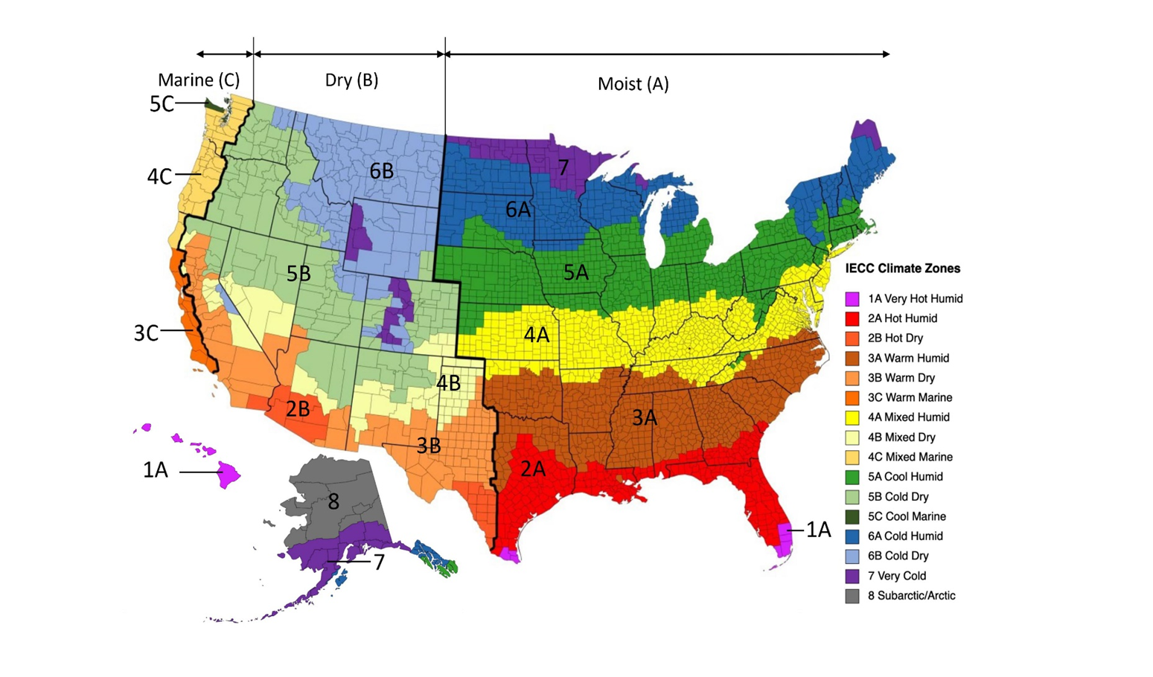
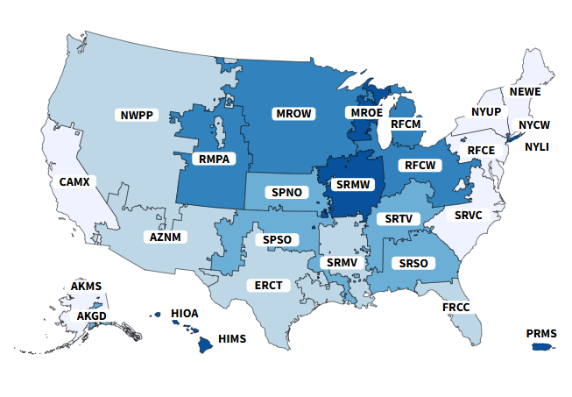
Hypothesis
When applying air-source heat pumps, fully electrifying heating by using electric resistance supplemental heat does not yield appreciable emissions reductions relative to using natural gas supplemental heat.
Building
Climate
Grid Emissions
Envelope
HVAC
Plumbing
Domestic Hot Water
Process
Mechanical
Electrical
Lighting
Plug Load
Process
Insulation
Roofing
Walls
Windows
Piping
Source: US Department of Energy
Source: US Department of Energy
Source: US EPA eGRID

Slide 7
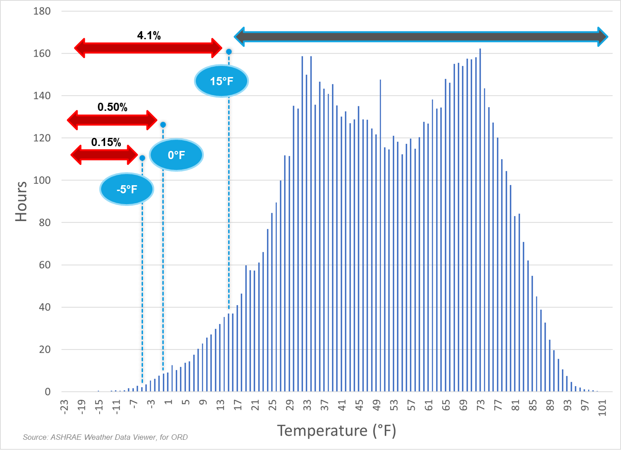
Assumptions
For a given location/climate and building, building characteristics, climate and grid emissions determine the intersection of heat pump operation and supplemental heat.
Air-source heat pump performance in terms of efficiency and capacity is a function of outdoor ambient temperature.

Slide 8
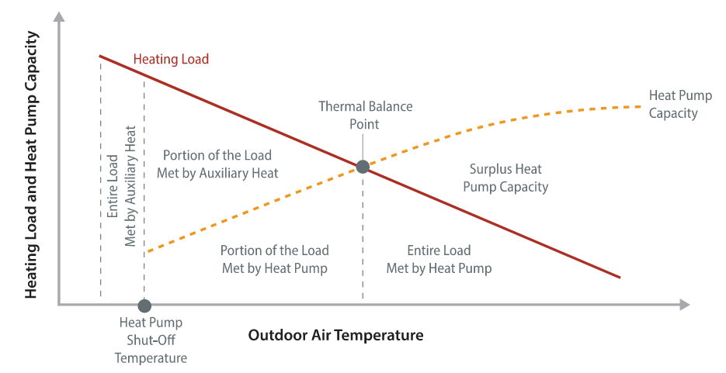


Problem Statement & Study Goals
Problem Statement:
Heat pump efficiency and capacity decreases at low ambient temperatures; thus, the need for supplemental heat.
When applying supplemental heat, how does the heat source impact emissions, now and in the future?
Study Goals:
Evaluate emissions impact of electric vs. gas supplemental heat for ASHPs in commercial buildings across the U.S.
Conduct a nationwide assessment across U.S climate zones and electric grid regions.
Incorporate historical grid emissions and forward-looking decarbonization projections (up to 2050).
Address gaps in prior research by isolating incremental emissions savings from electric vs. gas supplemental heating.
Provide insights for policy & system design decisions, ensuring effective decarbonization strategies.
Low ambient operation
Maximum heat pump heating capacity
Supplemental heat
Capacity $=f(OAT)$
Load $=f(OAT)$
Source: Decarbonizing Building Thermal Systems: A How-To Guide for Applying Heat Pumps and Beyond, NREL

Slide 9
Approach

Slide 10
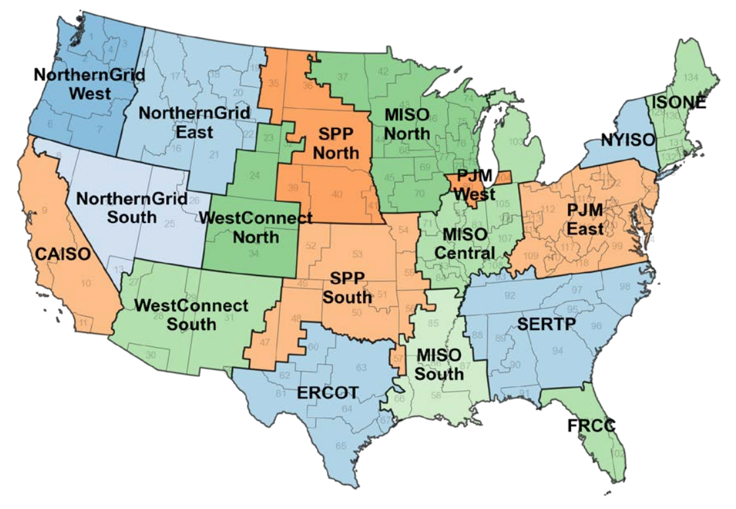
Electric GHG Emission Factors
Data Sources for Emissions Analysis
Historical Emissions Factors (2014-2022)
  Derived from EPA’s eGRID dataset, based on actual operational reports from U.S. power plants
  Includes fuel consumption, electricity generation, and direct emissions monitoring
  Provides annual emissions factors for each U.S. grid region (single value per year)
  Limitations: No hourly emissions variations, but highly accurate due to measured operational data
Projected Emissions Factors (2025-2050)
  Based on NREL’s Cambium dataset, which models future grid emissions
  Provides hourly emissions factors for simulated grid scenarios, enhancing accuracy
  Supports long-term energy decision-making with projections through 2050
  Mid-case scenario used: Assumes central estimates for technology costs, fuel prices, and demand growth
  Excludes nascent technologies and assumes 2023 electric sector policies
Data covers all 18 U.S. grid regions, aligned with electric grid system operators
GEA grid map illustrates the regions analyzed in the study
Gas emissions factor applied uniformly: 117 lb/MBtu (181 kg/MWh) across all years & regions
U.S electrical grid regions defined in NREL's Cambium dataset for simulated and projected electricity emission factors (through 2050) and historical emissions factors from EPA’s eGRID data (NREL 2023).
Source:. Cambium Data Sets: Forward-looking Projections. Golden, CO: National Renewable
Energy Laboratory, 2023.
Notes:
We relied on two data sets of electric emissions factors. The first is EPA eGrid data sets to model historical emissions from 2014-2022.
The second data source we used is NREL’s cambium data set, which models grid emissions on an hourly granularity. Among the various future grid scenarios, we leveraged the mid-case scenario which assessmes central estimates, excludes nascent technologies, and electric sector policies as they existed in 2023.
The electric grid regions that we modeled throughout the US, and that are aligned with these two datasets, is shown on the right.

Slide 11
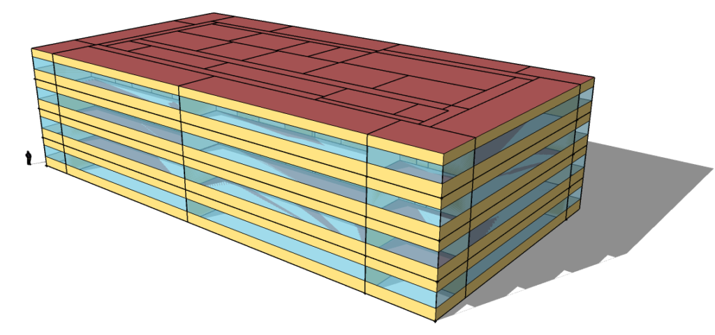
Building Energy Models
Simulation Approach
Developed hourly whole-building energy models using DOE’s EnergyPlus v23.1
Focuses on four common commercial building types:
  Office (125k ft² / 11.6k m², 4 stories)
  Multifamily (35k ft² / 3.3k m², 5 stories)
  Hospital (240k ft² / 22.2k m², 5 stories)
  School (210k ft² / 19.5k m², 3 stories)
Key Modeling Parameters
ASHRAE Standard 90.1 (2004) compliant models, reflecting HVAC replacement scenarios for existing buildings
DOE commercial building prototype models informed space type definitions
Simulations incorporate TMY3 hourly weather files for representative cities, covering all 18 U.S. electric grid regions
Modeled Representative Cities for Each Electric Grid Region Across the U.S.
Grid Region | Modeled State, City | Grid Region | Modeled State, City
NorthernGrid West | Washington, Seattle | SPP South | Kansas, Kansas City
CAISO | California, Los Angeles | ERCOT | Texas, Temple
NorthernGrid East | Montana, Helena | PJM West | Illinois, Chicago
NorthernGrid South | Nevada, Las Vegas | MISO Central | Indiana, Indianapolis
SPP North | South Dakota, Pierre | MISO South | Mississippi, Jackson
WestConnect North | Colorado, Denver | ISONE | Maine, Augusta
WestConnect South | New Mexico, Santa Fe | NYISO | New York, Queens
MISO North | Minnesota, International Falls | PJM East | Pennsylvania, Philadelphia
SERTP | North Carolina, Raleigh | FRCC | Florida, Tampa
Notes:
Do need to go through the entire list of grid regions and modeled cities, but let me point out a few
NorthernGrid West → Washington State
CAISO → CA
MISO North (Midcontinent Independent System Operator) → Minnesota
PJM West → Chicago, Illinois
PJM East → Pennsylvania
NYISO → New York
ISONE → ISO New England

Slide 12
Modeled Scenarios
Scenario 1: Gas-Fueled Heating Baseline
System type: Packaged single-zone rooftop air conditioner (PSZ-AC)
Cooling: Direct expansion (DX)
Heating: Gas combustion
Used as the baseline for emissions comparisons
Reflects System Type 3 in PRM ASHRAE 90.1
Scenario 2: Dual Fuel (ASHP + Gas Supplemental Heat)
System type: Packaged single-zone rooftop, air-to-air heat pump (PSZ-HP)
Cooling: DX
Heating: Electric heat pump with gas supplemental heating
Reflects System Type 4 in PRM ASHRAE 90.1
Scenario 3: All Electric (ASHP + Electric Supplemental Heat)
System type: Packaged single-zone rooftop, air-to-air heat pump (PSZ-HP)
Cooling: DX
Heating: Electric heat pump with electric resistance supplemental heating
Reflects System Type 4 in PRM ASHRAE 90.1
System Specifications & Modeling Parameter:
Heat pump sizing: Based on design cooling load for scenarios 2 & 3
DX cooling performance: Identical across all three scenarios. Variable speed supply fans & compressors modeled for all systems
Efficiency assumptions:
  Heat pump COP: 3.5 at 47°F (8.33°C), 2.335 at 17°F (-8.33°C)
  Gas combustion efficiency: 80%
  Electric supplemental heating efficiency: 100%
Heat pump compressor shutoff temperature: -10°F (-23.33°C)
Defrost cycles not considered in analysis
216 simulations (18 regions × 4 building types × 3 scenarios)
Notes:
Single zone VAV

Slide 13
Primary Results of Interest
Emission Savings Comparison
  ASHP with gas supplemental heat (dual fuel) vs. all-gas space heating:
  Additional savings from electrifying the supplemental heat:
Emissions Calculation Methodology
  Annual emissions = Σ hourly whole-building gas emissions + Σ hourly whole-building electricity emissions
Electricity Emissions Factors:
  Derived using EPA’s eGRID annual emission factors (pre-2025)
  NREL Cambium hourly emission factors for future years
  Multiplied by modeled hourly whole-building electricity consumption
Gas Emissions:
Based on EPA’s gas emission factor (constant value)
Multiplied by modeled annual whole-building gas consumption
$\% Emissions Savings_{Dual Fuel}=\frac{Annual Emissions_{All Gas }−Annual Emissions_{Dual Fuel}}{Annual Emissions_{All Gas }}$ x 100
$\% Incremental Emissions Savings_{All Electric}=\frac{Annual Emissions_{ Dual Fuel }−Annual Emissions_{All Electric}}{Annual Emissions_{All Gas }}$ × 100

Slide 14
Results

Slide 15
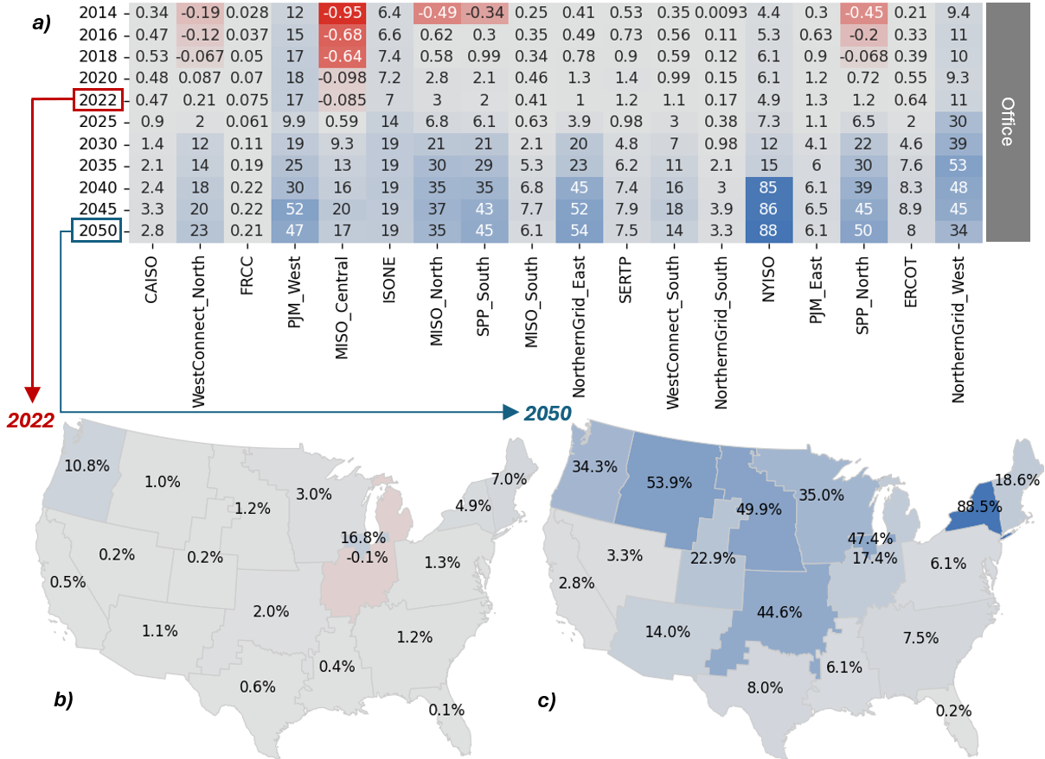
Emissions Impact of Replacing Gas-Fueled Space Heating with Dual Fuel ASHP
  Historical savings (2014-2022):
  Significant savings (≥10%) in PJM West, Northern Grid West, and ISONE.
Key Drivers of Regional Savings:
  PJM West: ~33% nuclear energy share.
  Northern Grid West: ~50% hydropower share.
  ISONE: ~40% energy from wind, solar, and hydro.
Future Projections (2025-2050)
Heat pumps expected to significantly increase emissions savings as grids shift to cleaner energy.
Most impacted regions:
  NYISO: Over 88% savings in 2050
  Northern Grid East, SPP North, PJM West, SPP South, MISO North, and Northern Grid West, (≥20% savings in 2050).
Least impacted regions: FRCC (low heating loads), followed by CAISO and Northern Grid South.
Influence of Policy & Grid Evolution
NYISO: New York’s zero-emissions electricity target (2040) and net-zero goal (2050).
MISO North, SPP North, SPP South: Among top impacted regions from 2025 onward due to significant wind power contributions (~40% of total energy mix in 2023, projected to increase through 2050).
Annual whole-building emissions savings (%)
Year
Notes:
Highlight key points – too much text.
Talking Points:
1- Dual fuel has a positive GHG emissions savings impact today and throughout the nation.
2- The most impacted regions today are PJM west (Chicago, IL), Northern Grid West (Washington), ISONE (New England) due to combination of high RE share and high heating loads.
Note: Even though CA & Washington both have about 50% RE shares, the lower heating load in CA means less whole-building savings compared with Washington state.. There are also examples of notable differences within the similar climates due to RE share differences: PJM West (Chicago Illinois) and MISO North (Wisconsin) and MISO Central (Indiana). Also, NYISO and PJM East (Pennsylvania)
3- Significant Emissions savings significantly increase with time throughout the nation
generally, northern US sees largest impact due to higher heating loads. ISONE is least impacted northern state not as many policies towards cleaner grid. But its not just northern states. For example, SPP South (Kansas) anticipated to have much more savings than PJM East (Pennsylvania) as an example.
NYISO is the most impacted region through 2050, due to net zero goals.
least impact is FRCC and CAISO

Slide 16
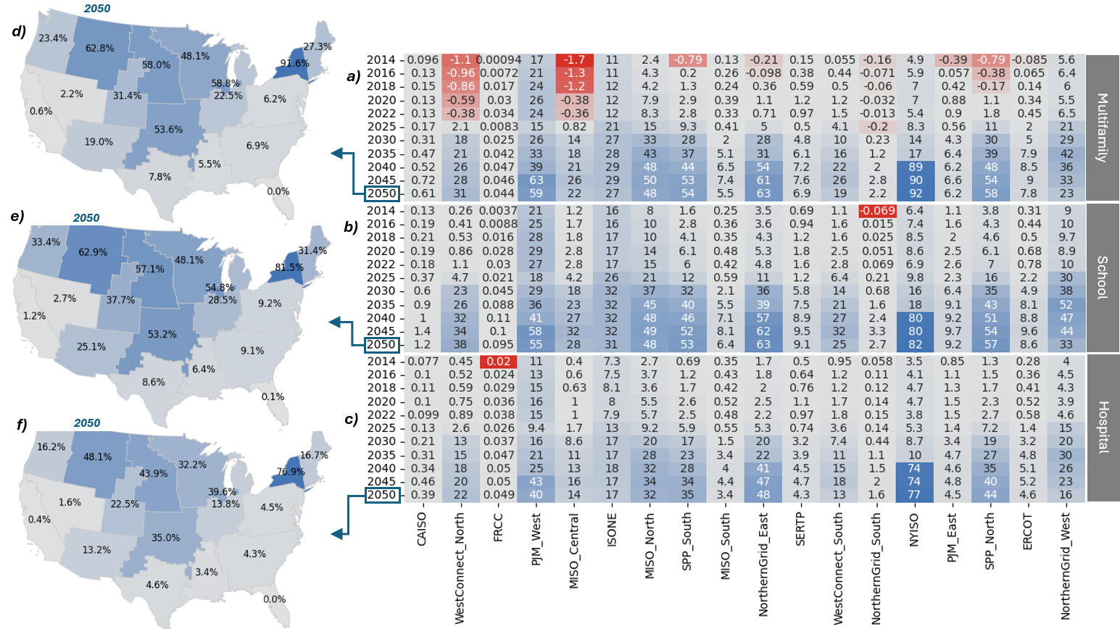
Emissions Impact of Replacing Gas-Fueled Space Heating with Dual Fuel ASHP
Annual whole-building emissions savings (%)
Consistent Trends Across Building Types
Impact varies by building due to differences in:
  Magnitude of heating loads
  Heating load profiles
  Ventilation rates
NYISO: Most Impacted Region through 2050
  Emissions savings reach 77%-92% with dual-fuel ASHPs

Slide 17
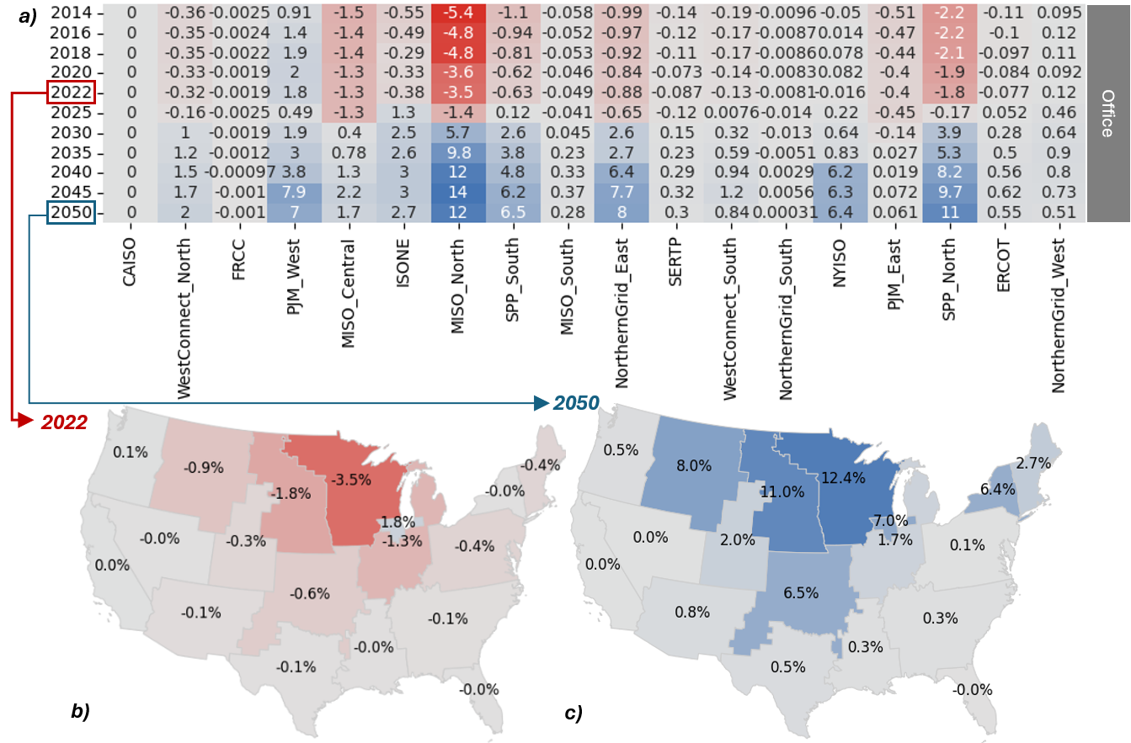
Emissions Impact of Replacing Dual Fuel ASHP with All Electric ASHP
Annual whole-building emissions savings (%)
Annual emissions savings from transitioning to all-electric heating
Minimal impact in most U.S. grid regions
In 12 of 18 regions, added emissions savings from switching to electric supplemental heating is less than 2.7% through 2050
Most impacted regions
MISO North, SPP North, Northern Grid East, PJM West show highest emissions savings
SPP South and NYISO follow
MISO North & SPP North exceed 10% additional emissions savings by 2050
Year
Notes:
2022, Electric supplemental heat has negative savings nationwide (almost). Positive in northern grid west (Washington), and PJM West) due to hydro and nuclear
Why? Savings from gas to electric supplemental heat are not enough to compensate for the marginal electric emissions benefits given todays RE mix
Turning point? Generally, sometime between 2025 and 2030
Most of the US does not see a significant increase in savings through 2050. Ex: look at all corners of the US. Very small savings, if any.
NYSO is not the largest beneficiary, MISO North and SPP North are.
Kansas benefits much more than Pennsylvania and Maine despite not being as cold.
Reminder, this is through 2050! The savings are much smaller over the next 15 years, as we will later see
The extraordinary cost of electrifying supplemental heat may not be worth the investment. Upper Midwest potentially benefits most

Slide 18
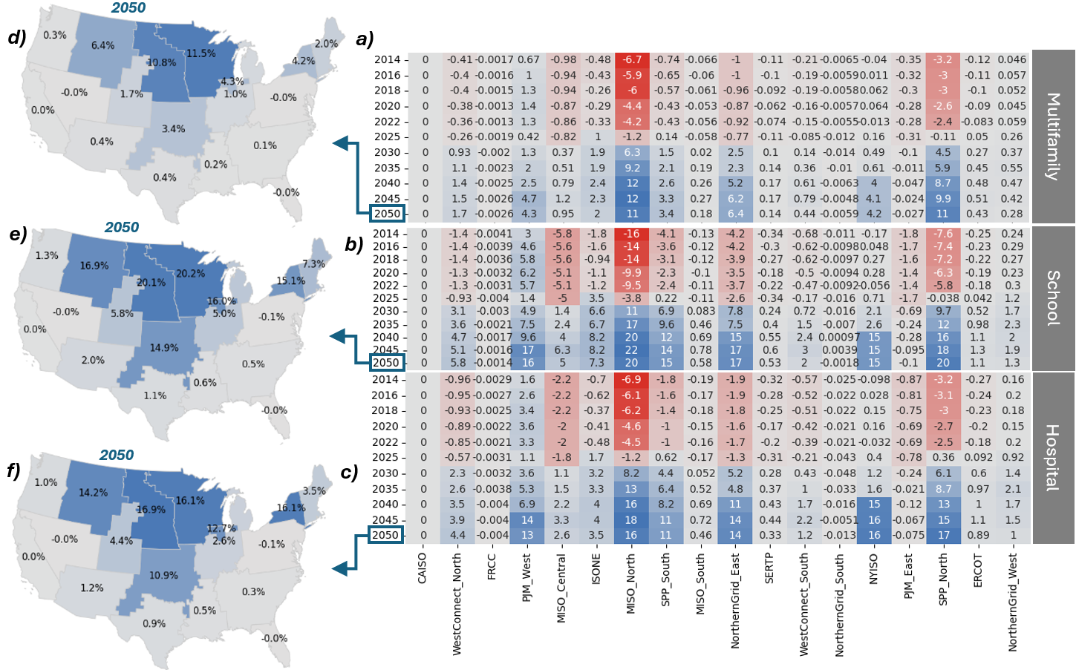
Emissions Impact of Replacing Dual Fuel ASHP with All Electric ASHP
Annual whole-building emissions savings (%)
Electrification trends across building types
Similar impact observed across multiple building categories
MISO North & SPP North remain most positively impacted by full transition to electrification
Many U.S. electrical grid regions show marginal (<1%) difference in emissions savings through 2050
Notes:
Minnesota Electricity Generated by Renewables Held Flat in 2024
Zero by 2040 / Minnesota Department of Commerce - Energy
MN current gets about ~30% from RE, and 20% nuclear, it needs to reach 80% carbon free by 2030, 90% by 2035, and 100% by 2040. very sharp increases

Slide 19
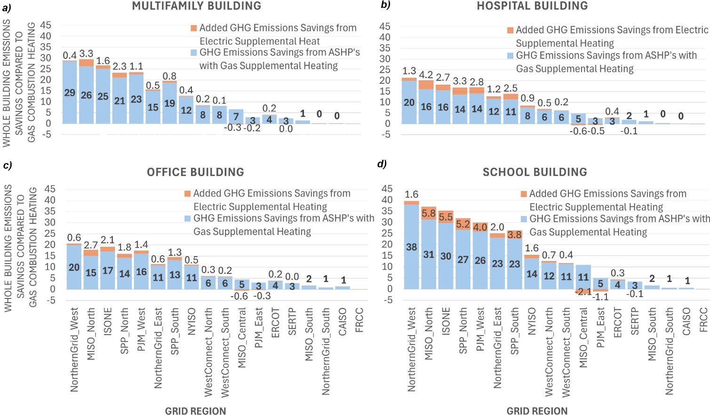
15-year Assessment (2025-2040)
Regional differences in emissions savings
  NYISO shows the largest cumulative impact over 25 yr but not over 15yr
  MISO North sees greatest emissions savings from electrifying supplemental heating
Schools see the most benefit
At least half of U.S. grid regions show <1% in added savings with electric compared to gas supplemental heating
Notes:
Nation wide average savings
HVAC end use savings
Be prepared for defrost cycle questions
a15 year analysis provides a realistic design scenario for decisions made today regarding equipment selection
Results look very different, with electric supplemental heat accounting for even less savings
Dual fuel is beneficial everywhere. In almost all regions, electric supplemental heat provides marginal benefits. In some states, a negative savings (MISO central – Indiana , PJM East - Pennsylvania)
Note: NYISO is no longer the biggest beneficiary of heat pumps and electric supplemental heat ahead of the states 2040 and 2050 goals.
Washington state has most savings from dual fuel, with negligible savings due to electrifying supplemental heat.
From a whole building savings standpoints, school's standout given larger percentage of ventilation loads and associated outdoor air conditioning.

Slide 20
Study Limitations, Conclusions, and Future Work
Study Limitations & Future Research Directions
Data limitations: Cambium’s hourly emissions data and EPA’s historical annual emissions factors
Technology scope: Focuses on heat pumps with shut-off temperatures of -10°F (-23.33°C), does not account for defrost cycles
Future grid assumptions: Based on Cambium’s mid-case future grid scenario
Potential areas for further research:
  Cost analysis between supplemental heat options
  Expanded grid scenario evaluations using Cambium dataset
  Inclusion of more building types and vintages
  Defrost cycle considerations and impact
Conclusions & Key Findings
ASHPs with gas supplemental heating can significantly reduce whole-building emissions as U.S. grids transition to cleaner energy
Electrifying supplemental heating offers minimal additional savings in most grid regions
  Regions most impacted by electric supplemental heating through 2050: MISO North and SPP North (at least 10% additional savings)
All electric solutions do not always yield greater emissions savings → Critical importance of equipment selection decisions today for long-term emissions impacts
Notes:
Mention the final takeaway – electrification should not be the default for decarb
Gas offers redundancy, and mitigates challenges in low ambient temp.
Swap limitation and conclusions
Dual fuel heat pumps have a positive savings today throughout the nation, and significantly increases with time
Electric supplemental heating has a negative impact today throughout the nation, with positive impacts only in the upper Midwest region. Negligible impact in most of the US.
Over 15 year period, electric supplemental heat is even less favorable. With most states have marginal benefits, and some negative (Pennsylvania, and Indiana/south illinios)
Kansas benefits much more than Pennsylvania or Maine, emphasizing the need for a regional analysis versus a blanket assumption around electrification.

Slide 21
Bibliography
ASHRAE. 2004. ANSI/ASHRAE/IESNA Standard 90.1-2004: Energy Standard for Buildings Except Low-Rise Residential Buildings. Atlanta, GA: ASHRAE, 2004
ASHRAE. 2022. ANSI/ASHRAE/IESNA Standard 90.1-2022: Energy Standard for Buildings Except Low-Rise Residential Buildings. Atlanta, GA: ASHRAE, 2022
Bayer, Daniel R. and Marco Pruckner. 2024 "Data-driven Heat Pump Retrofit Analysis in Residential Buildings: Carbon Emission Reductions and Economic Viability." Applied Energy 373: 123823. https://doi.org/10.1016/j.apenergy.2024.123823.
CaraDonna, Chris, Andrew Parker, Ryan Meyer, "Impact Analysis of Transitioning to Heat Pump Rooftop Units for the U.S. Commercial Building Stock." National Renewable Energy Laboratory (NREL), May 2023. NREL/TP-5500-85390. https://www.nrel.gov/docs/fy23osti/85390.pdf.
Deetjen, Thomas, Liam Walsh and Parth Vaishnav. "US Residential Heat Pumps: The Private Economic Potential and Its Emissions, Health, and Grid Impacts." Environmental Research Letters 16, no. 7 (July 2021): 074008. https://iopscience.iop.org/article/10.1088/1748-9326/ac10dc/meta.
Dichter, Nelson, Aref Aboud. “Analysis of Greenhouse Gas Emissions from Residential Heating Technologies in the USA.” Western Cooling Efficiency Center (WCEC), University of California, Davis, 2020. https://wcec.ucdavis.edu/wp-content/uploads/GHG-Emissions-from-Residential-Heating-Technologies-091520.pdf
DOE. 2023. Energy Efficiency and Renewable Energy. Washington, D.C.: Department of Energy. 2023
DOE. 2024. Heat Pump Systems. Energy Saver, Washington, D.C.: U.S. Department of Energy. 2024 https://www.energy.gov/energysaver/heat-pump-systems.
DOE. 2025. EnergyPlus Documentation. Washington, D.C.: U.S. Department of Energy, 2025.
DOE 2025b Prototype Building Models. Office of Energy Efficiency & Renewable Energy. U.S. Department of Energy. Accessed March 25, 2025. https://www.energycodes.gov/prototype-building-models.
EIA. 2022. Annual Energy Outlook 2022. Washington, D.C.: Energy Information Administration.
EPA. 2023. eGRID Summary Tables. Washington, D.C.: Environmental Protection Agency.
EPA. 2025a. Emissions & Generation Resource Integrated Database (eGRID). Washington, D.C.: EPA,. Environmental Protection Agency eGRID (database version).
EPA. 2025b. Inventory of U.S. Greenhouse Gas Emissions and Sinks: 1990-2022. Washington, D.C.: EPA, 2025. Tables A-20, A-25, A-32, and A-226.
Flores, Robert, Sammy Houssainy, Weixi Wang, Khanh Nguyen Cu, Xiao Nie, Noah Woolfolk, Ben Polly, Ramin Faramarzi, Jim Maclay, Jaeho Lee, and Jack Brouwer. 2024 "Addressing Building Related Energy Burden, Air Pollution, and Carbon Emissions of a Low-Income Community in Southern California." Advances in Applied Energy 14: 100169. https://doi.org/10.1016/j.adapen.2024.100169.
Gagnon, Pieter, Pedro Andres Sanchez Perez, Kodi Obika, Marty Schwarz, James Morris, Jianli Gu, and Jordan Eisenman. 2024 Cambium 2023 Scenario Descriptions and Documentation. Golden, CO: NREL. NREL/TP-6A40-88507.
IEA. 2021. Buildings: A Source of Significant Emissions. Paris: International Energy Agency.
Landman, Jared, Sean Smillie, Dan Alberga, Molly Bertolacini, Michael Sontag, Michaela Levine, Dan Aas, Snuller Price. “Debunking the Myths of Hybrid Heat Pumps”, Proceedings of the 2024 Summer Study on Energy Efficiency in Buildings, American Council for an Energy-Efficient Economy (ACEEE), 2024. https://www.aceee.org/sites/default/files/proceedings/ssb24/assets/attachments/20240722163133624_dbffa54e-2033-4535-bbcc-ffa2bbbaa7cb.pdf
NREL. 2023. Cambium Data Sets: Forward-looking Projections. Golden, CO: National Renewable Energy Laboratory.
Nienhuis, Piet. “Hybrid Heat Pumps Minimize Emissions and Minimize Overall Costs.” 12th IEA Heat Pump Conference, International Energy Agency (IEA), 2017. https://heatpumpingtechnologies.org/archive/hpc2017/wp-content/uploads/2017/08/O.2.2.1-Hybrid-Heat-Pumps-minimize-emissions-and-minimize-overall-costs.pdf
NYSERDA. 2025. Climate Leadership and Community Protection Act (CLCPA). Albany, NY: NYSERDA, 2025.
Pistochini, Theresa, Mitchal Dichter, Subhrajit Chakraborty, Nelson Dichter, Aref Aboud. 2022 "Greenhouse Gas Emission Forecasts for Electrification of Space Heating in Residential Homes in the US." Energy Policy 163: 112813. https://doi.org/10.1016/j.enpol.2022.112813.
RMI. "Now Is the Time to Go All In on Heat Pumps." RMI, July 6, 2023. https://rmi.org/now-is-the-time-to-go-all-in-on-heat-pumps/.
Shekhadar, Saurabh, Nicholas Fette, Cristalle Mauleon,. “Energy Modeling and Analysis of Dual Fuel Heating Systems in Single Family Homes.” Proceedings of the 2024 Summer Study on Energy Efficiency in Buildings, American Council for an Energy-Efficient Economy (ACEEE), 2024. https://www.aceee.org/sites/default/files/proceedings/ssb24/pdfs/Energy%20Modeling%20and%20Analysis%20of%20Dual%20Fuel%20Heating%20Systems%20in%20Single%20Family%20Homes.pdf
Wilson, Eric J.H. et al. 2024. "Heat Pumps for All? Distributions of the Costs and Benefits of Residential Air-Source Heat Pumps in the United States." Joule 8, no. 4: 1000-1035.

Slide 22
Questions?
Sammy Houssainy, Daikin Applied Americas
Sammy.Houssainy@DaikinApplied.com
Jeff Seewald, Daikin Applied Americas
Jeffrey.Seewald@DaikinApplied.com
Paul Ehrlich, Building Intelligence Group
Paul@BuildingIntelligenceGroup.com

