Slide 1
Decarbonization & Electrification for Applied HVAC Systems
Review & Update
Presented by: Jeff Seewald, HVAC Systems Business Development Manager
April 16, 2025
DISCLAIMER: This presentation is intended only for educational purposes and does not replace independent professional judgment and/or legal advice.
This presentation is copyrighted and cannot be used without the express permission of Daikin Applied Americas Inc.
Notes:
Revision A 4/16/2025

Slide 2




Introductions
Jeffrey Seewald, PE, CEM
HVAC Systems Business Development Manager
jeffrey.seewald@daikinapplied.com
Joined Daikin in November 2023
30 years of experience
    HVAC equipment and systems
    Building automation and controls
    Energy efficiency and infrastructure renewal
Focus areas at Daikin include:
    Decarbonization
    Refrigerants
    Electrification and heat pumps
    Energy efficiency
    Indoor air quality

Slide 3
Disclaimer
This content subject to change without notice and is intended only for educational purposes and does not replace independent professional judgment and/or legal advice. The ultimate responsibility is on the engineer of record to ensure the design complies with all applicable codes and Daikin Applied will not accept responsibility or liability for actions that result from the information shared in this presentation. This content is copyrighted and cannot be used without the express permission of Daikin Applied Americas Inc.
Always consult your state & local codes, which may take precedence over standards which vary in adoption, complete or partial, by state. Also note that a state may adopt a different year of the standard than the latest version.
The local Authority Having Jurisdiction (AHJ) has the final authority in interpreting code requirements.

Slide 4
Decarbonization Webinars
Upcoming Webinars
Part | Date | Title | Description
1 | April 16 | Decarbonization of HVAC Systems - Part 1: Review and Industry Update | In this session, we’ll explore the decarbonization of HVAC systems with a review of the latest industry advancements and essential concepts, followed by discussion of heat pump system application and design considerations, and groundbreaking projects that are shaping the future of electrified and sustainable HVAC systems.
2 | May 14 | Decarbonization of HVAC Systems - Part 2: Industry Guidance on Thermal Systems | A guided tour of Decarbonizing Building Thermal Systems: A How-to Guide for Heat Pump Systems and Beyond. This guide, produced by NREL in conjunction with the US Department of Energy and ASHRAE offers essential guidance as we prepare to decarbonize and electrify buildings.
3 | June 11 | Decarbonization of HVAC Systems - Part 3: Rooftop Unit Heat Pump Systems | “All Things RTU Heat Pump”: The third installment of our three-part webcast series will zoom in on rooftop unit heat pump systems and discuss application and design considerations of this ubiquitous equipment, now available in a versatile and high-performance heat pump form.

Slide 5
Review
Refrigerants
Efficiency
Optimization
Heat pumps
Electrification
Low GWP

Slide 6
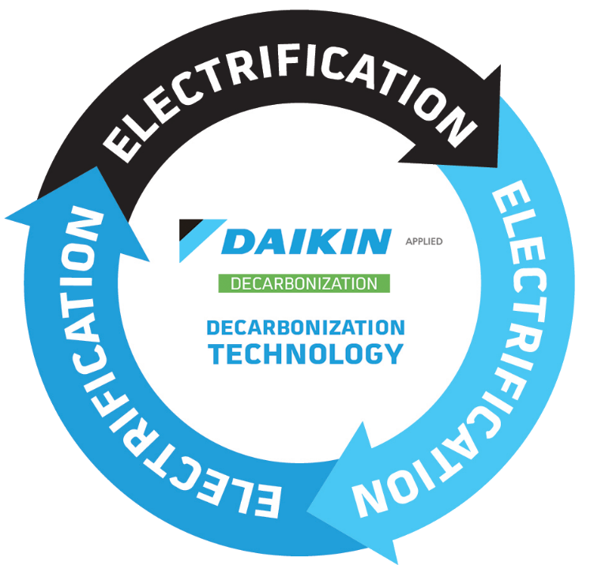
Review
Refrigerants
Efficiency
Optimization
Heat pumps
Electrification
Low GWP

Slide 7
Agenda
Industry & Market Update
Heat Pumps
Systems & Solutions
Government/Policy
Case studies
Climate
System scenarios
Industry & NGOs
Inspiring projects
Utilities
Building
Emissions
Utilities
What is happening with policy, industry and NGOs?
How are utilities supporting decarbonization of buildings?
How are building systems evolving?
What are key aspects of heat pump system application and design?
How do climate, emissions and utilities impact heat pump system design?
Understand selected heat pump system scenarios
Review heat pump equipment
Learn about real projects

Slide 8
Registration Questions
What do you think are the greatest challenges of decarbonization and electrification of HVAC systems in buildings?
What questions do you have about decarbonization and electrification of HVAC systems in buildings?
Policy
Power grid limitations
Site electrical infrastructure/upgrades
Cold climates / low ambient
Controls / sequence of operations
Peak heating load / supplemental heat
Heating capacity and temperature
Retrofits
Footprint / weight
Ventilation
Cost
Lack of design expertise
Why decarbonization?
Evaluation of system options
How to upgrade electrical infrastructure
Proper design of heat pump plants
Thermal storage
Operation and maintenance impact
Variation in policy by state or region
Equipment
System / plant design
©2025 Daikin Applied

Slide 9
Audience Question
Question 1
How important is decarbonization in your market?
  Scale 1-5
  1 = not important
  5 = very important
©2025 Daikin Applied

Slide 10
Industry & Market Update
Industry & Market Update
Heat Pumps
Systems & Solutions
Notes:
Transitional slide to shift to how regulations are driving behavior

Slide 11
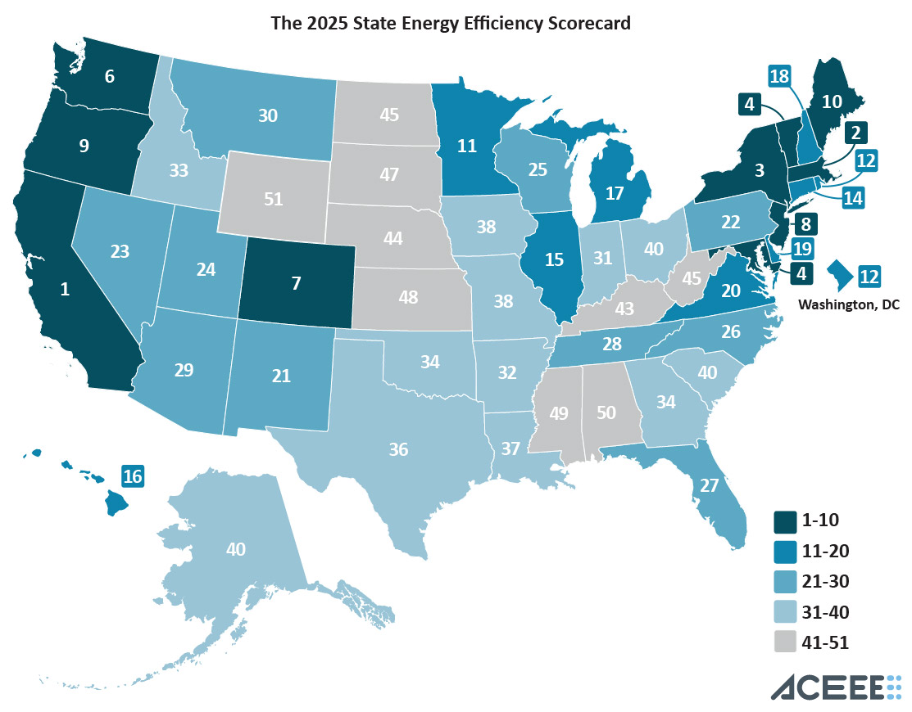
Government & Policy
State and Local Government: Moving Forward
Federal government policy evolving, but uncertain
ACEEE’s State Energy Efficiency Scorecard ranks the 50 states and DC on their policies and programs to advance energy efficiency
Top ten:
  California
  Massachusetts
  New York
  Maryland
  Vermont
  Washington
  Colorado
  New Jersey
  Oregon
  Maine
Source: ACEEE 2025 State Energy Score Card
https://www.aceee.org/state-policy/scorecard

Slide 12
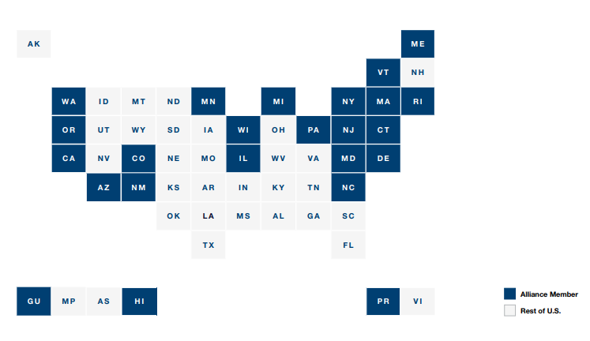
Government & Policy
State and Local Government: Moving Forward
The U.S. Climate Alliance is a bipartisan coalition of 24 governors securing America’s net-zero future by advancing state-led, high-impact climate action.
These states together have 54% of the nation’s population and 57% of the nations GDP
The Alliance pledged to work to collectively reduce net greenhouse gas emissions by at least 61-66 percent below 2005 levels by 2035
Source: United States Climate Alliance
https://usclimatealliance.org/

Slide 13








Industry & NGOs
Selected Organizations Driving Transformation

Slide 14
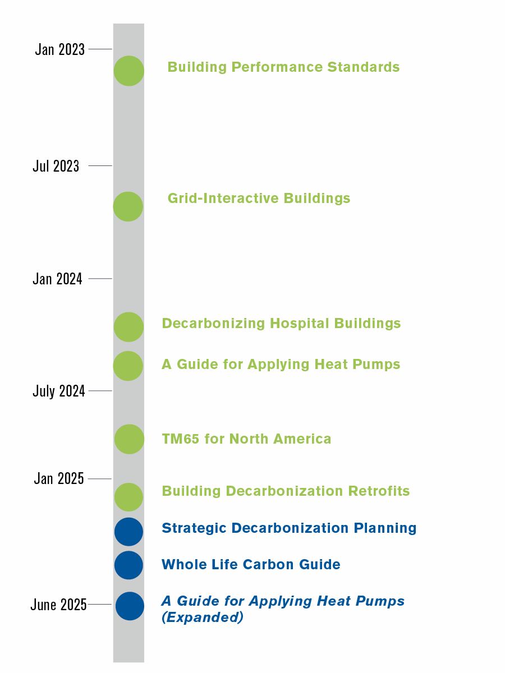
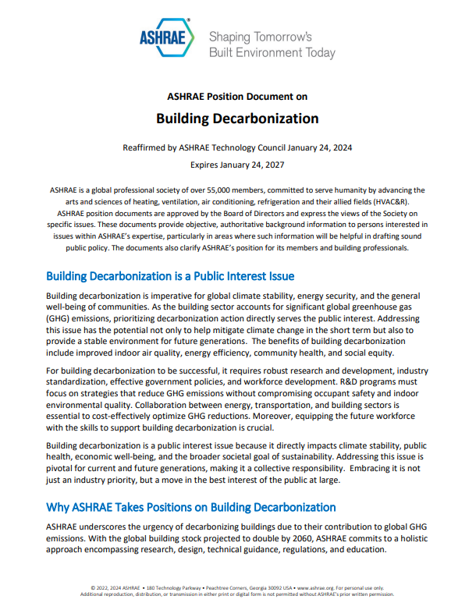
ASHRAE
ASHRAE and Building Decarbonization
Standards and Guidelines
  ASHRAE Standard 90.1
  ASHRAE Guideline 36
Center of Excellence for Building Decarbonization
Guides:
  Decarbonizing Building Thermal Systems: A Guide for Applying Heat Pumps and Beyond
  Grid-Interactive Buildings for Decarbonization
  Building Performance Standards: A Technical Resource Guide
  Decarbonizing Hospital Buildings
  Building Decarbonization Retrofits for Commercial and Multifamily Buildings
ASHRAE Decarbonization Conference
  October 22-24, in Chicago, Illinois

Slide 15


Utilities
Utilities and Building Decarbonization
2000
City of Seattle sets net-zero GHG target
2005
Seattle City Light Achieves Net-Zero GHG emissions target
2018
Xcel Energy adopts 100% carbon-free target by 2050
Established targets vary by utility
  GHG reduction
  Renewable energy
As of 2024:
  83% of US customer accounts served by utility with a carbon reduction target
  80% of US customer accounts served by utility with a 100% carbon reduction target
Rebates/incentives vary by utility
  Research rebates/incentives and consult with utilities early in a project

Slide 16
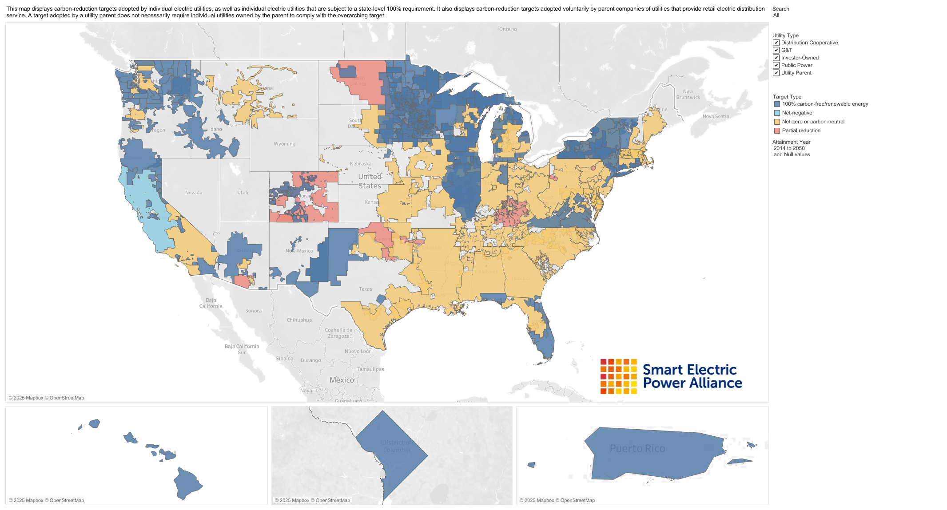
Utilities
100% carbon-free/renewable energy
Net-negative
Net-zero or carbon-neutral
Partial reduction

Slide 17
Audience Question
Question 2
Have you been involved with a decarbonization / electrification project?
  Yes, or
  No

Slide 18
Heat Pumps
Industry & Market Update
Heat Pumps
Systems & Solutions
©2025 Daikin Applied
Notes:
Transitional slide to shift to how regulations are driving behavior

Slide 19
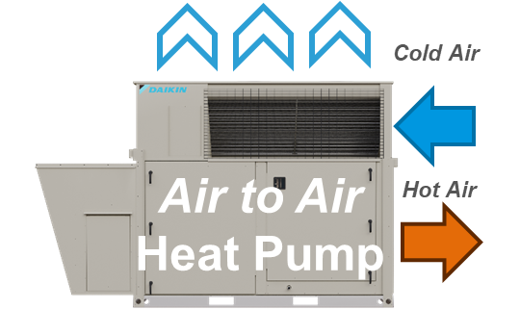
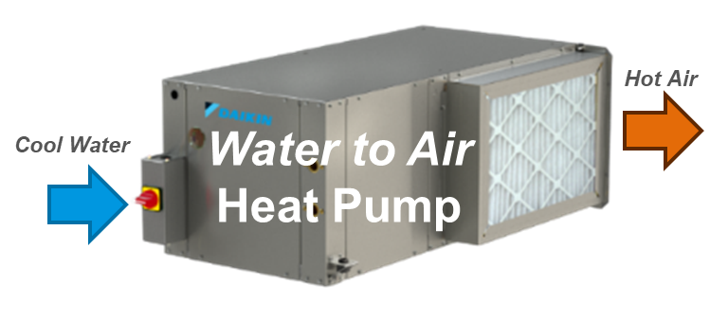
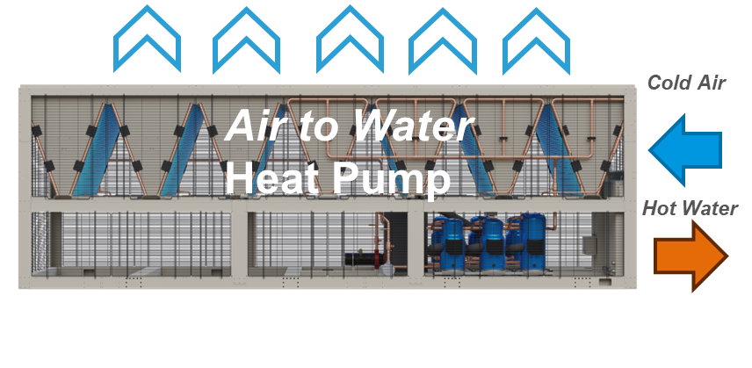
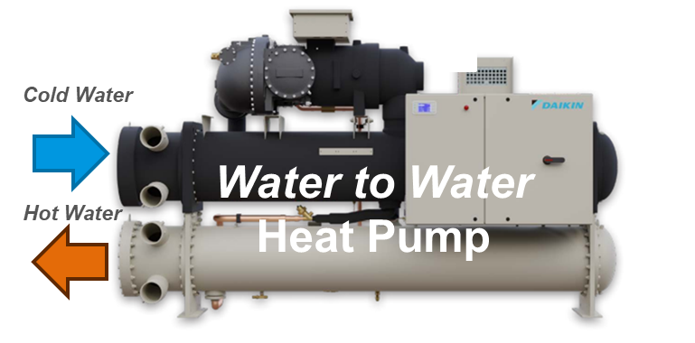
Heat Pumps
Air-to-Air
RTU
Water-to-Air
WSHP
Packaged
Air-to-Water
Water-to-Water
Heat Recovery
Chiller-Heater
Types
Air-to-Air
Water-to-Air
Air-to-Water
Water-to-Water

Slide 20
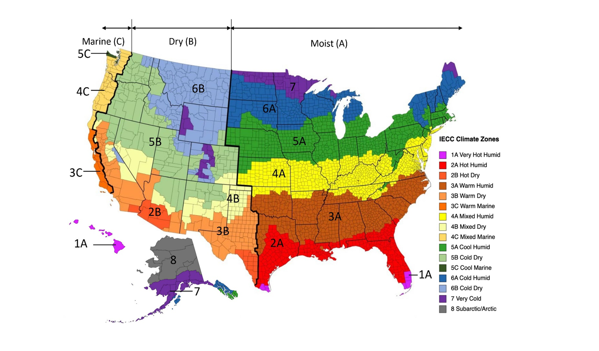
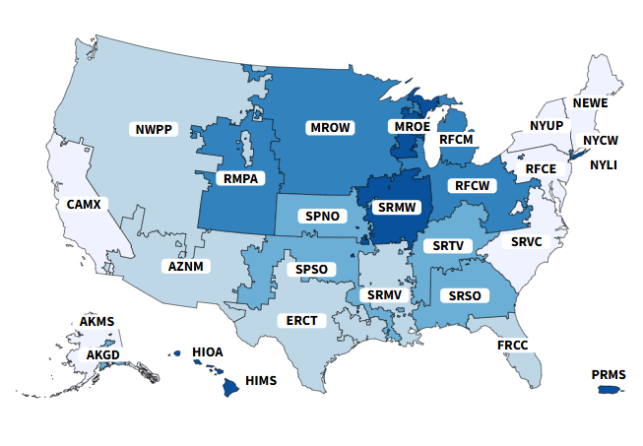
Heat Pump Systems
Application & Design
Climate Zones
Grid Regions
Building
  Envelope
  Infrastructure
  Temperatures
Climate
Emissions
  Targets
  Rates
Utilities
  Power
  Incentives
  Rates
Source: US Department of Energy
Source: US EPA eGRID

Slide 21
Audience Question
Question 3
What aspects of heat pump system application and design most concern you?
  Performance (for example, low ambient)
  Electrical infrastructure
  Controls
  Cost
  Other
If you select Other, please comment in the chat
Please put any additional comments in the chat

Slide 22
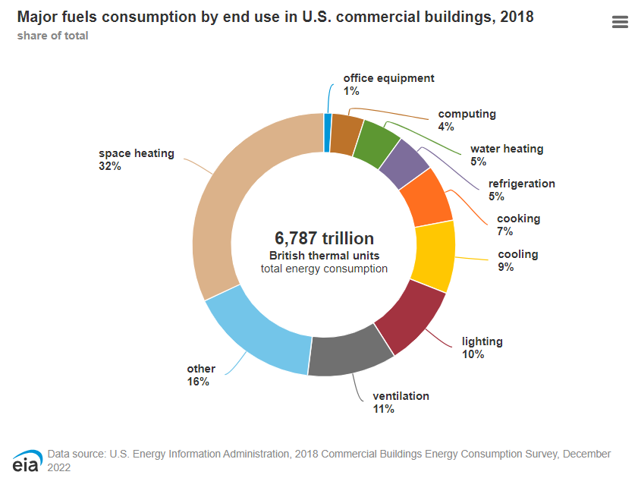
Heat Pump Systems
Building
Envelope
Load
  Cooling
  Heating
  Hot water
  Ventilation
Recovery
System temperatures
  Chilled water
  Hot water
Distribution
Supplemental heat
Energy storage

Slide 23
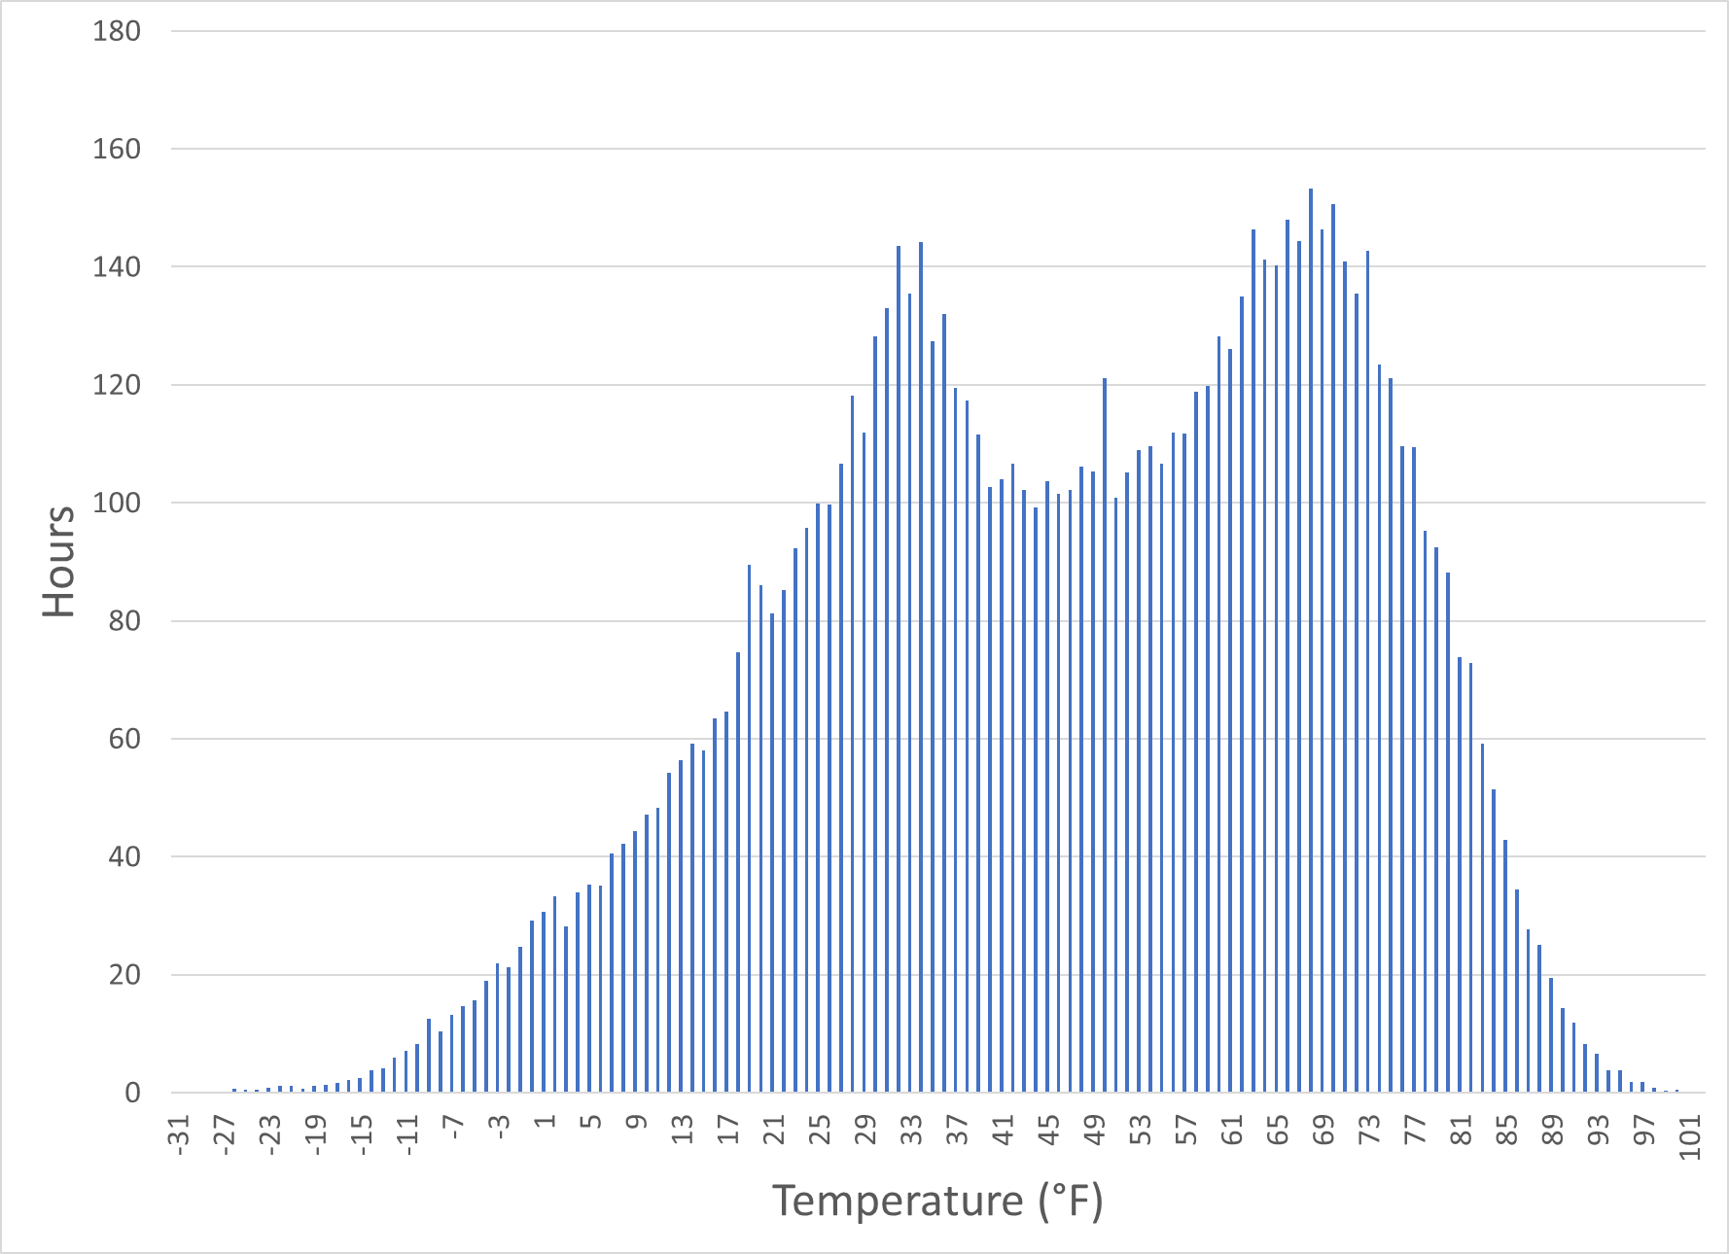
Climate and Heat Pump Performance
Minneapolis-St. Paul, MN
1.26%
2.58%
9.96%
Source: ASHRAE Weather Data Viewer, for MSP

Slide 24
Climate and Heat Pump Performance
1.26%
2.58%
9.96%
Capacity
Efficiency
Supply Temperature
Ambient Temperature
Source: ASHRAE Weather Data Viewer, for MSP

Slide 25
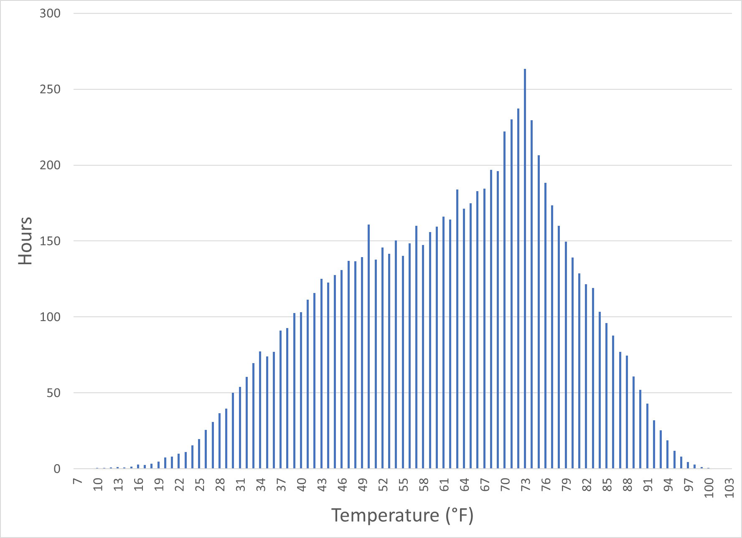
Climate and Heat Pump Performance
0.305%
Charlotte, NC
0.067%
20°F
15°F
Source: ASHRAE Weather Data Viewer, for CLT

Slide 26
Selecting & Sizing Heat Pumps
Heat Load
Heat Pump
+
Supplemental
Heat Pump
Capacity
-10°F
0F
15°F
30°F
45°F
Outdoor Air Temperature

Slide 27



Emissions
Notes:
This is not an Ishihara color perception test

Slide 28
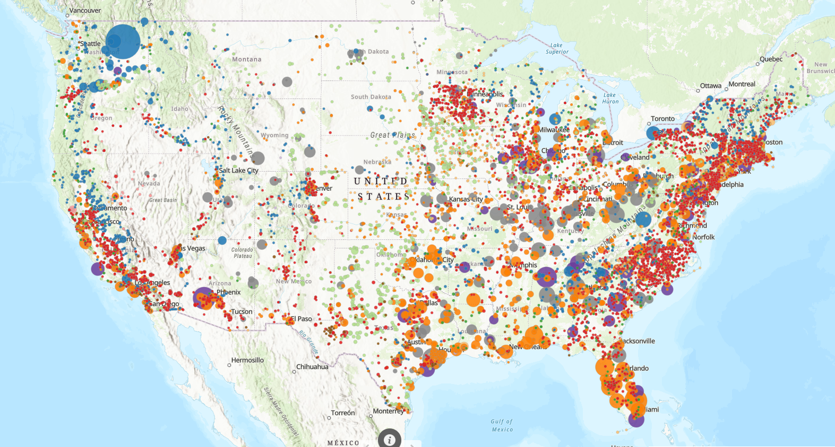
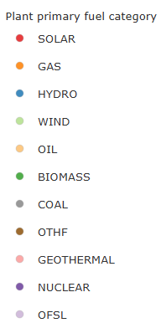
Emissions
Grid emissions vary considerably based on location
MN: 920
WI: 1402
NY: 975
OR: 632
CA: 437
TX: 738
NJ: 595
NC: 590
Source: US EPA eGRID
Notes:
This is not an Ishihara color perception test

Slide 29
Heat Pump Heating Emissions – Minnesota
Assumptions
Natural Gas Efficiency: | 85%
Electric Resistance Efficiency: | 99%
Grid Emissions Factor: (lb/MWh) | 752
Natural Gas Emissions (lbs/therm) | 12.1
Elect. Heat
Nat. Gas
Emissions Changeover
Heat Pump
Increasing Efficiency
Temperature
Emissions changeover varies with grid emissions factors, available from US EPA eGRID
©2025 Daikin Applied

Slide 30
Heat Pump Heating Emissions – Minnesota
Assumptions
Natural Gas Efficiency: | 85%
Electric Resistance Efficiency: | 99%
Electricity Cost: ($/kWh) | $0.12
Natural Gas Cost: ($/mcf) | $8.61
Elect. Heat
Cost Changeover
Nat. Gas
Heat Pump
Increasing Efficiency
Temperature
Cost changeover point varies with utility rates, available from US EIA and utilities
©2025 Daikin Applied

Slide 31
Heat Pump Heating Emissions – North Carolina
Assumptions
Natural Gas Efficiency: | 85%
Electric Resistance Efficiency: | 99%
Grid Emissions Factor: (lb/MWh) | 626
Natural Gas Emissions (lbs/therm) | 12.1
Elect. Heat
Nat. Gas
Emissions Changeover
Heat Pump
Increasing Efficiency
Temperature
Emissions changeover varies with grid emissions factors, available from US EPA eGRID
©2025 Daikin Applied

Slide 32
Heat Pump Heating Emissions – North Carolina
Assumptions
Natural Gas Efficiency: | 85%
Electric Resistance Efficiency: | 99%
Electricity Cost: ($/kWh) | $0.11
Natural Gas Cost: ($/mcf) | $10.12
Elect. Heat
Cost Changeover
Nat. Gas
Heat Pump
Increasing Efficiency
Temperature
Cost changeover point varies with utility rates, available from US EIA and utilities
©2025 Daikin Applied

Slide 33
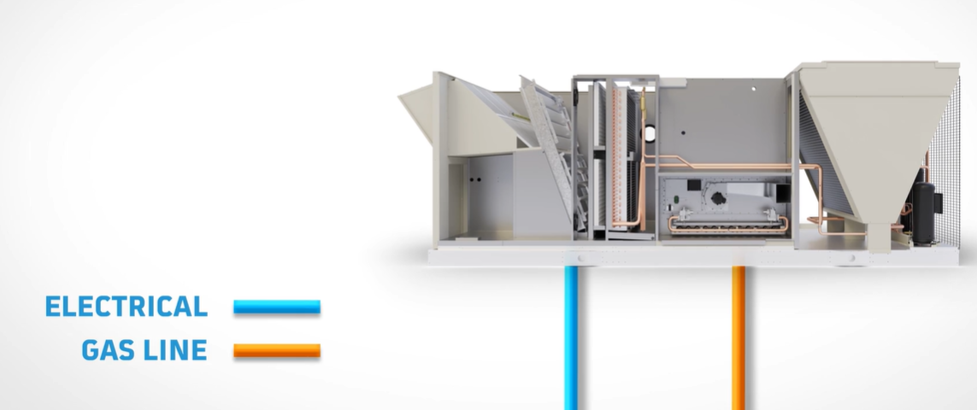
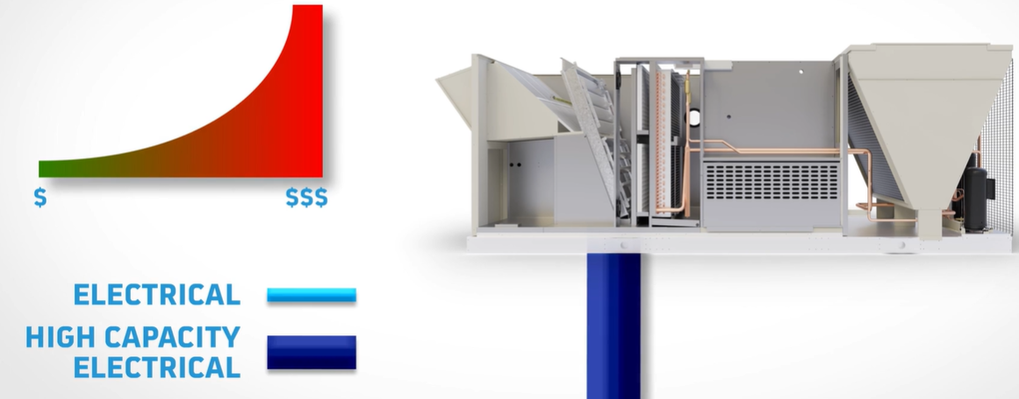
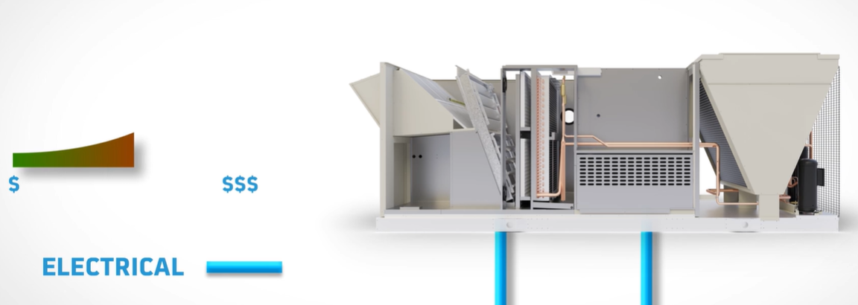
Heat Pumps and Electrical Distribution
Gas Heat Unit Being Replaced
Electrical for cooling
Gas for heating
Traditional Heat Pump w/ Electric Heat
Electrical for cooling & heating
Large wire/breaker sizes required
High electrical install cost
Rebel Heat Pump w/ Electric Heat & Dedicate EH Power
Existing electrical for cooling
New, separate, smaller electrical for heating
Simplified installation!
Lower electrical installed cost!

Slide 34
Retrofitting Package Rooftop HPs
Existing Unit
Rooftop w/ Gas Heat
 | Existing Unit
MCA | 130A – 1/0 AWG
MOP | 150
New ASHP Rooftop Unit
 | Scenario 1: Std Heat Pump | Scenario 2: Inverter Heat Pump | Scenario 3: Inverter HP Dual-point Electrical
MCA | 280 amps – 300 MCM | 233 amps – 4/0 AWG | C1: 130A 1/0 AWG C2: 100A 3 AWG
MOP | 300 amps | 250 amps | C1 150A / C2 = 125A
Install Requirements | New 280A Feed (+6 wire sizes) | New 233A Feed (+3 wire sizes) | Use existing 130A Feed, New 100A Feed
Relative Electrical Install Cost | High | Medium | Low
©2025 Daikin Applied
Notes:
Key Points:
For example, if we look at replacing an existing gas rooftop with a HP, we can see how the electrical feed may be impacted
Newer products have some technology enablers that help reduce cost. For example, inverter units that can boost capacity and feature electrical designs that are laid out to minimize the retrofit work required
If we compare 3 different options, a standard HP RTU, an inverter RTU, and an inverter RTU with dual point electrical, we will see that the cost to retrofit is different
Scenario 1 is a standard HP RTU. Because it has electric supplemental heat, the electrical feed must be larger, growing from 130A to 280A. This means we have to rip out our existing electrical feed and replace with a much larger one; 6 wire sizes larger in this case

Slide 35
Retrofitting Package Rooftop HPs
Existing Unit
Rooftop w/ Gas Heat
 | Existing Unit
MCA | 130A – 1/0 AWG
MOP | 150
New ASHP Rooftop Unit
 | Scenario 1: Std Heat Pump | Scenario 2: Inverter Heat Pump | Scenario 3: Inverter HP Dual-point Electrical
MCA | 280 amps – 300 MCM | 233 amps – 4/0 AWG | C1: 130A 1/0 AWG C2: 100A 3 AWG
MOP | 300 amps | 250 amps | C1 150A / C2 = 125A
Install Requirements | New 280A Feed (+6 wire sizes) | New 233A Feed (+3 wire sizes) | Use existing 130A Feed, New 100A Feed
Relative Electrical Install Cost | High | Medium | Low
©2025 Daikin Applied
Notes:
Key Points:
In scenario 2, our inverter unit is more efficient and can boost capacity in colder temperatures, leading to a smaller amount of backup heat required and lower electrical feed of 233A. We still have to replace our wiring feed, but the new wire is smaller than in scenario 1

Slide 36
Retrofitting Package Rooftop HPs
Existing Unit
Rooftop w/ Gas Heat
 | Existing Unit
MCA | 130A – 1/0 AWG
MOP | 150
New ASHP Rooftop Unit
 | Scenario 1: Std Heat Pump | Scenario 2: Inverter Heat Pump | Scenario 3: Inverter HP Dual-point Electrical
MCA | 280 amps – 300 MCM | 233 amps – 4/0 AWG | C1: 130A 1/0 AWG C2: 100A 3 AWG
MOP | 300 amps | 250 amps | C1 150A / C2 = 125A
Install Requirements | New 280A Feed (+6 wire sizes) | New 233A Feed (+3 wire sizes) | Use existing 130A Feed, New 100A Feed
Relative Electrical Install Cost | High | Medium | Low
©2025 Daikin Applied
Notes:
Key Points:
In Scenario 3, our inverter unit has 2 electrical feeds. 1 is sized to match up with the existing unit, so we can reuse that feed, we don’t have to throw it away. It has a 2nd feed that covers the difference in amps between the old and new unit, so we do still have to run a new feed, but it is a small 100A feed.
This leads to relatively smaller retrofit costs than scenario 1 and 2

Slide 37
Application & Design
Mechanical / HVAC
Electrical
Structural
Ambient temperature?
Operating map?
Recalculate space loads?
Controls?
Is there adequate power available?
Will the supporting structure suffice?
Add capacity?
What are the new equipment requirements?
Distribution?
What changes are needed?
What will it cost?

Slide 38
Application & Design
Mechanical
BAS & Controls
Lower hot water supply temperatures
Increase ΔT for chilled water and hot water
Increase coil sizes
Apply high quality actuators/valves
Decouple sensible heating and cooling from ventilation
Apply DOAS
Consider use of dual fuel systems
Use an energy model to calculate loads and evaluate options
Integration
  Communication
  I/O
  Control
  Graphics
Apply high quality actuators/valves
Add building and/or system level energy metering
Assess
Plan
Design
Construct
Estimate
©2025 Daikin Applied

Slide 39
Application & Design
Electrical
Structural
Assess the existing service and distribution, including transformers, switchgear, and electrical panels
What are the new or revised loads?
What are the options for adding service and/or distribution?
  Is there space for additional equipment?
  What are the routing options?
Assess the existing structure supporting HVAC equipment
What are the new equipment footprints and weights?
What space is available?
What are the options for adding or modifying supporting structural elements?
Assess
Plan
Design
Construct
Estimate
©2025 Daikin Applied

Slide 40
Application & Design
Utilities
Economics
Engage utility if needed to add electrical service
Are there applicable utility incentives and rates?
  Involve the utility early in the process for custom incentives/rebates
Quantify
  Cost versus savings
  Emissions
Evaluate incentives and rebates
  Tax credits
  Utility rebates
Assess
Plan
Design
Construct
Estimate
©2025 Daikin Applied

Slide 41
Heat Pump Systems
Application & Design
Perspective | Take-Away | Action
Building | Location, location, location Decarbonization is a process | Engage the process Minimize loads
Climate | Heat pump ≠ boiler Performance = f(Climate Zone) | Adjust system design temperatures Evaluate climate profile operating hours Consider dual fuel systems
Emissions | Emissions = f(Location) Decarbonization of electricity grid is progressing | Evaluate emissions of system options
Utilities | Incentives / rebates may apply Electrical/power upgrades may be needed | Assess electrical infrastructure and power needs Engage utility early
Combined | Adapt the path to decarbonization for each building | Apply energy modeling to quantify options and optimize system design
Building
  Envelope
  Infrastructure
  Temperatures
Climate
Emissions
  Targets
  Rates
Utilities
  Power
  Incentives
  Rates
©2025 Daikin Applied

Slide 42
Systems & Solutions
Industry & Market Update
Heat Pumps
Systems & Solutions
©2025 Daikin Applied
Notes:
Transitional slide to shift to how regulations are driving behavior

Slide 43
Rooftop Unit System
Rebel & Rebel Applied
RTU Heat Pump System
Rooftop unit heat pumps with inverter compressor technology
Supplemental heat options:
  Gas
  Hot water
  Electric
Add options:
  Energy recovery
  IAQP/SVT to optimize ventilation
Most suitable for:
  RTU retrofits
  Public assembly, warehouses, offices
©2025 Daikin Applied

Slide 44
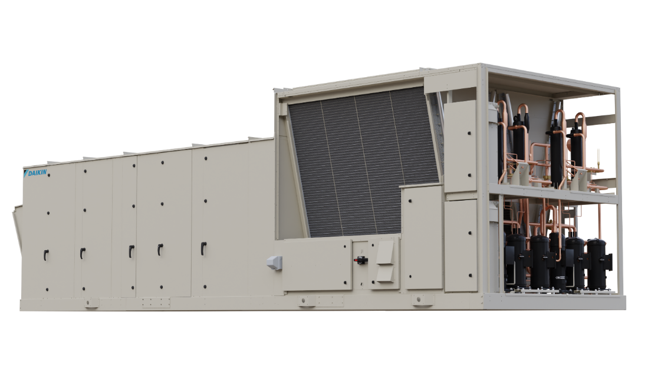
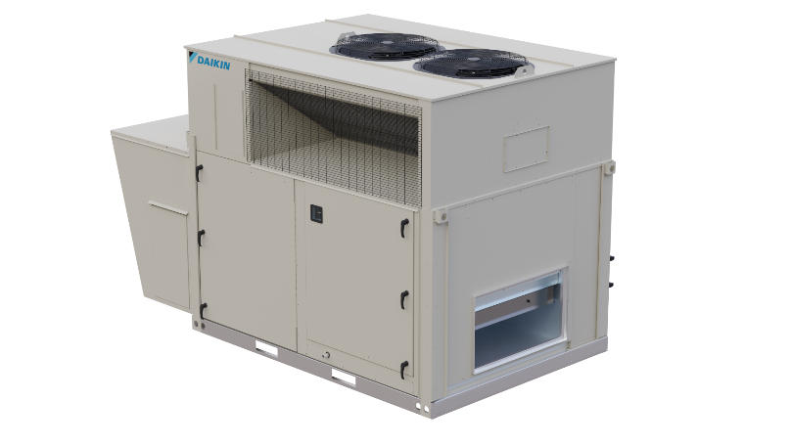
Heat Pump Equipment
Heat Pump Equipment
Attributes | Rebel | Rebel Applied
Type | Air-to-Air | Air-to-Air
Capacity Range | 3 to 31 tons | 30 to 75 tons
Efficiency (COP) | 3.4 @ 47°F 2.5 @ 17°F 2.0 @ 5°F | 3.6 @ 47°F 2.4 @ 17°F
Supplemental Heat | Gas, electric, hot water | Gas, electric, hot water
©2025 Daikin Applied

Slide 45
Heat Pump Systems
Rebel / Rebel Applied
Trailblazer AGZ-F
Mega Q
ASHP with WSHPs and DOAS
Small to medium systems/buildings
2-pipe hydronic thermal loop
Retrofit existing WSHP systems
RTU heat pump DOAS
Options:
  Adiabatic cooling tower
  Geothermal field
  Add heat pump for domestic hot water
    Air source or water source
Most suitable for:
  HVAC/control flexibility for spaces/zones
  Retrofit of existing WSHP systems
Enfinity or SmartSource WSHPs
©2025 Daikin Applied

Slide 46
Heat Pump Systems
Mega Q
Trailblazer AGZ-F
ASHP with AHUs, DHW and Heat Recovery
Medium to large systems/buildings
4-pipe cooling and heating
Options:
  Add IAQP/SVT to optimize ventilation
  Add heat recovery
    To boost hot water temperature
    And/or, to recover waste energy
  Add heat pump for domestic hot water
    Air source or water source
  Radiant heating and/or cooling
Most suitable for:
  Retrofit of existing chiller-boiler systems
Navigator TWV
©2025 Daikin Applied

Slide 47
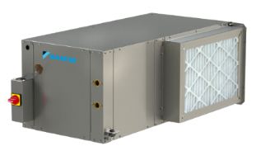
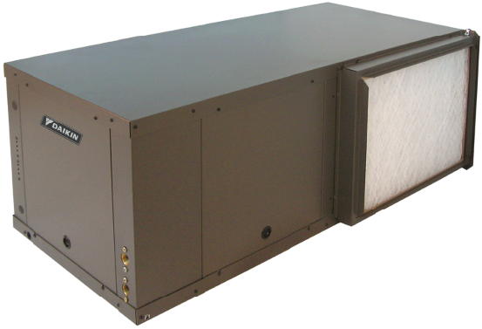
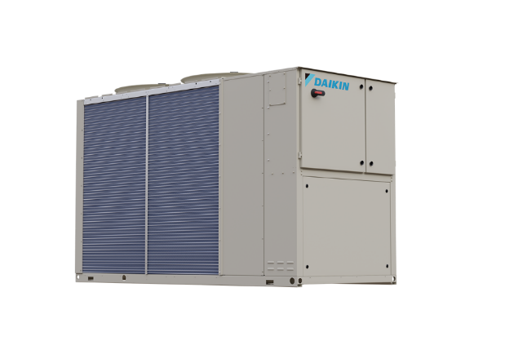
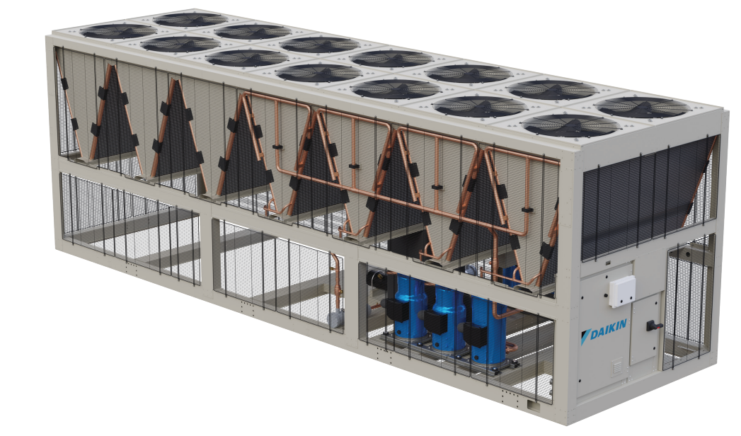
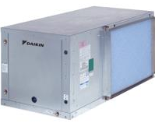
Heat Pump Systems
Equipment
Attributes | Enfinity & SmartSource WSHPs | Trailblazer EWYQ/T | Trailblazer AGZ-F
Type | Water-to-Air | Air-to-Water | Air-to-Water
Capacity Range | 0.5 to 6.0 Tons | 25 tons 310 MBH | 75-230 tons
Leaving Hot Water Temperature | N/A | Up to 140°F | Up to140°F
Coming soon…
©2025 Daikin Applied

Slide 48
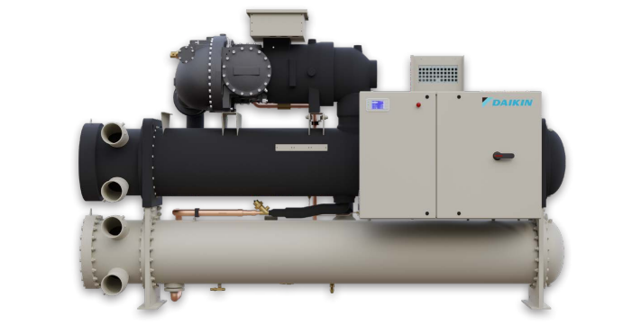
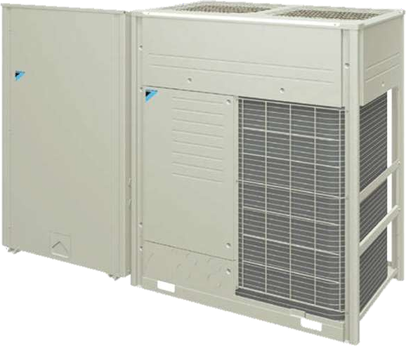
Heat Pump Systems
Equipment
Attributes | Navigator WWV/TWV | Mega-Q
Type | Water-to-Water | Air-to-Water (Cascade)
Capacity Range | 150 to 300 tons 1,200 to 4,300 MBH | 120 MBH (Domestic Hot Water)
Leaving Hot Water Temperature | Up to 140°F | 140°F to 194°F
©2025 Daikin Applied

Slide 49
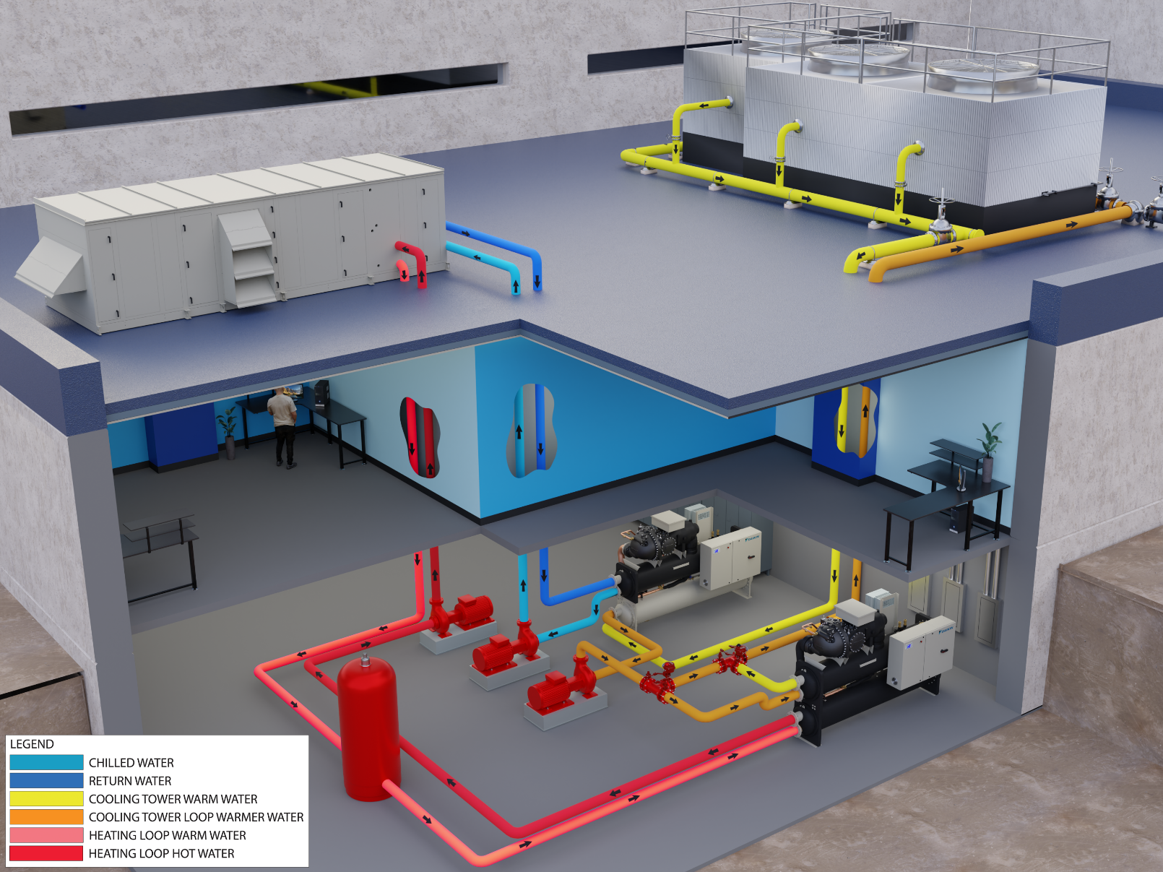
Heat Recovery
Navigator TWV - Templifier® Water Heater
  Capacity:
    150 to 300 tons
    1,200 to 4,300 MBH
  Condenser water temperature up to 140°F
    Up to 130°F @ 25°F evaporator leaving temperature
  Recover heat from condenser or chilled water
©2025 Daikin Applied

Slide 50
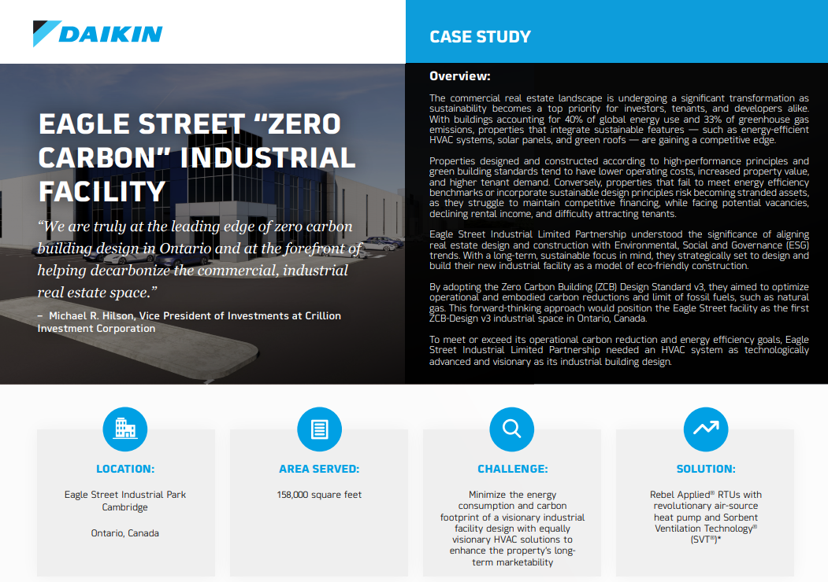

Inspiring Projects
Eagle Street Industrial Facility
Toronto
New construction
Industrial/logistical warehouse
CaGBC Zero Carbon Building Design Standard V3
Rooftop unit heat pumps with
    R-32 refrigerant
    Optimized ventilation
    Supplemental gas heat
©2025 Daikin Applied

Slide 51

Inspiring Projects
Empire State Building
New York City
Retrofit
District steam
Chilled water
Envelope
Lighting
60% energy reduction
©2025 Daikin Applied

Slide 52

Inspiring Projects
JPMorgan Chase
New York City
New construction
All-electric
Net zero
Air-to-water heat pumps
©2025 Daikin Applied

Slide 53

Inspiring Projects
555 Greenwich & 345 Hudson
New York City
New construction and retrofit
Hydronic loop
Geothermal
Heat pumps:
  Air-to-water heat pumps
  Water-to-air heat pumps
  Water-to-water heat pumps
Thermal storage
Distribution: Radiant, ducted, induction
©2025 Daikin Applied

Slide 54


Where Can I Go for Information?
Selected Resources
https://www.ashrae.org/about/cebd-center-of-excellence-for-building-decarbonization
https://www.ashrae.org/about/cebd-building-decarb-101
US Department of Energy: Decarbonizing the U.S. Economy by 2050: A National Blueprint for the Buildings Sector
Decarbonization Guides
  Decarbonizing Building Thermal Systems: A How-To Guide for Applying Heat Pumps and Beyond
Pathways to Commercial Liftoff: Geothermal Heating and Cooling
©2025 Daikin Applied

Slide 55

Where Can I Go for Information?
Selected Resources
Dedicated web site
On demand webinars:
  Decarbonization in HVAC
    Part 1: Overview
    Part 2: Systems & Solutions (Coming soon)
  Refrigerants
    Preparing Buildings for A2L Refrigerants
https://www.daikinapplied.com/decarbonization
©2025 Daikin Applied

Slide 56
Decarbonization Webinars
Upcoming Webinars
Part | Date | Title | Description
1 | April 16 | Decarbonization of HVAC Systems - Part 1: Review and Industry Update | In this session, we’ll explore the decarbonization of HVAC systems with a review of the latest industry advancements and essential concepts, followed by discussion of heat pump system application and design considerations, and groundbreaking projects that are shaping the future of electrified and sustainable HVAC systems.
2 | May 14 | Decarbonization of HVAC Systems - Part 2: Industry Guidance on Thermal Systems | A guided tour of Decarbonizing Building Thermal Systems: A How-to Guide for Heat Pump Systems and Beyond. This guide, produced by NREL in conjunction with the US Department of Energy and ASHRAE offers essential guidance as we prepare to decarbonize and electrify buildings.
3 | June 11 | Decarbonization of HVAC Systems - Part 3: Rooftop Unit Heat Pump Systems | “All Things RTU Heat Pump”: The third installment of our three-part webcast series will zoom in on rooftop unit heat pump systems and discuss application and design considerations of this ubiquitous equipment, now available in a versatile and high-performance heat pump form.

Slide 57

Questions & Key Takeaways
Key Takeaways
Policy, industry and NGOs
Support for decarbonization varies
Action is at the state and local level
Utilities are setting targets and making progress
Building systems are evolving to support efficiency and electrification
Heat pump system application and design must consider many factors, including:
Building
Climate
Emissions
Utilities
Heat pump equipment:
Product portfolios are expanding and advancing
Performance continues to improve
Heat pump system solutions are rapidly evolving
©2025 Daikin Applied

Slide 58
Thank you for your time and attention
For more information, contact:
Jeff Seewald
jeffrey.seewald@daikinapplied.com
©2025 Daikin Applied

