Slide 1
Decarbonization & Electrification for Applied HVAC Systems
Rooftop Unit Air-Source Heat Pumps
Presented by: Jeff Seewald, HVAC Systems Business Development Manager
June 18, 2025
DISCLAIMER: This presentation is intended only for educational purposes and does not replace independent professional judgment and/or legal advice.
This presentation is copyrighted and cannot be used without the express permission of Daikin Applied Americas Inc.
Notes:
Revision A /2025

Slide 2




Introductions
Jeffrey Seewald, PE, CEM
HVAC Systems Business Development Manager
jeffrey.seewald@daikinapplied.com
Joined Daikin in November 2023
30 years of experience
    HVAC equipment and systems
    Building automation and controls
    Energy efficiency and infrastructure renewal
Focus areas at Daikin include:
    Decarbonization
    Electrification and heat pumps
    Refrigerants
    Energy efficiency
    Indoor air quality

Slide 3

Introductions
Sharon Haeg, PE, CEM, LEED AP BD+C
HVAC Systems Business Development Manager
sharon.haeg@daikinapplied.com
Joined Daikin in November 2024
17 years of experience
    Energy efficiency and infrastructure renewal
    HVAC equipment and systems
    Building automation and controls
Focus areas at Daikin include:
    Refrigerants
    Decarbonization
    Energy efficiency
Notes:
Update for me

Slide 4
Disclaimer
This content subject to change without notice and is intended only for educational purposes and does not replace independent professional judgment and/or legal advice. The ultimate responsibility is on the engineer of record to ensure the design complies with all applicable codes and Daikin Applied will not accept responsibility or liability for actions that result from the information shared in this presentation. This content is copyrighted and cannot be used without the express permission of Daikin Applied Americas Inc.
Always consult your state & local codes, which may take precedence over standards which vary in adoption, complete or partial, by state. Also note that a state may adopt a different year of the standard than the latest version.
The local Authority Having Jurisdiction (AHJ) has the final authority in interpreting code requirements.

Slide 5
Review
Refrigerants
Efficiency
Optimization
Heat pumps
Electrification
Low GWP

Slide 6

Review
Refrigerants
Efficiency
Optimization
Heat pumps
Electrification
Low GWP

Slide 7
Agenda
RTU Heat Pumps
Application & Design
Field Study
Equipment
Low ambient
RTU heat pump performance
Operating map
Defrost
Electric / power
Refrigerant
Supplemental heat
DOAS
What equipment is available?
How does it work?
How does performance vary with temperature?
What are the key application and design considerations for RTU heat pumps?
How does defrost work?
What supplemental heat options are available?
What are options for addressing electrical power requirements?
What have we learned from field studies of RTU heat pumps?

Slide 8
Registration Questions
What do you presently see as the greatest opportunity(ies) in application and design of heat pump systems?
What do you presently see as the greatest challenges in application and design of heat pump systems?
Decarbonizing HVAC in mild climates
Ability to use one system
Replacing natural gas
Efficiency
RTU replacements
Big box retail
Water source systems
Low ambient
Higher initial cost
Supplemental heat requirements
Retrofits
Electrical service and infrastructure
Electricity demand
Electricity cost
Defrost
©2025 Daikin Applied

Slide 9
Registration Questions
What questions do you have about applying rooftop unit heat pumps?
Low ambient
Minimize electrical demand
Supplemental heat options
DOAS applications
©2025 Daikin Applied

Slide 10

Q&A
Instructions
Please submit questions via email to:
sharon.haeg@daikinapplied.com
We will respond to your questions at the end of the webinar, and/or via email.
©2025 Daikin Applied

Slide 11

Audience Question
Question 1
Parts 1 and 2: Recordings Available!
Do you expect to be involved in a RTU heat pump system design and/or installation?
  Presently involved in one or more projects
  In the next 6-12 months
  In the next 1-2 years
  In the next 3-5 years
  Not sure
Missed Parts 1 or 2 of this Decarbonization webcast series?
  Part 1: Review / Update
  Part 2: Industry Guidance on Thermal Systems
Check out the recordings.
https://www.daikinapplied.com/decarbonization/knowledge-center
©2025 Daikin Applied

Slide 12
RTU Heat Pumps
RTU Heat Pumps
Application & Design
Field Study
Notes:
Transitional slide to shift to how regulations are driving behavior

Slide 13
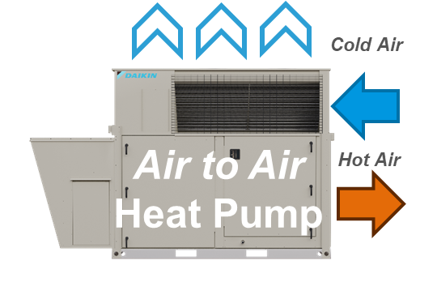
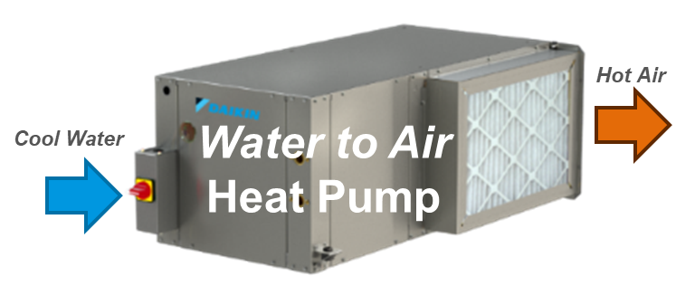
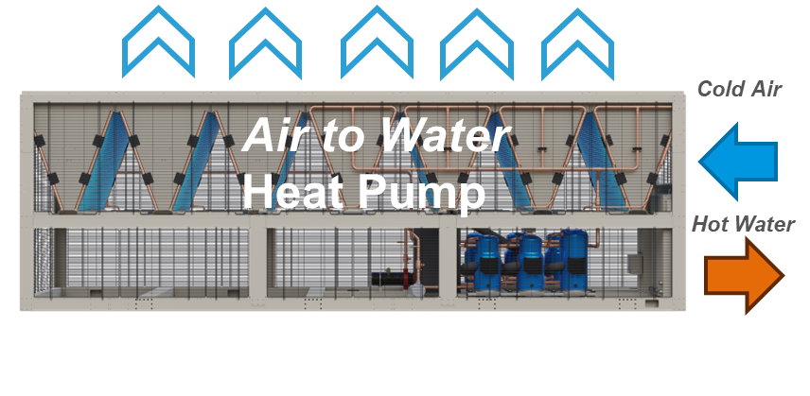
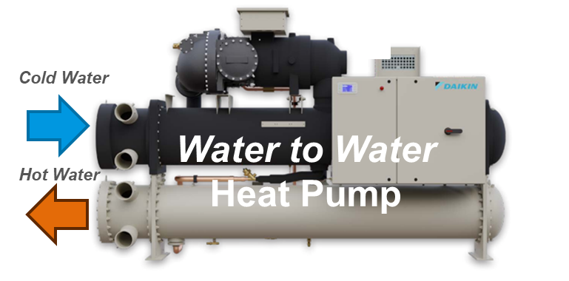
Heat Pumps
Air-to-Air
RTU
Water-to-Air
WSHP
Packaged
Air-to-Water
Water-to-Water
Heat Recovery
Chiller-Heater
Types
Air-to-Air
Water-to-Air
Air-to-Water
Water-to-Water

Slide 14
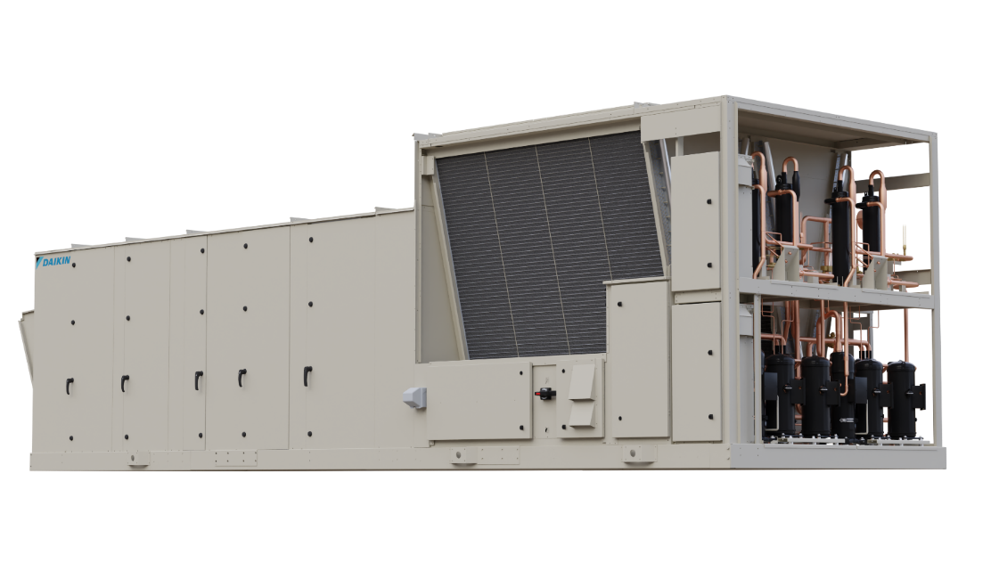
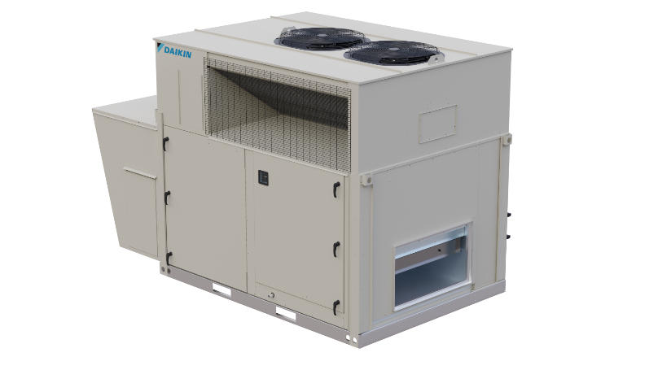
Heat Pump Equipment
Rooftop Units
Attributes | Rebel | Rebel Applied
Type | Air-to-Air | Air-to-Air
Capacity Range | 3 to 31 tons | 31 to 68 tons
Efficiency (COP) | 3.4 @ 47°F 2.5 @ 17°F 2.0 @ 5°F | 3.6 @ 47°F 2.4 @ 17°F
Supplemental Heat | Gas, electric, hot water | Gas, electric, hot water
©2025 Daikin Applied

Slide 15
Heat Pump Equipment
Rebel & Rebel Applied
RTU Heat Pump System
Rooftop unit heat pumps with inverter compressor technology
Mixed air or DOAS
Supplemental heat options:
  Gas
  Hot water
  Electric
Additional options include:
  Energy recovery
  IAQP/SVT to optimize ventilation
©2025 Daikin Applied

Slide 16


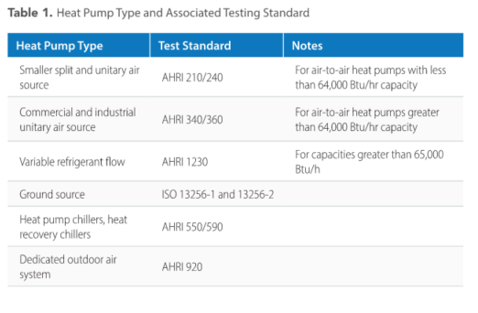
Heat Pump Equipment
Codes, Standards & Certification
ASHRAE Standard 90.1-2019 and 2022
  New equipment tables
AHRI and ISO test standards
AHRI certificates
  https://ahridirectory.org/
Not all heat pump equipment is certified!
Source: Decarbonizing Building Thermal Systems: A How-To Guide for Applying Heat Pumps and Beyond, NREL
Notes:
Note: Not all equipment is certified.
Recommend specifying AHRI certification.

Slide 17

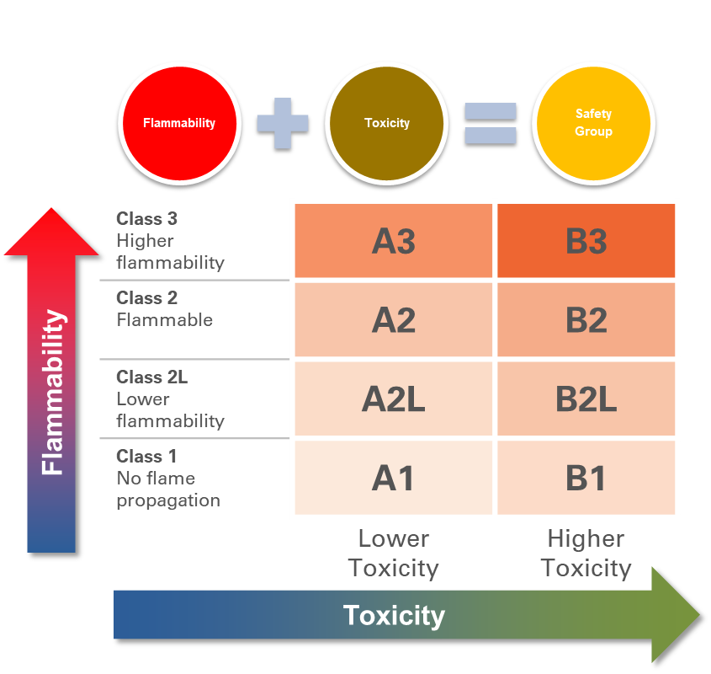
Heat Pump Equipment
Refrigerant
Rebel & Rebel Applied
R-32 → A2L
System Classification
  High Probability
Design / calculations
  EDVC
Refrigerant detection system required
R-32: Better efficiency with less charge!
©2025 Daikin Applied
Notes:
Better efficiency, less charge

Slide 18
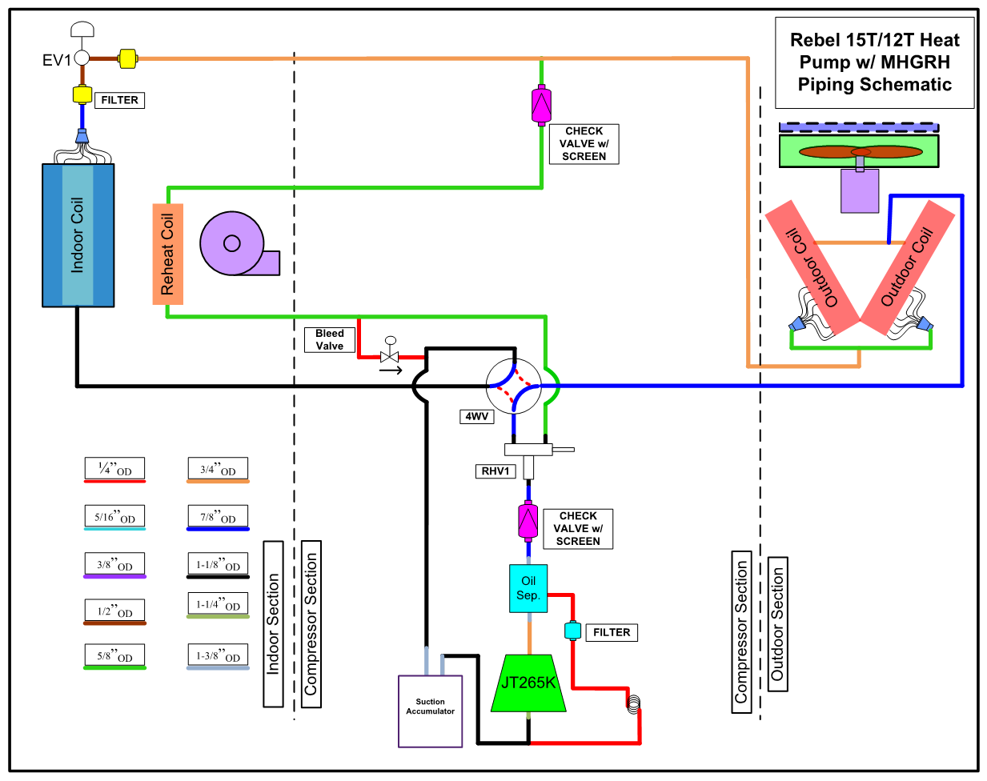
Heat Pump Equipment: How Does It Work?
Condensed liquid
Rebel & Rebel Applied
Air @ 90°F
Cooling
Evaporator
Mixed air @ 65°F
Supply air @ 50°F
Air @ 80°F
Condenser
Supply fan
Vapor
Hot gas
Inverter compressor
Reversing valve
©2025 Daikin Applied

Slide 19

Heat Pump Equipment: How Does It Work?
Condensed liquid
Rebel & Rebel Applied
Air @ 9°F
Heating
Condenser
Mixed air @ 60°F
Supply air @ 90°F
Air @ 17°F
Evaporator
Supply fan
Hot gas
Vapor
Inverter compressor
Reversing valve
©2025 Daikin Applied

Slide 20
Heat Pump Equipment: How Does It Work?
Condensed liquid
Rebel & Rebel Applied
Air @ 35°F
Defrost
Evaporator
Mixed air @ 65°F
Supply air @ 50°F
Air @ 17°F
Condenser
Supply fan
Vapor
Hot gas
Inverter compressor
Reversing valve
©2025 Daikin Applied

Slide 21
RTU Heat Pump
Operating Map
Definitions
*Mixed Air Temperature: The determined mixed air temperatures based on the amount of return air volume, outside air volume, and return temperatures entered in the Heating Mixed Air and COP Calculator.
*Required Supplemental Heat (kW): The required additional heat output from your auxiliary heater during heat pump operation to reach the heating supply air setpoint entered in the Heating Mixed Air and COP calculator.
*AHRI Heat Pump COP: The heat pump COP at various ambient temperatures at AHRI airflow, static pressure, and entering indoor air conditions.
*Application COP: The Application specific heat pump COP based on entered outside air temperatures, Mixed Air Temperatures, and supply fan CFM/Static pressure.
*Blended COP: The combined COP of your heat pump operating in tandem with your (assumed) electric auxiliary heater.
*Load Ratio: shows the required heating output from the auxiliary heater during heat pump operation to reach the enter supply air heating setpoint. This is a percentage of the required supplemental heat versus the total heat capacity required to reach the heating supply air set point.
Notes:
Specify provision of operating map

Slide 22
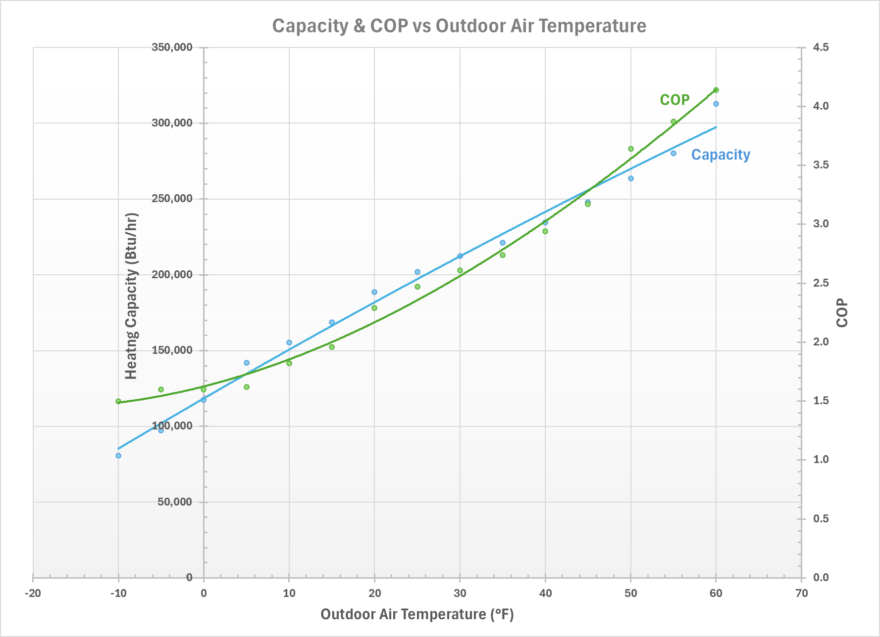


RTU Heat Pump
Operating Map
Capacity & COP
COP $=f(OAT)$
Capacity $=f(OAT)$
Specify provision of operating map data!
Notes:
Specify provision of operating map

Slide 23
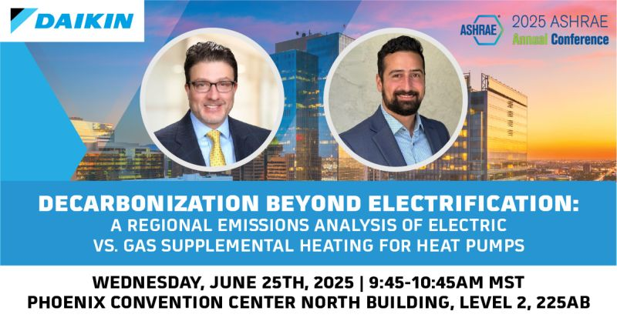

Audience Question
Question 2
In your estimation, what is the greatest obstacle to adoption of rooftop unit heat pumps?
  Electrical infrastructure / requirements
  Performance / efficiency
  Size / weight
  Operating cost
  First cost
  Other

Slide 24
Application & Design
RTU Heat Pumps
Application & Design
Field Study
©2025 Daikin Applied
Notes:
Transitional slide to shift to how regulations are driving behavior

Slide 25
Heat Pump Systems
Application & Design
Perspective | Take-Away | Action
Building | Location, location, location Decarbonization is a process | Engage the process Know the building and its loads Minimize loads
Climate | Heat pump ≠ boiler Performance = f(Climate Zone) | Adjust system design temperatures Evaluate climate profile operating hours Consider dual fuel systems
Emissions | Emissions = f(Location) Decarbonization of electricity grid is progressing | Evaluate emissions of system options
Utilities | Incentives / rebates may apply Electrical/power upgrades may be needed | Assess electrical infrastructure and power needs Design for submetering Engage utility early
Combined | Adapt the path to decarbonization for each building | Apply energy modeling to quantify options and optimize system design
1
Low Ambient
2
Emissions
3
Power
©2025 Daikin Applied

Slide 26
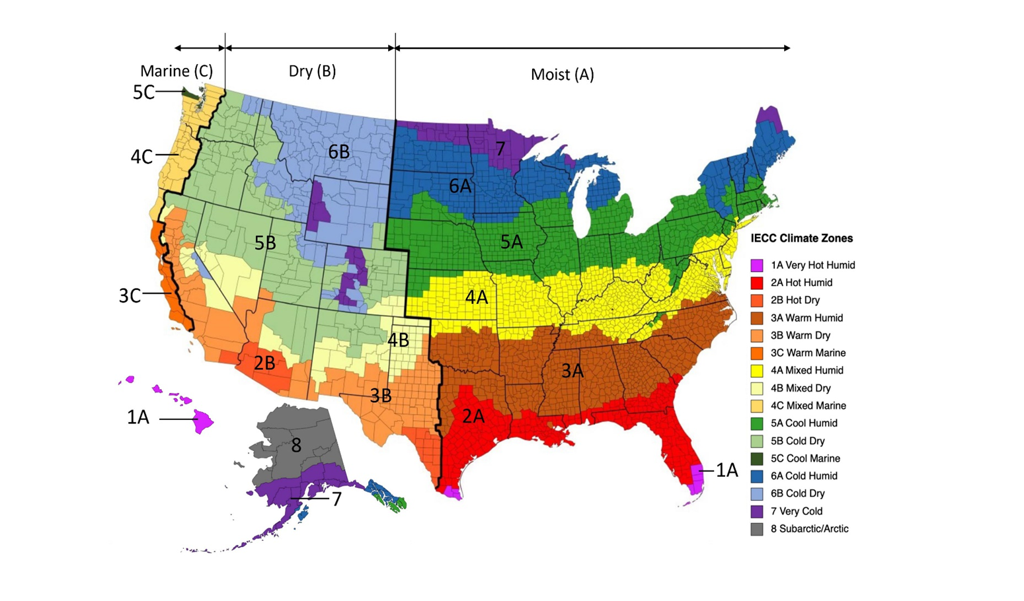
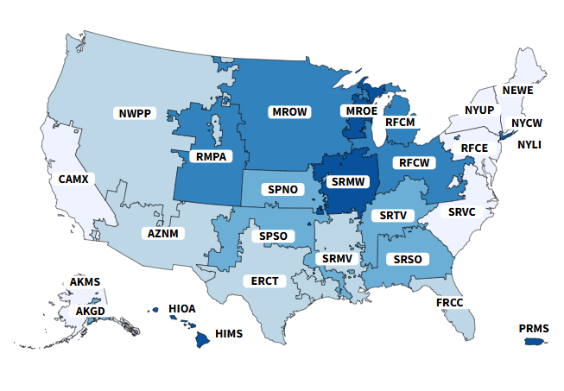
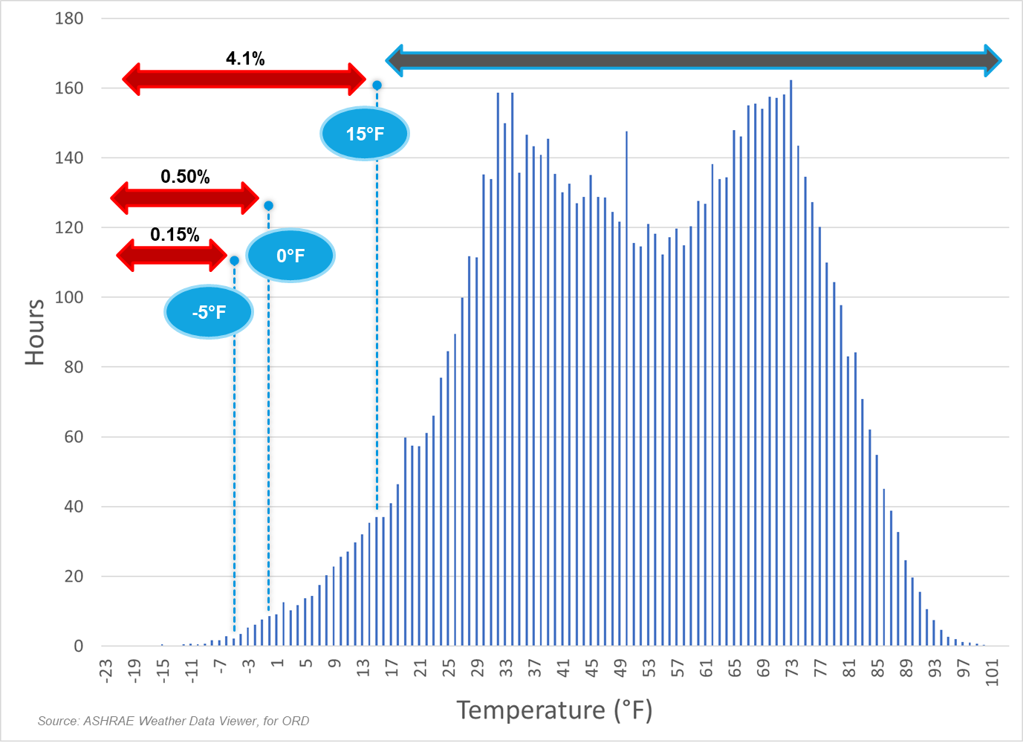
Heat Pump Systems
Climate Zones
Grid Emissions
RTU Heat Pump System Challenges
1a
Low Ambient
1b
Defrost
Climate
1c
Supplemental Heat
1d
DOAS
2
Climate & Emissions
Emissions
3
Building &
Utilities
Power
©2025 Daikin Applied

Slide 27
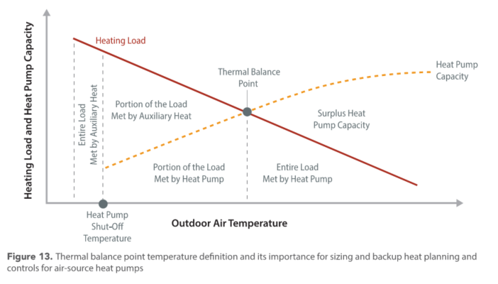


Heat Pump System Challenges
1a
Low Ambient
To operate HPs in cold climates, consider the following:
  Reduce the load
    Optimize ventilation
  Lower the heating supply temperature
    Increase heat emitter size/area
  Explore heat sources
    Geothermal exchange
  Recover energy
    DOAS with ERV
  Share the lift
    Cascade systems
  Use supplemental heat
Thermal balance point at intersection of heating load line and heat pump capacity curve
Maximum heat pump heating capacity
Capacity $=f(OAT)$
Load $=f(OAT)$
Low ambient operation
Supplemental heat
Source: Decarbonizing Building Thermal Systems: A How-To Guide for Applying Heat Pumps and Beyond, NREL
Notes:
Mention ventilation/IAQP

Slide 28
Heat Pump System Challenges
Operating Map
Capacity & COP
COP $=f(OAT)$
Capacity $=f(OAT)$
COP @ AHRI conditions
COP @ selected conditions
COP with assumed electric supplemental heat
Portion of load met by supplemental heat
Notes:
Specify provision of operating map

Slide 29
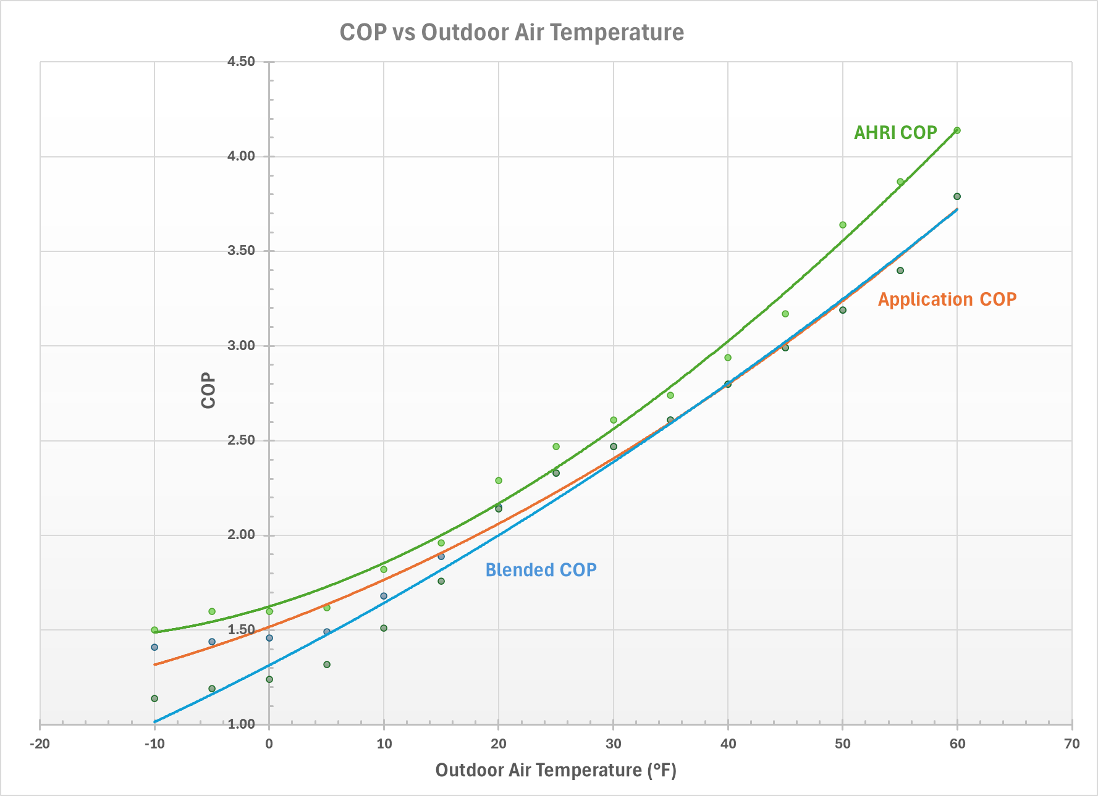
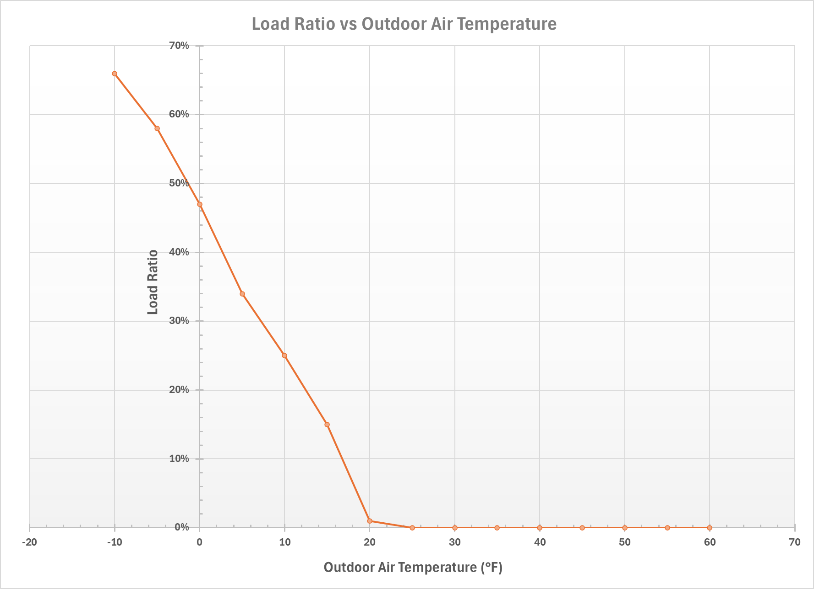
Heat Pump System Challenges
COP
Load Ratio

Slide 30
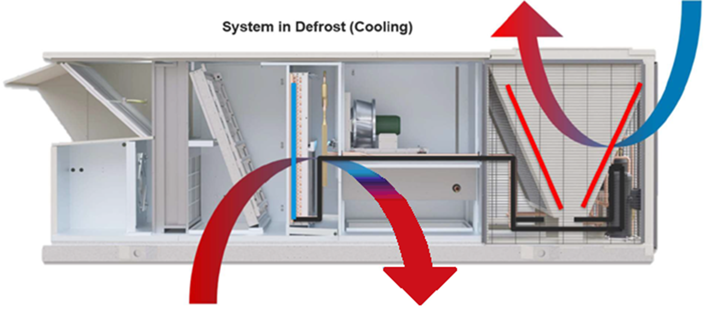
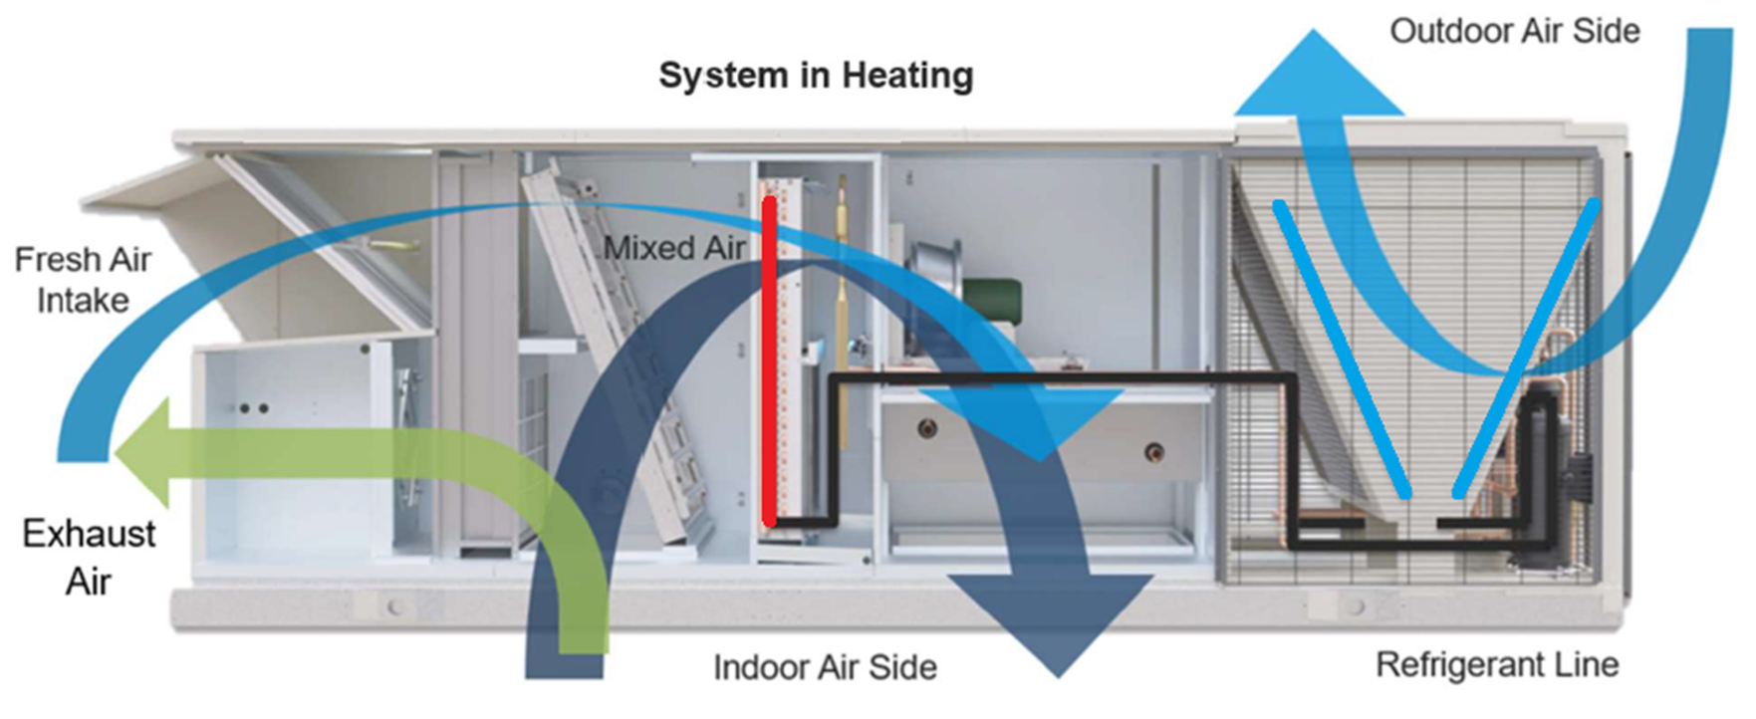
Heat Pump System Challenges
1b
Defrost
Heating
Defrost
Compressor modulates to meet load
Outdoor air damper modulates
Supply fan modulates to maintain static pressure
Compressor runs at high speed
Outdoor coil fan(s) turn off
Outdoor air damper closes
Supply fan modulates to maintain static pressure
Supplemental heat modulates to maintain space temperature
Condensate management heating energizes
Average time in defrost: ~5-10 minutes
For units with multiple refrigerant circuits, defrost applies to one circuit at a time

Slide 31
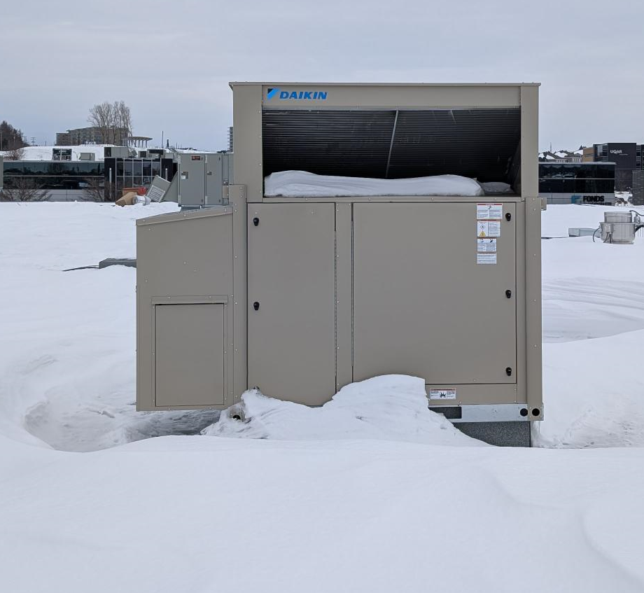
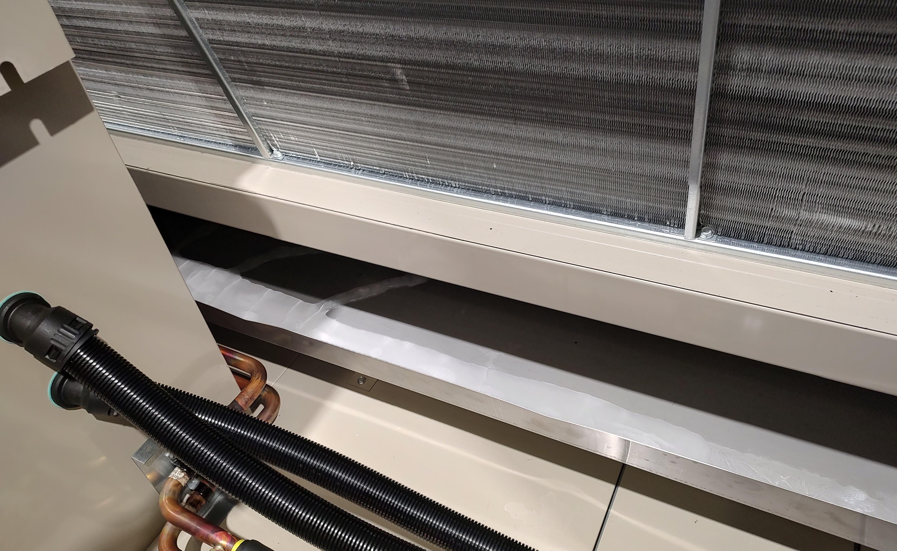
Heat Pump System Challenges
Defrost Operation: Frost / Refreeze Mitigation
Rebel | Rebel Applied
©2025 Daikin Applied
Notes:
Examples
Heated condensate mgmt

Slide 32
Heat Pump System Challenges
1c
Supplemental Heat
Why supplemental heat?
Gas vs. Electric
  Optimize heat pump sizing
  Ensure heating load will be met in all conditions
  Mitigate defrost operation
  First cost
  Operating cost
  Infrastructure

Slide 33
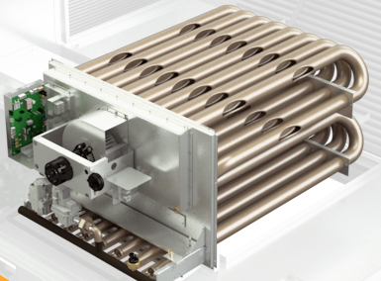
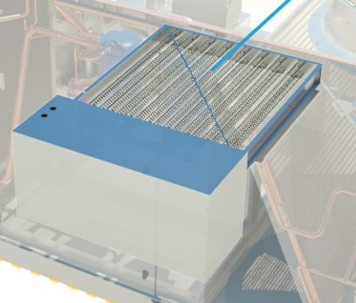
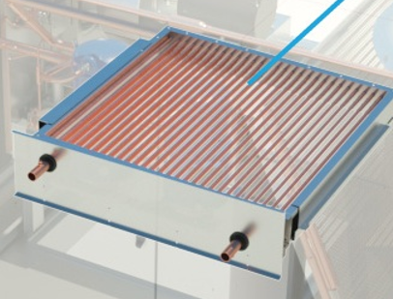
Supplemental Heat Options
Natural Gas/Propane
Electric
Hot Water / Steam
Simultaneous dual fuel operation
Staged or Modulating controls
High turndown
High temp rise
High temp rise
Staged or SCR controls
Keep MCA/MROPD down on heat pumps by using:
  EH dedicated power option
  kW limiting controls
Coil options
Factory installed freeze-stat option
Factory installed valve packages available

Slide 34
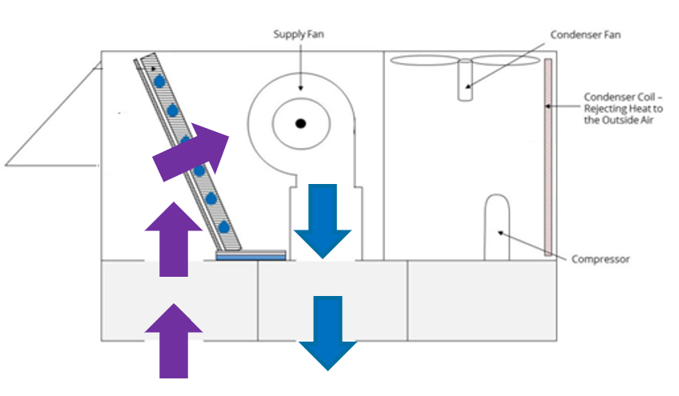
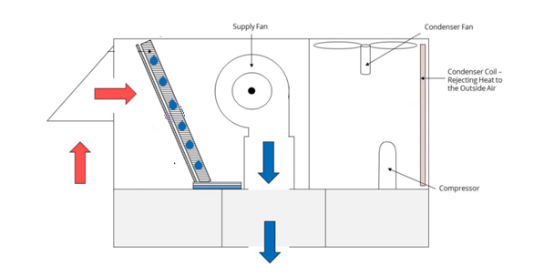
Heat Pump System Challenges
1d
DOAS
During defrost indoor coil subject to freezing
Frozen indoor coil will “snowball” into controls problem
Mixed Air Defrost Operation
DOAS Defrost Operation

Slide 35
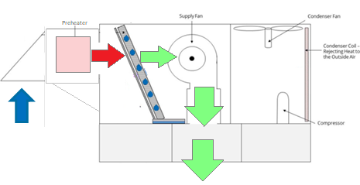
Heat Pump System Challenges
1d
DOAS
During defrost Preheat will be engaged to prevent any possibility of the indoor coil freezing.
DOAS Preheat Option

Slide 36


Heat Pump System Challenges
2
Emissions
As ambient temperature decreases, heat pump COP decreases
As COP decreases, more power is required to operate the heat pump for a given capacity, resulting in greater energy consumption
More energy consumption in turn yields greater emissions
COP $=f(OAT)$
Emissions $=f(COP)$
Temperature

Slide 37
Heat Pump Heating Emissions – Illinois
Assumptions
Natural Gas Efficiency: | 85%
Electric Resistance Efficiency: | 99%
Grid Emissions Factor: (lb/MWh) | 911
Natural Gas Emissions (lbs/therm) | 12.1
Elect. Heat
Nat. Gas
Emissions Changeover
Heat Pump
Increasing Efficiency
Temperature
Emissions changeover varies with grid emissions factors, available from US EPA eGRID
©2025 Daikin Applied
Notes:
Coming soon in DST, work with your sales rep
In the meantime, contact us…

Slide 38
Heat Pump Heating Emissions – Illinois
Assumptions
Natural Gas Efficiency: | 85%
Electric Resistance Efficiency: | 99%
Electricity Cost: ($/kWh) | $0.13
Natural Gas Cost: ($/mcf) | $12.23
Elect. Heat
Cost Changeover
Nat. Gas
Heat Pump
Increasing Efficiency
Temperature
Cost changeover point varies with utility rates, available from US EIA and utilities
©2025 Daikin Applied

Slide 39
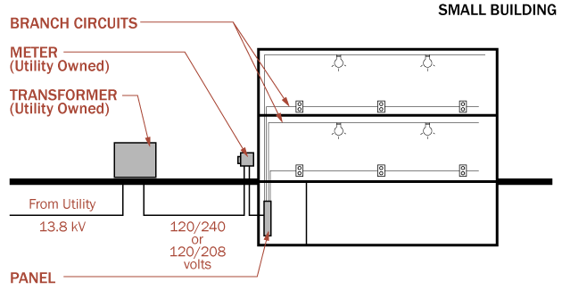
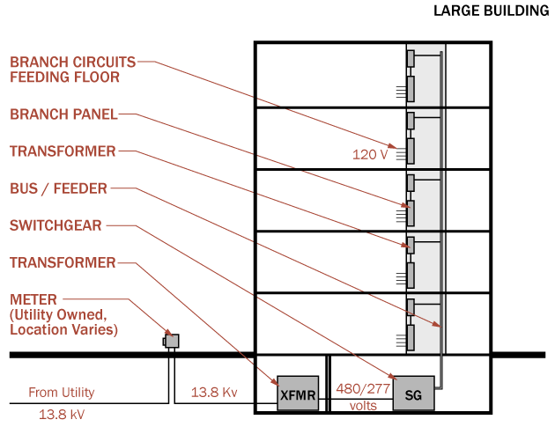
Heat Pump System Challenges
3
Electrical / Power
Physical capacity
  Breaker space
Electrical capacity
  Building service
  Transformers
  Switch gear
  Panels
Location
Is there adequate capacity?
Is there adequate space?
Is the capacity where it is needed?

Slide 40
Heat Pump System Challenges
3
Electrical / Power
Typical infrastructure challenge switching from gas to electric heat results in:
    Heat Pump w/ Electric Heat increases MCA/MROPD
    Wire feed / breaker sizes grow = increasing cost($)
    Existing building infrastructure complicates retrofit process
Solutions:
    Increased HP capacity = reduced EH kW
    Controls = Configurable Auxiliary EH Limits
    Dual Point Power = Dedicated EH Circuit
    EH = Electric Heat

Slide 41

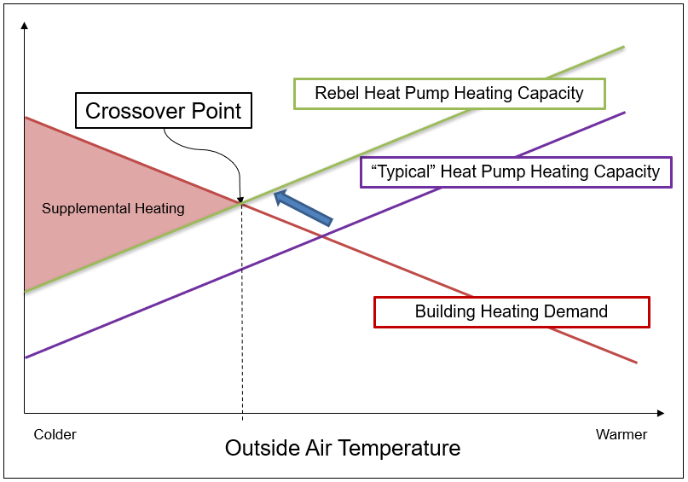
Heat Pump System Challenges
3
Electrical / Power
Standard Compressor
Variable Speed Compressor
A
B
Inverter Compressor runs faster in heating
Heat pump & Building Crossover point shifts

Slide 42
Heat Pump System Challenges
3
Electrical / Power
Control option limits electric heater capacity during compressor operation
  Four limit options available (0%, 25%, 50%, 75%)
When compressor is inactive, electric heat is 100% available
Example:
RTU with KW limiting control
10-ton RTU
208V, 54 kW electric heater,
50% kW limiting capacity.
With compressor running
27 kW EH available,
54 kW available w/out compressor
Reduces MCA & MROPD
  Reduce power wire feed size/cost
  Reduced breaker size/cost
  Reduced electrical infrastructure requirement to the building
Maintains 100% electric heat capacity for redundancy scenario
Item | Normal Heat Pump | RTU with kW Limiting Control
MCA | 207 | 163
MROPD | 250 | 175
Wire Size | 4/0 | 2/0 (Reduced by 2 gage sizes!)

Slide 43
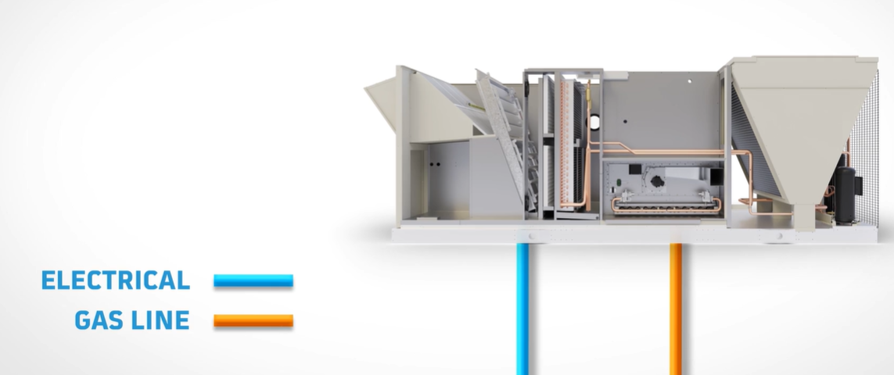
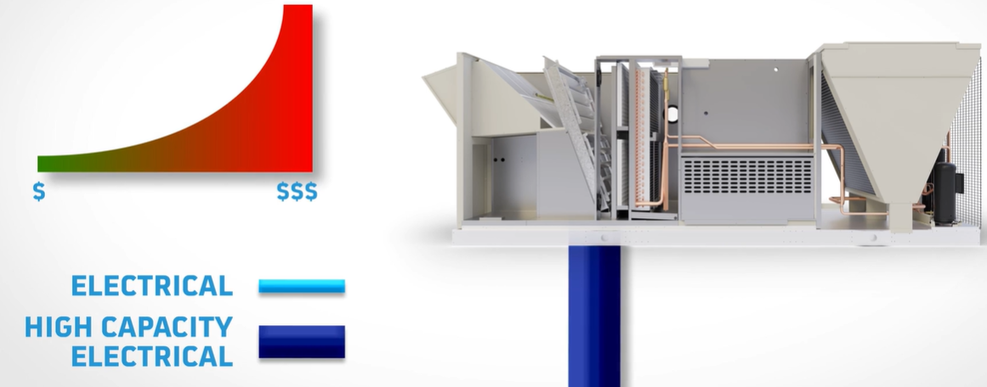
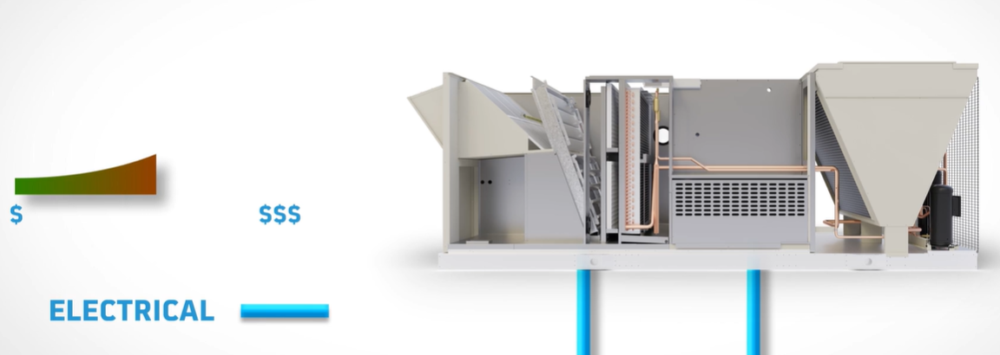
Heat Pumps and Electrical Distribution
Gas Heat Unit Being Replaced
Electrical for cooling
Gas for heating
Traditional Heat Pump w/ Electric Heat
Electrical for cooling & heating
Large wire/breaker sizes required
High electrical install cost
Rebel Heat Pump w/ Electric Heat & Dedicate EH Power
Existing electrical for cooling
New, separate, smaller electrical for heating
Simplified installation!
Lower electrical installed cost!

Slide 44
Retrofitting Package Rooftop HPs
Existing Unit
Rooftop w/ Gas Heat
 | Existing Unit
MCA | 130A – 1/0 AWG
MOP | 150
New ASHP Rooftop Unit
 | Scenario 1: Std Heat Pump | Scenario 2: Inverter Heat Pump | Scenario 3: Inverter HP Dual-point Electrical
MCA | 280 amps – 300 MCM | 233 amps – 4/0 AWG | C1: 130A 1/0 AWG C2: 100A 3 AWG
MOP | 300 amps | 250 amps | C1 150A / C2 = 125A
Install Requirements | New 280A Feed (+6 wire sizes) | New 233A Feed (+3 wire sizes) | Use existing 130A Feed, New 100A Feed
Relative Electrical Install Cost | High | Medium | Low
©2025 Daikin Applied
Notes:
Key Points:
For example, if we look at replacing an existing gas rooftop with a HP, we can see how the electrical feed may be impacted
Newer products have some technology enablers that help reduce cost. For example, inverter units that can boost capacity and feature electrical designs that are laid out to minimize the retrofit work required
If we compare 3 different options, a standard HP RTU, an inverter RTU, and an inverter RTU with dual point electrical, we will see that the cost to retrofit is different
Scenario 1 is a standard HP RTU. Because it has electric supplemental heat, the electrical feed must be larger, growing from 130A to 280A. This means we have to rip out our existing electrical feed and replace with a much larger one; 6 wire sizes larger in this case

Slide 45
Retrofitting Package Rooftop HPs
Existing Unit
Rooftop w/ Gas Heat
 | Existing Unit
MCA | 130A – 1/0 AWG
MOP | 150
New ASHP Rooftop Unit
 | Scenario 1: Std Heat Pump | Scenario 2: Inverter Heat Pump | Scenario 3: Inverter HP Dual-point Electrical
MCA | 280 amps – 300 MCM | 233 amps – 4/0 AWG | C1: 130A 1/0 AWG C2: 100A 3 AWG
MOP | 300 amps | 250 amps | C1 150A / C2 = 125A
Install Requirements | New 280A Feed (+6 wire sizes) | New 233A Feed (+3 wire sizes) | Use existing 130A Feed, New 100A Feed
Relative Electrical Install Cost | High | Medium | Low
©2025 Daikin Applied
Notes:
Key Points:
In scenario 2, our inverter unit is more efficient and can boost capacity in colder temperatures, leading to a smaller amount of backup heat required and lower electrical feed of 233A. We still have to replace our wiring feed, but the new wire is smaller than in scenario 1

Slide 46
Retrofitting Package Rooftop HPs
Existing Unit
Rooftop w/ Gas Heat
 | Existing Unit
MCA | 130A – 1/0 AWG
MOP | 150
New ASHP Rooftop Unit
 | Scenario 1: Std Heat Pump | Scenario 2: Inverter Heat Pump | Scenario 3: Inverter HP Dual-point Electrical
MCA | 280 amps – 300 MCM | 233 amps – 4/0 AWG | C1: 130A 1/0 AWG C2: 100A 3 AWG
MOP | 300 amps | 250 amps | C1 150A / C2 = 125A
Install Requirements | New 280A Feed (+6 wire sizes) | New 233A Feed (+3 wire sizes) | Use existing 130A Feed, New 100A Feed
Relative Electrical Install Cost | High | Medium | Low
©2025 Daikin Applied
Notes:
Key Points:
In Scenario 3, our inverter unit has 2 electrical feeds. 1 is sized to match up with the existing unit, so we can reuse that feed, we don’t have to throw it away. It has a 2nd feed that covers the difference in amps between the old and new unit, so we do still have to run a new feed, but it is a small 100A feed.
This leads to relatively smaller retrofit costs than scenario 1 and 2

Slide 47
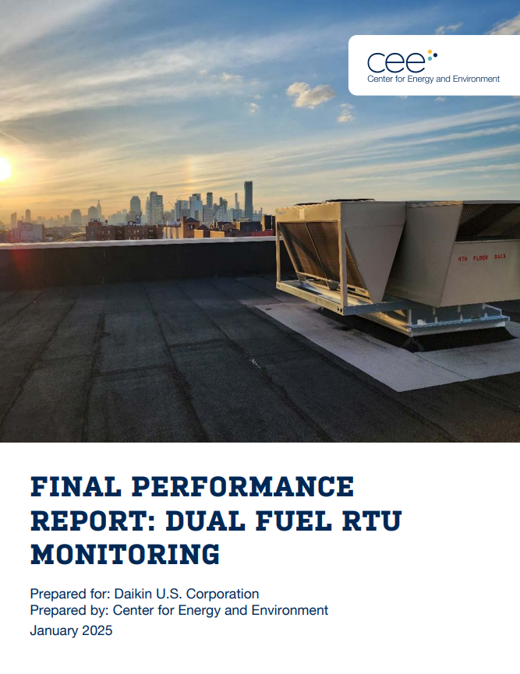
Audience Question
Question 3
Field Study
What supplemental heat option would be most preferred on your projects?
  Natural gas / propane
  Electric
  Hot water
Source: Center for Energy and Environment

Slide 48
Field Study
RTU Heat Pumps
Application & Design
Field Study
©2025 Daikin Applied
Notes:
Transitional slide to shift to how regulations are driving behavior

Slide 49
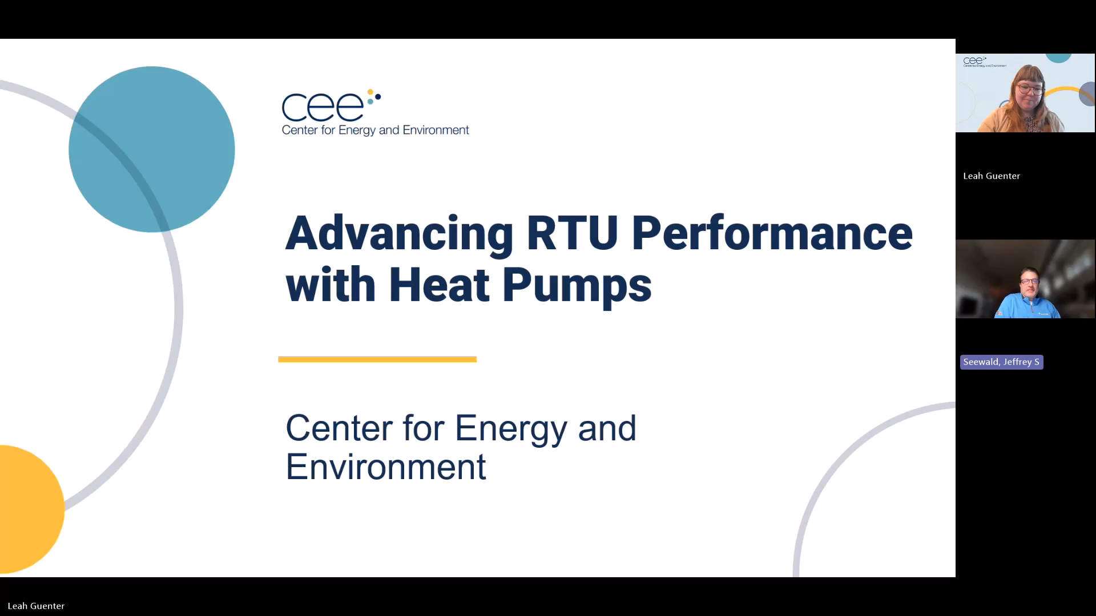
Field Study
CEE Field Study with Leah Guenter
©2025 Daikin Applied

Slide 50
Field Study
Dual Fuel RTU Heat Pumps
Sunnyside, NY
Two rooftop unit heat pumps
    R-32 refrigerant
    Supplemental gas heat
Heating season efficiency
  Overall: COP > 2.5
  Heat Pump: COP > 3.0
Supplemental heat
  < 1% of operating hours
Savings
  Energy: ~70%
  Emissions: ~45%
©2025 Daikin Applied
Source: Center for Energy and Environment

Slide 51
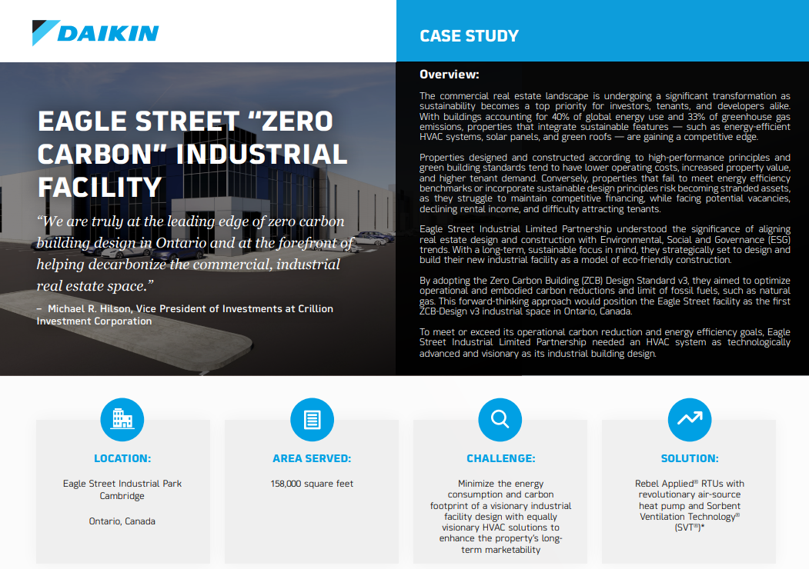

Inspiring Projects
Eagle Street Industrial Facility
Toronto
New construction
Industrial/logistical warehouse
CaGBC Zero Carbon Building Design Standard V3
Rooftop unit heat pumps with
    R-32 refrigerant
    Optimized ventilation
    Supplemental gas heat
©2025 Daikin Applied

Slide 52


Where Can I Go for Information?
Selected Resources
https://www.ashrae.org/about/cebd-center-of-excellence-for-building-decarbonization
https://www.ashrae.org/about/cebd-building-decarb-101
US Department of Energy: Decarbonizing the U.S. Economy by 2050: A National Blueprint for the Buildings Sector
Decarbonization Guides
  Decarbonizing Building Thermal Systems: A How-To Guide for Applying Heat Pumps and Beyond
Pathways to Commercial Liftoff: Geothermal Heating and Cooling
©2025 Daikin Applied

Slide 53

Where Can I Go for Information?
Selected Resources
Dedicated web site
On demand webinars:
  The Path to Decarbonization for Applied HVAC Systems
  Decarbonization in HVAC
    Part 1: Update & Review
    Part 2: Thermal Systems Guidance
    Part 3: RTU Heat Pumps
  Refrigerants
    Preparing Buildings for A2L Refrigerants
https://www.daikinapplied.com/decarbonization
©2025 Daikin Applied

Slide 54

Where Can I Go for Information?
Podcast - HVACOLOGY Talks to Daikin about R32: The Future of Refrigerants
The refrigerants powering our air conditioning systems are undergoing a major transition, and understanding this shift is crucial for anyone involved in the HVAC industry. In this episode, we explore the fascinating world of R32 refrigerant with Daikin Applied experts Sharon Haeg and Rob Landes, who break down complex concepts into practical knowledge you can use.
https://hvacology.buzzsprout.com/2361012/episodes/17268376-hvacology-talks-to-daikin-about-r32-the-future-of-refrigerants
©2025 Daikin Applied

Slide 55

Questions & Key Takeaways
Key Takeaways
RTU air-source heat pumps present a viable electrification option
With supplemental heat
Specify RTU heat pumps
With AHRI certification
With operating map data
RTU heat pumps present some unique challenges, but solutions include:
Optimized compressor operation
Supplemental heat
Electric heat kW limiting
Multiple electrical connections / dedicated electric heat circuit
Preheat with DOAS
©2025 Daikin Applied
Notes:
Call to Action
Sales rep – work with your customers
Engineers and owners -

Slide 56

Questions & Survey
We Value Your Feedback!
We welcome your feedback on this webinar and the series:
  Please complete the survey – link in the chat, or use the QR code below
  Provide additional comments in the chat
©2025 Daikin Applied

Slide 57
Thank you for your time and attention
For more information, contact:
Jeff Seewald
jeffrey.seewald@daikinapplied.com
©2025 Daikin Applied

