Slide 1
Preparing Buildings for A2L Refrigerants
Presented by:
DISCLAIMER: This presentation is intended only for educational purposes and does not replace independent professional judgment and/or legal advice.
This presentation is copyrighted and cannot be used without the express permission of Daikin Applied Americas Inc.

Slide 2
Disclaimer
The content in these materials is copyrighted by Daikin Applied Americas Inc. (Daikin Applied) and cannot be used without the express written permission of Daikin Applied. This training, along with the related materials, is for educational purposes and is only for the persons attending the training. It is not intended to provide legal or technical advice and does not replace independent professional judgment. While all information in the training materials is provided in good faith, Daikin Applied makes no representation or warranty of any kind, express or implied, regarding the accuracy, adequacy, validity, reliability, availability, or completeness of any information in the training materials. Under no circumstance shall Daikin Applied have any liability to you or any other party for any loss or damage of any kind incurred as a result of the use of the training materials or reliance on any information provided in the training materials. Your use of the training materials and your reliance on any information in the training materials is solely at your own risk. The ultimate responsibility is on the engineer of record to ensure the design complies with all applicable codes and regulations.
Always consult your state & local codes, which may take precedence over standards like ASHRAE Standards 15, 34, or other standards which vary in adoption, complete or partial, by state. Also note that a state may adopt a different year of the standard than the latest version.
The local Authority Having Jurisdiction (AHJ) has the final authority in interpreting code requirements. When in doubt, contact the AHJ.

Slide 3
Agenda
Address common questions:
How do refrigerants align with the goal of decarbonization
Regulations and standards driving changes for applied equipment
Can I use A2L refrigerants in applied products in my jurisdiction?
Are A2Ls safe?
R-410A alternatives and common misconceptions
What do I need to do to prepare?
    Design requirements
    Refrigerant detection / control signals
    Ventilation
    Refrigerant piping

Slide 4
Why Are Refrigerants Important for Decarbonization?

Slide 5
Decarbonization in HVAC
Electrification
Refrigerants
Efficiency Gains
Decarbonization

Slide 6
Decarbonization in HVAC
Electrification
Refrigerants
Efficiency Gains
Decarbonization
Electrification
  Convert fossil fuel equipment/processes to electric
  Most benefit with highly-renewable power grid

Slide 7
Decarbonization in HVAC
Electrification
Refrigerants
Efficiency Gains
Decarbonization
Refrigerants
  Direct effect: greenhouse effect of the gas
  Indirect effect: change in efficiency changes power usage over equipment lifecycle

Slide 8
Decarbonization in HVAC
Electrification
Refrigerants
Efficiency Gains
Decarbonization
Efficiency Improvements
  Greatest impact with grids using higher percentage of fossil fuels
  Reduced (but not zero) impact as grid converts to renewable
  (e.g. embedded carbon in power gen equipment)

Slide 9
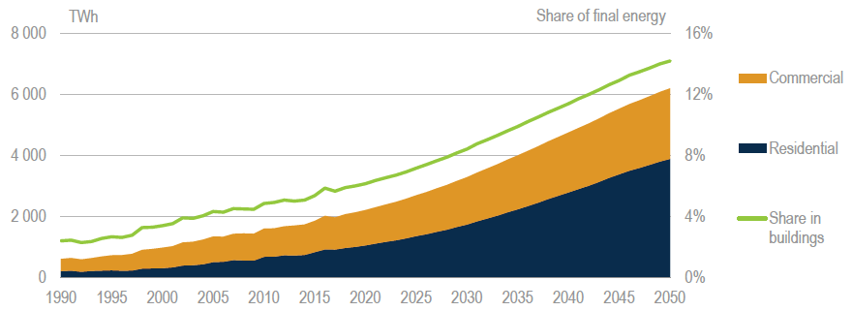
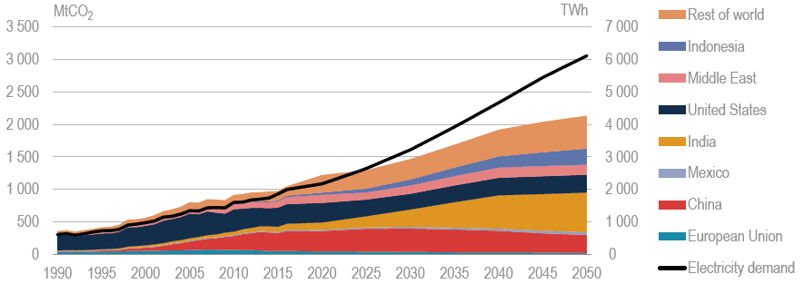
Growth of AC Through 2050: Impact to Energy Use and CO2 Emissions
AC Energy Consumption Triples
Total Electric Consumption Sextuples
CO₂ Emissions
Double
1.6B 5.6B
People using AC
Source: IEA “The Future of Cooling”

Slide 10
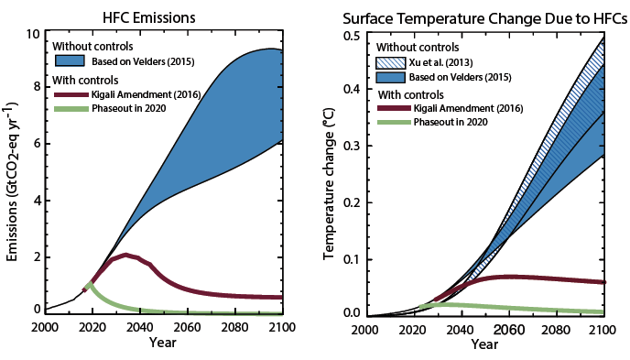
Kigali Amendment to Montreal Protocol
Scientific Assessment of Ozone Depletion: 2018, Executive Summary

Slide 11
GWP is Not the Full Measure of Emissions
Direct Effect from Refrigerant
Indirect Effect from Energy Use
Life Cycle Climate Performance
(LCCP)
  Majority of climate impact from HVAC is electrical power generation over equipment lifetime
  A lower GWP refrigerant with lower efficiency could actually create more global warming!
Source: Zhang M., et al. 2011. “Life Cycle Climate Performance Model for Residential Heat Pump Systems.” AHRTI Report 09003-01

Slide 12
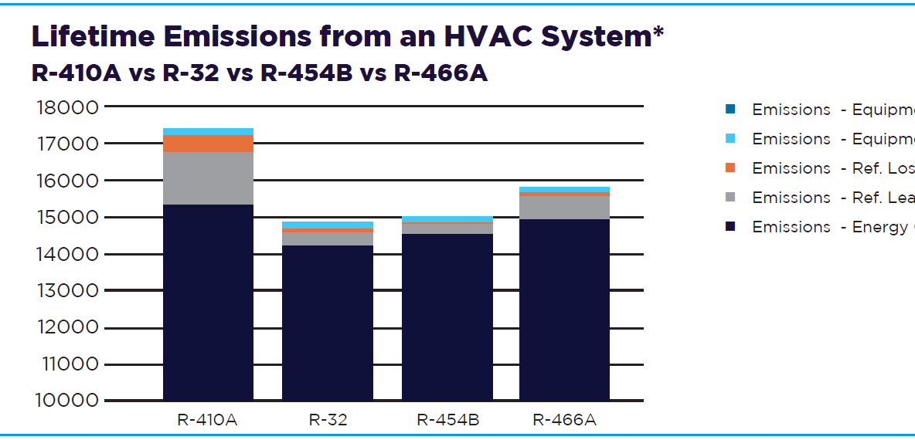
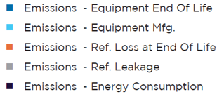
Lifetime Emissions
*Comparison is made using the Life Cycle Climate Performance (LCCP) metric, measured in kg-CO2.eq. LCCP analysis was performed using a high efficiency HP (24+ SEER), using performance gains claimed by respective refrigerant manufacturer, for a residential sized (9000 Btu/h cooling capacity), installed in Houston, TX climate zone, with an assumed annual leakage rate of 4% and end of life refrigerant leakage of 15% with a 15 year lifetime. The heating COP and SEER were adjusted based on refrigerant characteristics and performance. The physical system size, trim charge requirements and capacity were kept consistent to ensure a like-to-like comparison.

Slide 13
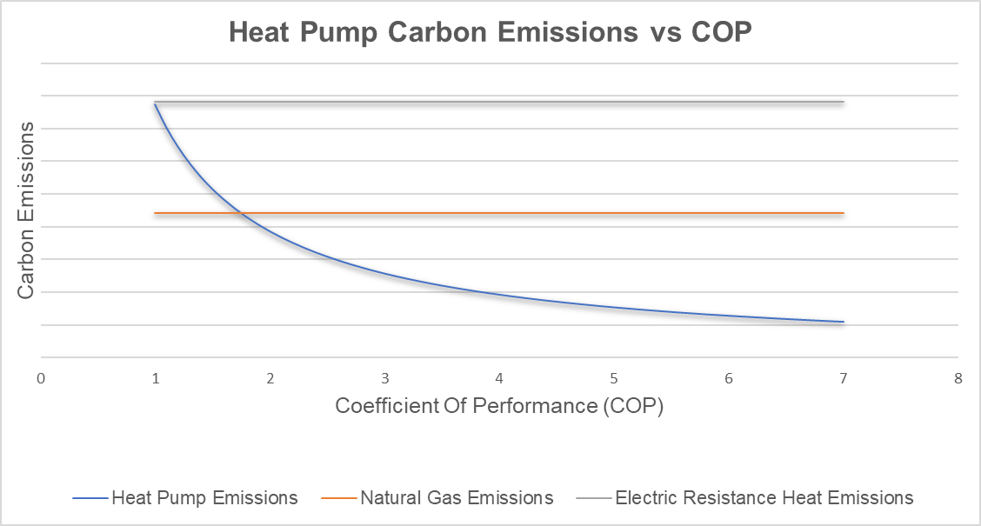
HP Emissions vs Gas – National Average
Assumptions
Natural Gas Efficiency: | 85%
Electric Resistance Efficiency: | 99%
Grid Emissions Factor: (gram/kWh) | 387
Natural Gas Emissions (lbs/therm) | 12.1
Elect. Heat
Nat. Gas
Emissions Changeover
HP
Increasing Refrigerant Efficiency
Note: This is highly dependent on electric grid emissions factors – Based on US EPA eGRID data

Slide 14
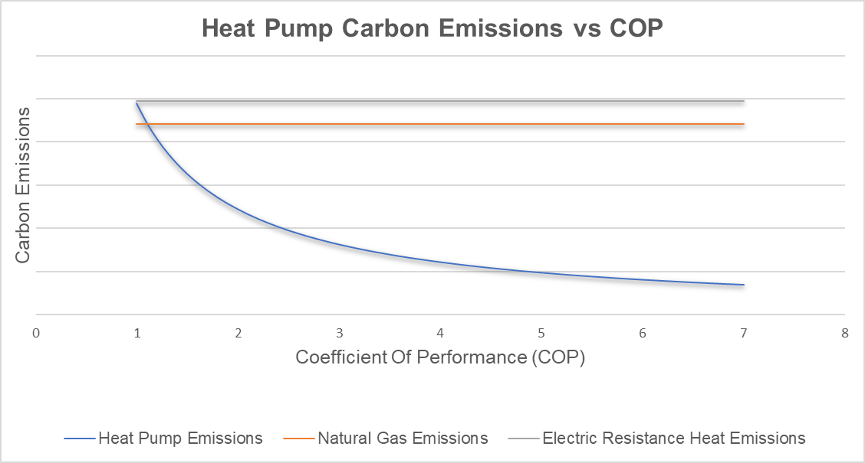
HP Emissions vs Gas – Massachusetts
Assumptions
Natural Gas Efficiency: | 85%
Electric Resistance Efficiency: | 99%
Grid Emissions Factor: (gram/kWh) | 245
Natural Gas Emissions (lbs/therm) | 12.1
Elect. Heat
Nat. Gas
Emissions Changeover
HP
Increasing Refrigerant Efficiency
Note: This is highly dependent on electric grid emissions factors – Based on US EPA eGRID data

Slide 15
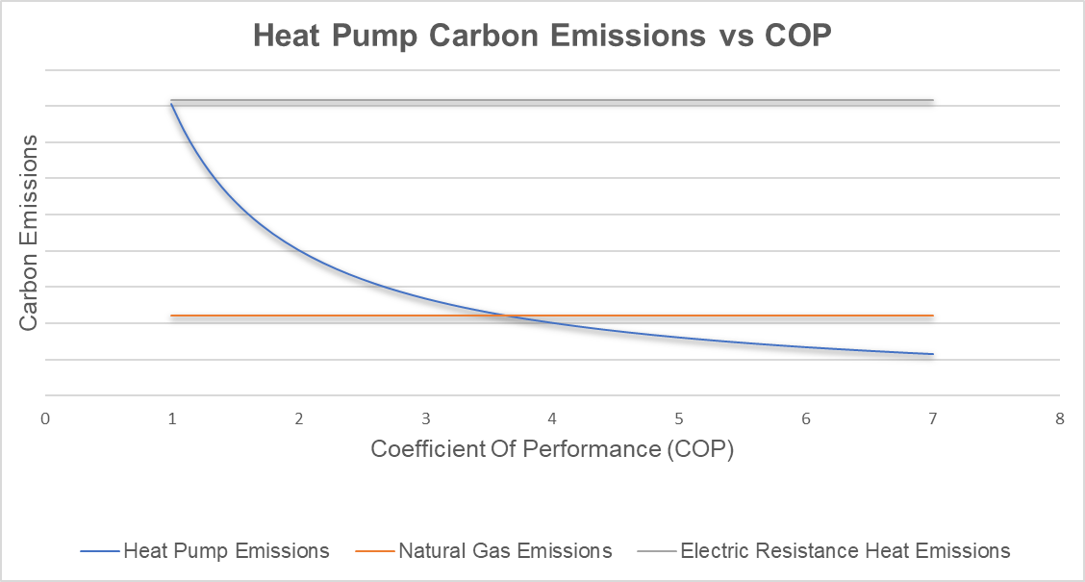
HP Emissions vs Gas – Kentucky
Assumptions
Natural Gas Efficiency: | 85%
Electric Resistance Efficiency: | 99%
Grid Emissions Factor: (gram/kWh) | 807
Natural Gas Emissions (lbs/therm) | 12.1
Elect. Heat
Emissions Changeover
Nat. Gas
HP
Increasing Refrigerant Efficiency
Note: This is highly dependent on electric grid emissions factors – Based on US EPA eGRID data

Slide 16
How Will The Aim Act Affect Applied HVAC Systems?

Slide 17


AIM Act: Law Passed Dec. 2020 | EPA Rulemaking Status
PHASEDOWN
via CO2eq Allocations of Bulk HFCs
(Supply Side constraints)
TECHNOLOGY TRANSITIONS
Sector based controls
SNAP restrictions
REFRIGERANT MANAGEMENT
Minimizing leaks
Maximizing recovery & reclamation
The AIM Act gives authority to the EPA to phase down HFC refrigerants in the US
Old news: EPA must write rules to phase down production and consumption of bulk HFCs to 15% of baseline, maximize reclamation, minimize releases from equipment and facilitate transition through sector-based restrictions

Slide 18
AIM Act: EPA Phasedown and Allocations
Phasedown Schedule
Production & Import of Bulk HFCs
All sectors
CO2eq = GWP x mass
CO2eq Phasedown
Baseline over 300 million metric tonnes CO2 equivalency
Phases down creating supply shortage of HFCs
Not refrigerant specific – not a phaseout
All bulk virgin HFCs in all sectors
Produced in USA and imported
Existing equipment may be serviced
Installed base can be serviced
Will need to transition to lower GWP refrigerants
2024
2029
2034
2036

Slide 19

AIM Act: EPA Technology Transition
Products - Factory-Charged Equipment
Chillers, RTUs, WSHP, PTAC
3-year sell-through period
*Installation deadline means charging the refrigeration circuit to full charge
Air conditioning equipment, including AC & HP, Chillers (comfort cooling), and ice rinks
Data Centers
1/1/2030
MFG and Import Deadline
Sell-through Deadline
MFG and Import Deadline
Sell-through Deadline
1/1/2028
1/1/2027
1/1/2026
Select states require chillers with GWP limit of 750
Systems - Field-charged equipment:
Split systems, knock-down units
Installation deadline instead of sell-through
Residential / Light Commercial Split system HPs and AC
VRF
MFG and Import Deadline
*Installation Deadline
MFG and Import Deadline
*Installation Deadline (proposed)
1/1/2025
1/1/2024

Slide 20
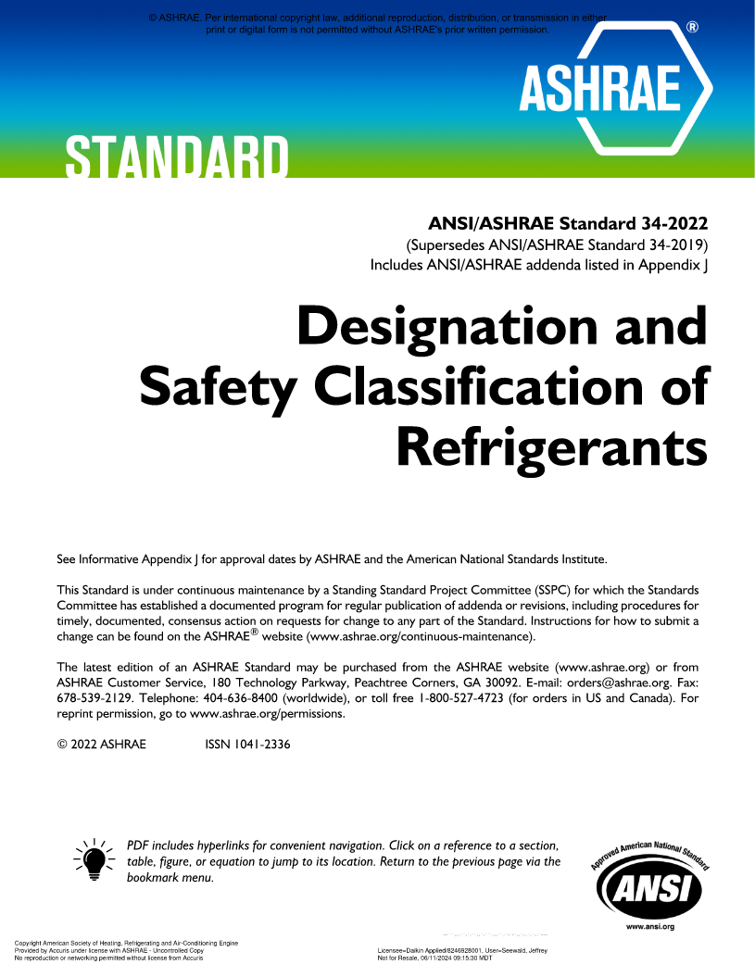
ASHRAE Standard 34-2022
Designation and Safety Classification of Refrigerants
ASHRAE Standard 34
Naming of refrigerants
Safety classifications
Refrigerant concentration limits

Slide 21
ASHRAE Standard 34 – Safety Groups
Flammability
Toxicity
Safety
Group
Flammability
Class 3 Higher flammability | A3 | B3
Class 2 Flammable | A2 | B2
Class 2L Lower flammability | A2L | B2L
Class 1 No flame propagation | A1 | B1
 | Lower Toxicity | Higher Toxicity
Toxicity

Slide 22
ASHRAE Standard 34 Basics: RCL
Refrigerant Concentration Limit
Maximum allowable concentration of refrigerant based on worst case of:
RCL
Flammability
Toxicity
Asphyxiation

Slide 23
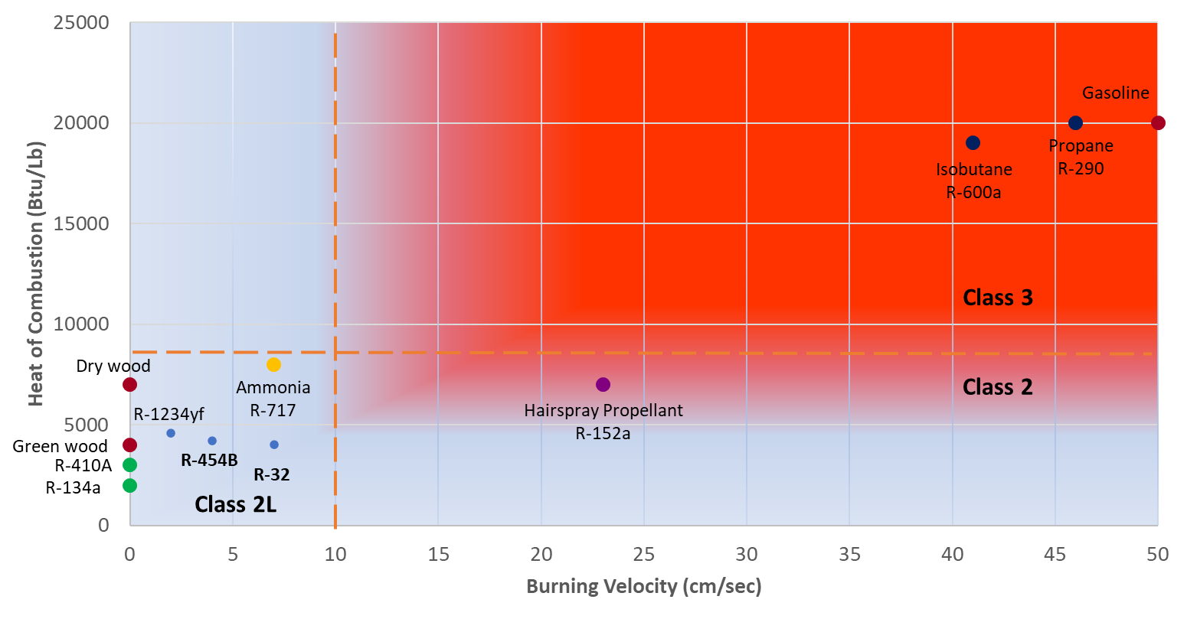
A2L Refrigerants – How Flammable Are They?
A2Ls have ‘lower flammability’
Relatively lower burning velocity & heat generation
Burning Velocity (S_{u})
    How fast does a flame propagate (<0.1 m/s)
Heat of combustion (HOC)
    How much energy is released by burning (< 1900 kJ/kg)
Lower Flammability Limit (LFL)
    What is the concentration required to burn (> 0.1 kg/m³)
Lower = Better

Slide 24
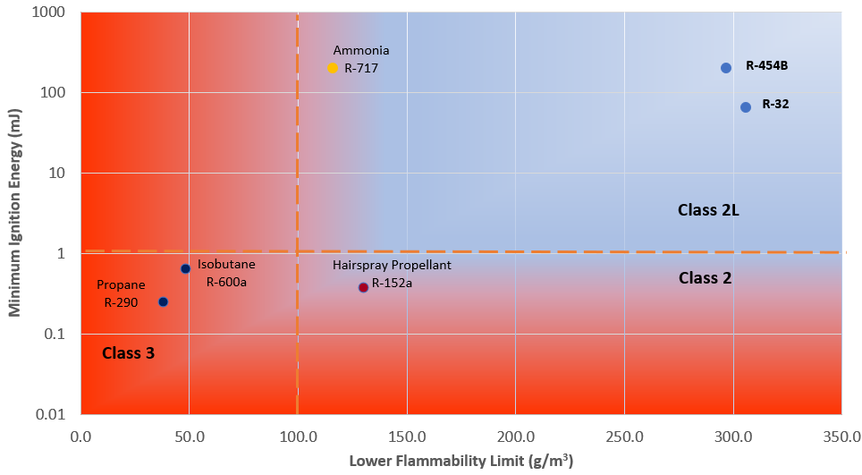
A2L Refrigerants – How Flammable Are They?
A2Ls have ‘lower flammability’
More difficult to ignite / higher concentration required
Burning Velocity (S_{u})
    How fast does a flame propagate (<0.1 m/s)
Heat of combustion (HOC)
    How much energy is released by burning (< 1900 kJ/kg)
Lower Flammability Limit (LFL)
    What is the concentration required to burn (> 0.1 kg/m³)
Higher = Better

Slide 25
‘New’ and Legacy Refrigerant Properties
Refrigerant | ASHRAE 34 Classification | GWP100 (AR4) | RCL (g/m³) | Composition | Efficiency | Capacity
R-410A Substitutes
R-410A | A1 | 2088 | 420 | 50% R32 / 50% R125
R-32 | A2L | 675 | 77
R-454B | A2L | 466 | * 74 | 68.9% R32 / 31.1% R1234yf
R-134a Substitutes
R-134a | A1 | 1430 | 210
R-513A | A1 | **630 | 320 | 44% R134a / 56% R1234yf
R-515B | A1 | **292 | 290 | 91.1% R1234ze(E) / 8.9% R227ea
R-1234ze(E) | A2L | 1 | 76
R-123 Substitutes
R-123 | B1 | 77 | 57
R-1233zd(E) | A1 | **2 | 85
R-514A | B1 | **2 | 14 | 74.7% R1336mzz(Z) / 25.3% R1130(E)
*ASHRAE 34 previously listed an RCL of 49 but that value was later updated in Addendum “a” of Standard 34-2022.
**Refrigerant was not included in AR4, AR5 values are utilized in lieu of AR4.

Slide 26
Can I use A2Ls in My State

Slide 27
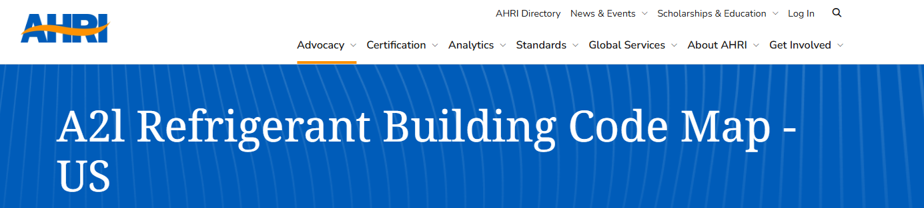
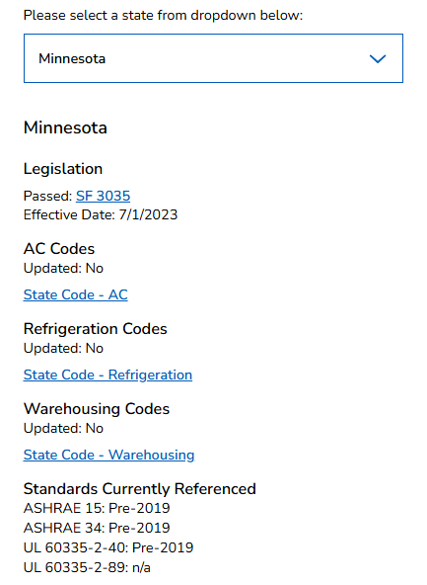
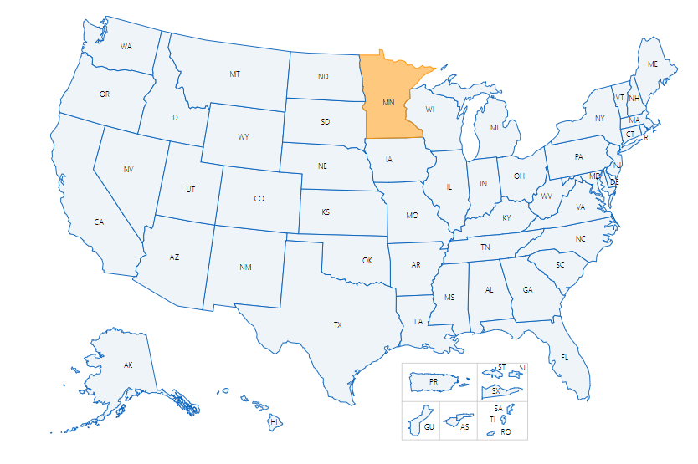
Group A2L Refrigerants Can Be Used Today
AHRI A2L Adoption Map
See how your state has adopted A2Ls
Find applicable codes & legislative language
Requirements differ by edition and local code. When in doubt, contact the Authority Having Jurisdiction (AHJ)
Chillers located in machinery rooms and outdoors are not in occupied spaces, and A2L refrigerants have been permitted in jurisdictions where 2018 or later model code editions are used.
Source: https://www.ahrinet.org/a2l-refrigerant-building-code-map-us?state=MN#map

Slide 28
What Refrigerant To Use When

Slide 29
Common HVAC Refrigerants
Compressor
Previous Refrigerant
Low GWP Alternative
R410A
Pressure
R32
R454B
Higher Pressure
Scroll
GWP = 2088
GWP = 675
GWP = 466
Medium Pressure
Screw or
Centrifugal
R134a
R513A
R1234ze
GWP = 1430
GWP = 631
GWP ~ 1
R123
R514A
R1233zd
Low Pressure
Centrifugal
GWP = 77 (but has ODP)
GWP ~ 2
GWP ~ 1

Slide 30
What Will Replace R-410A?

Slide 31


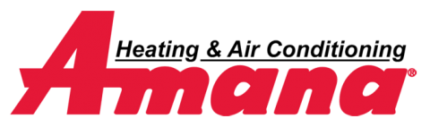



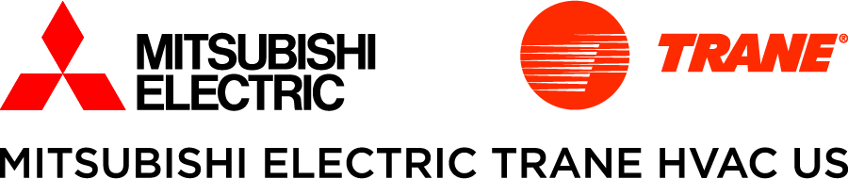


What Is Replacing R-410A?
Examples of announced products using R-32
Examples of announced products using R-454B
All products previously using R-410A
Residential, light commercial and commercial ducted HVAC applications
Ducted and ductless residential and light commercial applications
Air-cooled scroll chillers
Mini-split products
Most products
except ‘Hylex
All split-system products
Residential HPs and AC; commercial rooftop units and ducted split systems
Light commercial and residential heating and AC products

Slide 32
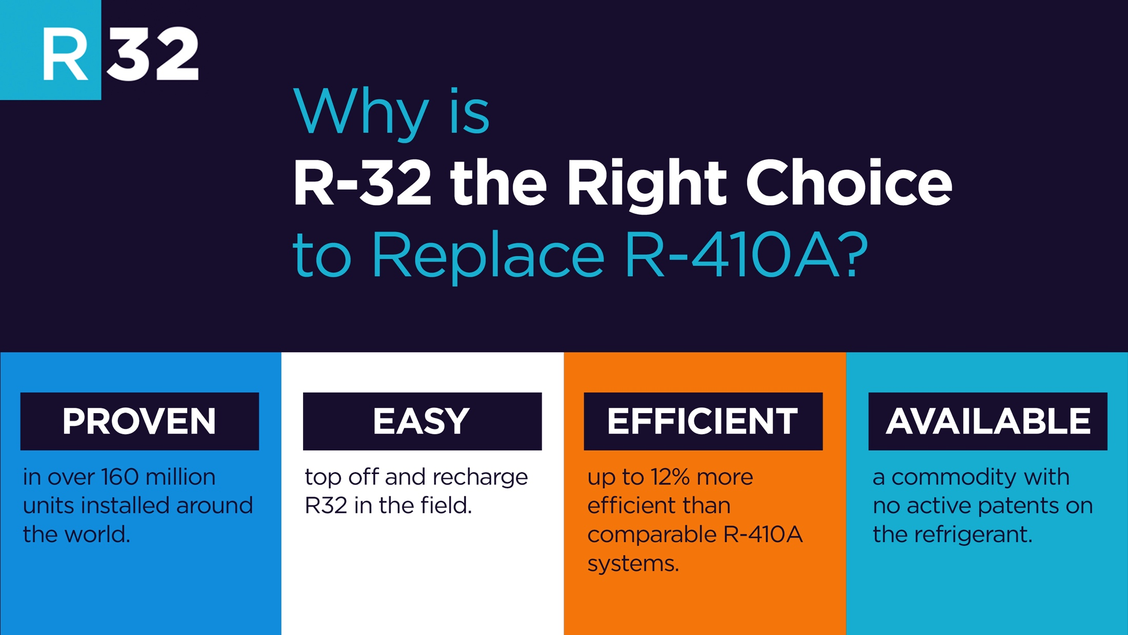
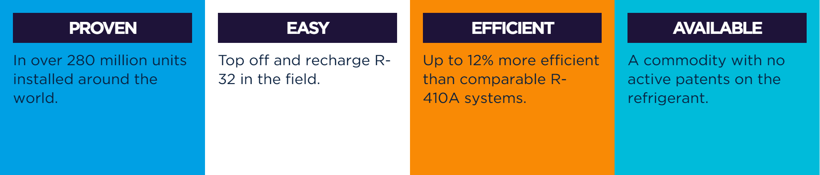
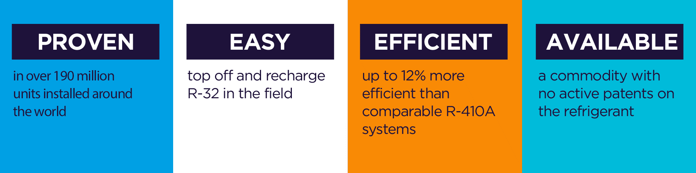
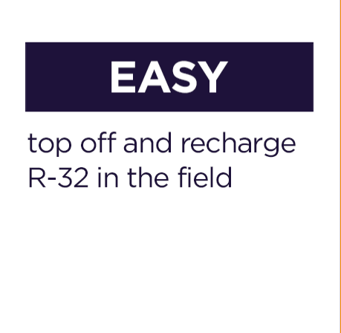

Slide 33
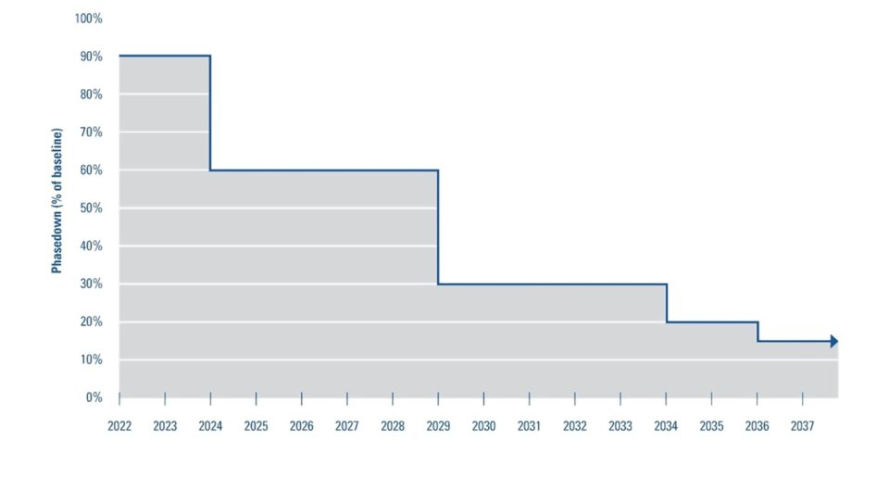
R-32: Common Misconceptions – ‘Is it as simple as GWP?’
Does the higher GWP of R-32 relative to R-454B mean R-32 is worse for the environment or will be phased down sooner?
-R-32’s GWP is higher than R-454B’s GWP but…
  -Charge/ton is typically lower for R-32
  -R-32 efficiency is superior
  -Produced Mass * GWP is what matters
  -Less mass of R-32 per ton of cooling is needed
Phasedown Schedule
Production & Import of Bulk HFCs
All sectors
CO2eq = GWP x mass
Refrigerant | Safety Class | GWP100 (AR4) | Refrigerant charge level (R-410A baseline) | 'Adjusted' GWP vs R-410A
R-410A | A1 | 2088 | 1 | 2088
R-32 | A2L | 675 | ~0.65 | ~435
R-454B | A2L | 466 | ~0.9 | ~419
Source: US EPA

Slide 34
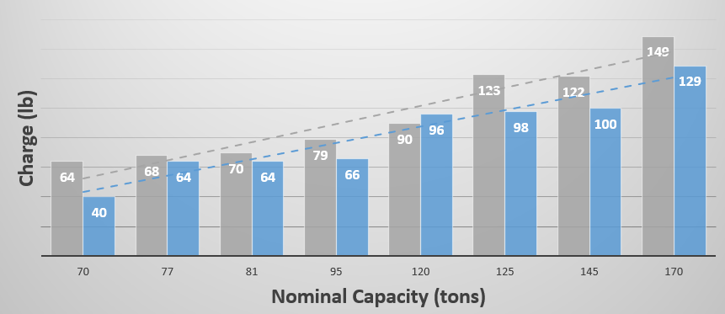
Efficiency and Refrigerant Charge
R-32 air-cooled scroll chiller vs. comparable R-454B scroll chiller
Actual side-by-side comparisons will vary due to non-refrigerant design factors
Tradeoff between efficiency and charge – maximizing efficiency would limit charge savings and vice-versa
R-32 Charge
19% Less
19% lower avg. charge
R-32 Efficiency
5% higher
R-32
R-454B

Slide 35
R-32: Common Misconceptions - Intellectual Property & Patents
R-32
R-454B
No active patents on the chemical itself – used in R-410A
Technology patents have been released to allow easier adoption
Proprietary and patented
2011
Patent owner offered free access to 93 patents for emerging countries
2019
Additional non-assertion pledge to patents filed since 2011
2022
Added 120 new patents, bringing the total to 419 to be used free of charge
R-32 TECHNOLOGY PATENT TIMELINE
2015
Expanded free access worldwide
2021
Released 123 further patents
The underlying concern is really cost, not patents, right…?

Slide 36
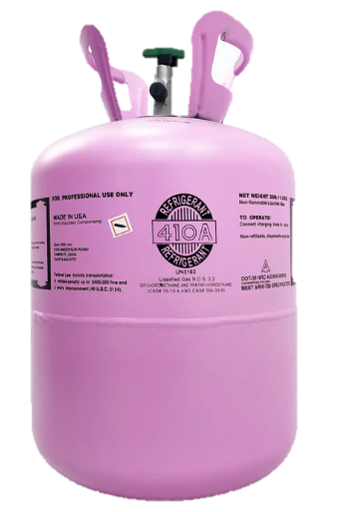
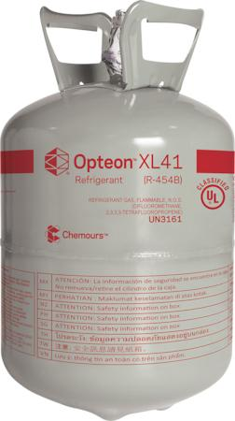
R-32: Common Misconceptions - Cost
Is R-32 more expensive than R-454B?
R-410A
R-32
R-454B
R-410A 25lb Cylinder
R-32 20lb Cylinder
R-454B 20lb Cylinder
$5.67 / lb
$11.12 / lb
$15.70 / lb
* Price source: Daikin Parts (January 2025)
**Online retailer eRefrigerants lists R-32 for $369/20lbs and R-454B for $499 per 20lb cylinder

Slide 37
Flammability
Higher number is better
Is R-32 more flammable than R-454B?
Both R-32 and R-454B are A2Ls, with similar flammability profiles
Safety & flammability limits (RCL & LFL) within about 3-4%
Both difficult to ignite, low flame velocity
Refrigerant | ASHRAE 34 Classification | RCL* (g/m3) | LFL* (g/m3)
R32 | A2L | 77 | 306
R454B | A2L | 74 | 297
Flammability Continuum
LFL: N/A
LFL: 297
LFL: 38
Water
R-454B
Propane
A1
A2L
A2
A3
LFL
R-410A
R-32
LFL: N/A
LFL: 306
*Based on updated RCL and LFL values of ASHRAE 34 -2022 Addendum a

Slide 38
What Standards Guide The Application of A2L Refrigerants

Slide 39
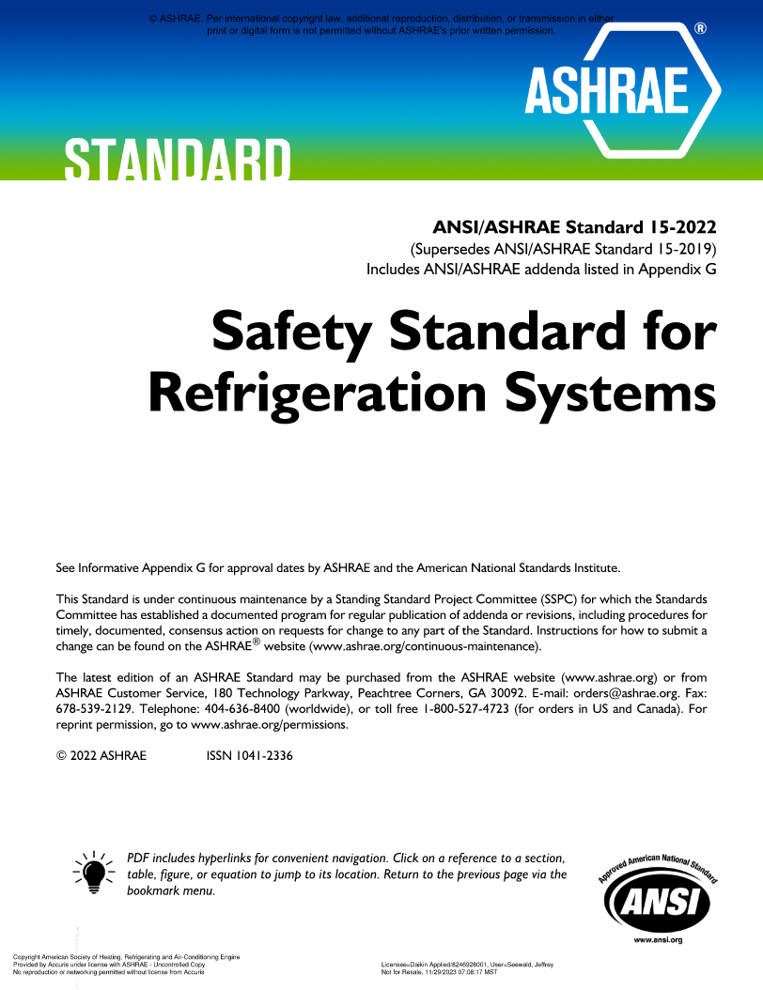
ASHRAE Standard 15-2022
Safety Standard for Refrigeration Systems
ASHRAE Standard 15 specifies requirements for the safe design, construction, installation, and operation of refrigeration systems.
Changes to refrigerant use restrictions, especially for A2Ls
Refrigerant overpressure protection and piping
Volume and refrigerant charge limit calculations
Refrigerant detector/detection and mitigation actions
Machinery room requirements
ASHRAE web site has errata sheet corrections and interpretations. Download them.

Slide 40
ASHRAE Standard 15
Refrigerant limit
Integral refrigerant detection system
Mitigation
Ventilation
Circulate air
Open zone dampers
Deenergize heat and ignition sources
Activate shutoff valves
Ventilate
Exhaust leaked refrigerant
Volume
EDVC
Refrigerant detection
“Listed” equipment
UL 60335-2-40 / CSA C22.2 No. 60335‑2‑40
UL 484
Ignition
No ignition sources in ductwork
Requirements
A
Occupancy
1
When a leak is detected
2
B
3
Refrigeration System
4
5
C
Safety
Group
6

Slide 41
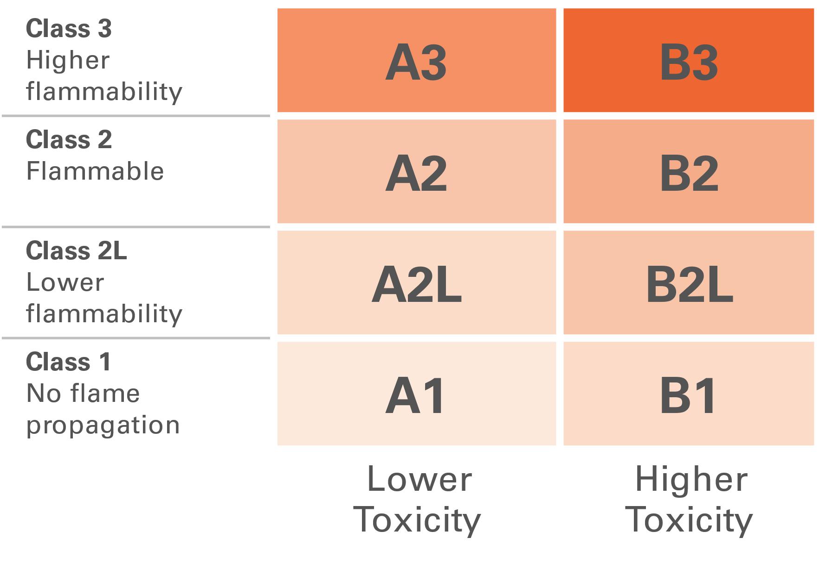
ASHRAE Standard 15
A
B
C
Occupancy Classification
Refrigeration System Classification
Safety Group
ASHRAE Standard 15, Section 4
Different occupancy types may require different actions
ASHRAE Standard 15, Section 5
ASHRAE Standard 15, Section 6
Per ASHRAE Standard 34
Classification
Institutional
Public assembly
Residential
Commercial
Large mercantile
Industrial
Mixed
Classification
High Probability
Low Probability

Slide 42
ASHRAE Standard 15
B
Refrigeration System Classification
Classification | Definition | Examples
High Probability | Any system where leakage of refrigerant has high probability to enter the occupied space. | Direct Systems Direct expansion (DX) split system Packaged RTU Water source heat pump VRF PTAC
Low Probability | Any system where leakage of refrigerant cannot enter the occupied space. | Indirect closed systems Water-cooled chiller in machinery room Air-cooled chiller outdoors Water-to-water heat pump in machinery room

Slide 43
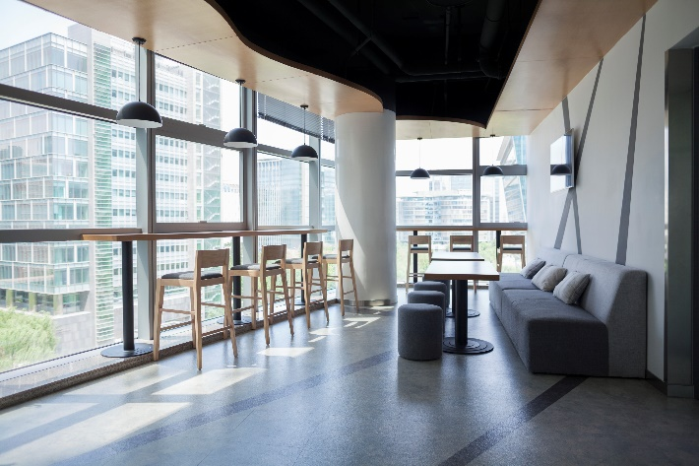

How Will ASHRAE 15-2022 Requirements Impact You?
Lobbies
  System Design
  Unit refrigerant charge must be checked against the volume of the spaces it serves
    Differs by occupancy type and refrigerant safety group
    Both occupied and non-occupied spaces for A2Ls
    Spaces with refrigerant piping must be included (some exceptions apply)
  Restrictions on type of system or refrigerant used in certain areas
    E.g. lobbies, public corridors
  Refrigerant piping that passes through spaces may require special testing and/or construction
Institutional Occupancies

Slide 44
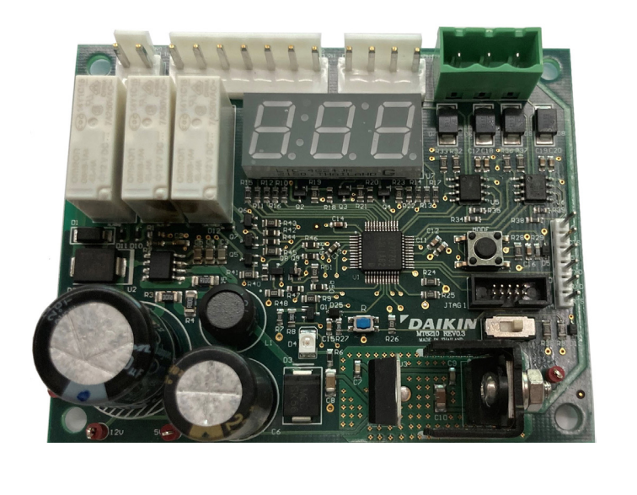
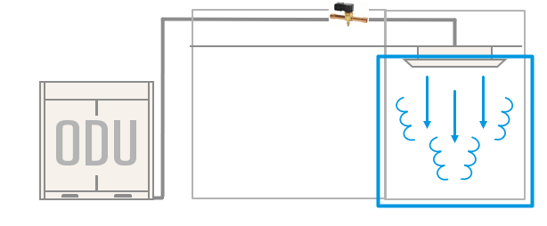
How Will ASHRAE 15-2022 Requirements Impact You?
Refrigerant Detection System
Installation / Controls Integration:
Units may require a ‘Refrigerant Detection System’ (RDS) or ‘Release Mitigation Controls’
  Hardware is required to complete certain functions and output specific signals
  Installers may need to connect these signals to other parts of the HVAC system
    e.g. dampers, ventilation fans, electrical interlocks, release mitigation controls, etc
  Release Mitigation Controls:
    Connected to RDS
    Limits amount of refrigerant that can leak
    Mostly used on smaller split systems, limited to indoor units of 5 Tons or smaller
Release Mitigation Controls

Slide 45

Refrigerant Limits: EDVC Calculation
1
20T HP RTU
Commercial Space
Floor Area = 6,000 sq ft
Ceiling Height = 10 ft

Slide 46



Refrigerant Limits: Example EDVC Calculation
1
Identify:
    Occupancy classification: Commercial, F_{occ} = 1.0
    Refrigeration system classification: High probability
Look up:
    Refrigerant LFL in ASHRAE Standard 34, Table 4-1 = 0.0191 lb/ft³
Determine the releasable refrigerant charge, m_{rel}
    m_{rel} = 31.2 lb
  Calculate EDVC per ASHRAE Standard 15, Section 7.6.1.1, where unit has air circulation initiated by refrigerant detection
20T HP RTU
Commercial Space
Floor Area = 6,000 sq ft
Ceiling Height = 10 ft
$$EDVC=Veff×LFL×CF×Focc$$
$$EDVC=60,000 ft3×0.0191lb/ft3×0.5×1.0$$
$$EDVC=573 lb$$

Slide 47

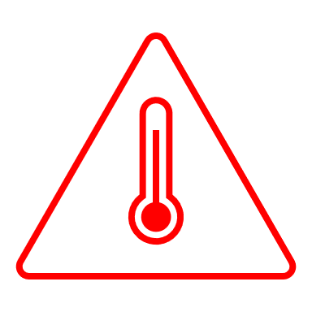
Ignition Sources for A2Ls
5
Ignition Sources in Ductwork
Open flame producing devices shall not be permanently installed in ductwork
Unclassified electrical devices shall not be located in ductwork
No devices with hot surfaces exceeding 1,290°F
    Unless air flow velocity exceeds 200 ft/min
    And, there is proof of air flow when the device is energized
Generally, the idea is to have heat sources in a listed unit, rather than separately in the ductwork

Slide 48
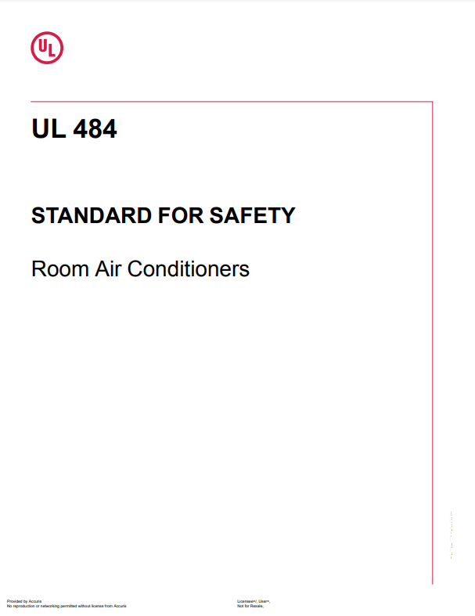
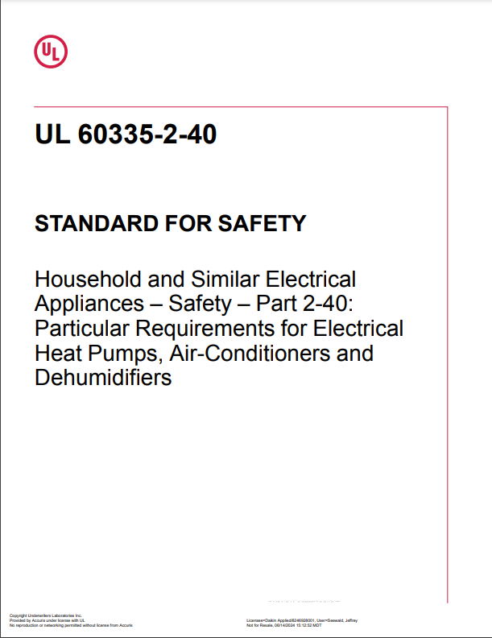
Listed Equipment
6
Product Safety Standard(s)
Refrigeration systems must be listed in accordance with UL 484 or UL 60335-2-40 / CSA C22.2 No. 60335-2-40 for HVAC equipment with A2L refrigerants
Requires certain information that OEMs must include in IOMs. For example:
    Spaces where refrigerant pipes are allowed
    Handling, installation, cleaning, servicing and disposal of refrigerant
  Always refer to the manufacturer’s IOM for specific installation requirements!

Slide 49
Refrigerant Piping
Spaces with refrigerant piping must be included in EDVC calculations except:
    areas that contain only continuous refrigerant piping, or
    contain only joints and connections that have been tested in accordance with Section 9.13
  Refrigerant piping requires special construction per Section 9.12. Some examples (there are more):
    Refrigerant piping that penetrates two or more floor/ceiling assemblies shall be enclosed in a fire-resistance-rated shaft enclosure.
    Refrigerant pipe shafts with systems using only Group A2L or B2L refrigerants shall be naturally or mechanically ventilated.
    Refrigerant pipe shafts with one or more systems using any Group A2, A3, B2, or B3 refrigerant shall be continuously mechanically ventilated and shall include a refrigerant detector.
    Continuous protection via shield plates for concealed piping may be required for non-A1 and non-B1 refrigerants per 9.12.2.1

Slide 50
Summary
Transition is Underway | Refrigerant Change Supports Decarbonization | ASHRAE 15 High Probability Systems
Our industry can safely commercialize low GWP refrigerants to reduce the impact of global warming Keep an eye on the latest EPA rules Order equipment in time to meet your project schedule! | It isn’t all about GWP Efficiency is arguably more critical, especially in the near term Your grid emissions factor has a big impact on the ‘indirect’ effect | New equipment may ship with refrigerant detection or SSOVs Contractors must interconnect these signals in the system Check charge and refrigerant piping considerations in your designs

Slide 51
Where Can I Learn More?

Slide 52


Where Can I Go for Information?
General Guidance:
https://www.daikinapplied.com/decarbonization/refrigerants
https://www.ahrinet.org/saferefrigerant
https://www.escogroup.org/training/lowgwprefrigerant.html
https://www.acca.org/education/a2l-refrigerants
https://www.rses.org/training/lowgwpa2l.aspx
https://www.r32reasons.com/
https://www.ashrae.org/technical-resources/bookstore/ashrae-refrigeration-resources
https://www.achrnews.com/articles/153195-understanding-a2l-refrigerants
https://www.esmagazine.com/articles/99996-a2l-refrigerants-safely-addressing-refrigerant-flammability-concerns

Slide 53
Where Can I Go for Information?
Building Codes:
https://www.iccsafe.org/products-and-services/i-codes/a2l-refrigerants-transition/
https://www.ahrinet.org/a2l-refrigerant-building-code-map?state=OH#map
https://www.ashrae.org/technical-resources/standards-and-guidelines/read-only-versions-of-ashrae-standards
https://www.iapmo.org/media/31999/2024-umc-code-changes-randy-young.pdf
https://www.iccsafe.org/products-and-services/i-codes/a2l-refrigerants-transition/
Presentations and Podcasts
https://www.ashrae.org/news/ashraejournal/ashrae-journal-podcast-episode-37
AHRI Webcast Series
    An Introduction to A2L Refrigerants
    A2L Refrigerants Webinar Series Part 2 - Updates to Standards and Model Codes
    A2L Refrigerants Webinar Series Part 3: State and Local Codes and Available Resources

Slide 54
Thank you for your time and attention
For more information, contact:

