Slide 1
Introducing the Future of Refrigerants
R-32 : The Global Replacement For R-410A
©2025 Daikin Applied
DISCLAIMER: This presentation is intended only for educational purposes and does not replace independent professional judgment and/or legal advice. This presentation is copyrighted and cannot be used without the express permission of Daikin Applied Americas Inc.

Slide 2
R-410A Replacements: R-32 and R-454B
Refrigerant | Composition | ASHRAE 34 Classification | RCL (g/m³) | GWP₁₀₀ (AR4) | Glide (K) | Efficiency | Capacity | Stability | Value | LCCP
R-410A | 50% R-32 / 50% R-125 | A1 | 420 | 2088 | < 0.5
R-32 | Pure 100% R-32 | A2L | 77 | 675 | 0
R-454B | 68.9% R-32 / 31.1% R-1234yf | A2L | 76 | 466 | 1.5
R-32 is the superior long-term choice:
All options contain R-32 in some percentage
Best in class for efficiency, ozone protection, environmental impact and value, and
Equal on safety to the other blend, R-454B
©2025 Daikin Applied

Slide 3
©2025 Daikin Applied

Slide 4
R-32 is a Proven Commodity Used Globally
PROVEN
Europe 2014
North America
2016
Japan 2012
Developing
Countries
India 2013
Thailand 2014
Australia 2014
R-32 has achieved a global installed base of over 280 million units in over 130 countries by more than 60 OEMs
©2025 Daikin Applied

Slide 5
Easy to Reuse, Reclaim, and Recycle
EASY
UNLIKE BLENDS, R-32 IS A PURE, SINGLE-COMPONENT REFRIGERANT, MAKING IT EASY TO REUSE, RECLAIM, AND RECYCLE
No glide; not a blend
Reuse and clean on site, without changing the composition
Reclaim and recycle offsite in a simple cleaning process
Blends such as R-454B do not share these benefits!
©2025 Daikin Applied

Slide 6
Easy to Service
EASY
UNLIKE BLENDS, R-32 IS A PURE, SINGLE-COMPONENT REFRIGERANT, MAKING IT EASY TO SERVICE
R-32 can be changed in both liquid and gas phase
Blends like R-454B, should be charged in liquid phase as composition can change otherwise
R-32 can be topped up and recharged easily without concerns about change in composition
All of this means easier and faster service on site
©2025 Daikin Applied

Slide 7
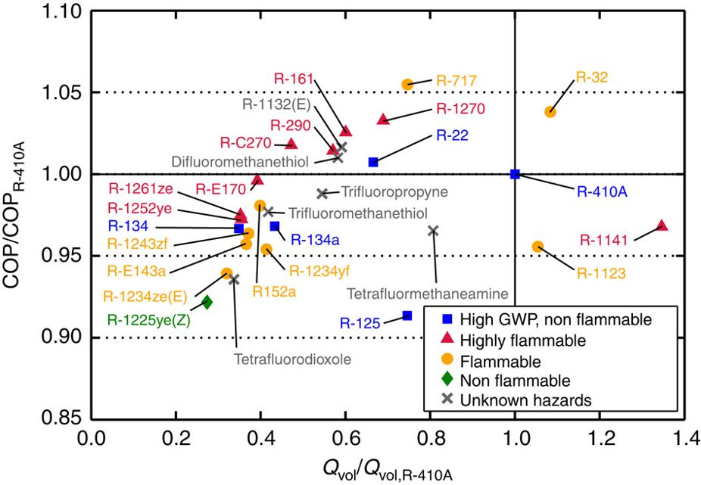
Excellent Efficiency and Capacity
EFFICIENT
R-32 has Excellent Efficiency and Capacity; Better than R-410A
R-454B
Figure shows COP comparisons based on simulation of a basic vapor compression cycle for an air-conditioner employing a typical forced-convection, air-to-refrigerant heat exchanger, maintaining the same heat flux in the evaporator for a fair comparison.
©2025 Daikin Applied

Slide 8
Flammability
Higher number is better
Is R-32 more flammable than R-454B?
Both R-32 and R-454B are A2Ls, with similar flammability profiles
Safety & flammability limits (RCL & LFL) within about 3-4%
Both difficult to ignite, low flame velocity
Refrigerant | ASHRAE 34 Classification | RCL* (g/m3) | LFL* (g/m3)
R-32 | A2L | 77 | 306
R-454B | A2L | 74 | 297
Flammability Continuum
LFL: N/A
LFL: 297
LFL: 38
Water
R-454B
Propane
A1
A2L
A2
A3
LFL
R-410A
R-32
LFL: N/A
LFL: 306
©2025 Daikin Applied
*Based on updated RCL and LFL values of ASHRAE 34 -2022 Addendum a

Slide 9
GWP is Not the Full Measure of Emissions
Direct Effect from Refrigerant
Indirect Effect from Energy Use
Life Cycle Climate Performance
(LCCP)
Majority of climate impact from HVAC is electrical power generation over equipment lifetime
A lower GWP refrigerant with lower efficiency could actually create more global warming!
Source: Zhang M., et al. 2011. “Life Cycle Climate Performance Model for Residential Heat Pump Systems.” AHRTI Report 09003-01
©2025 Daikin Applied

Slide 10
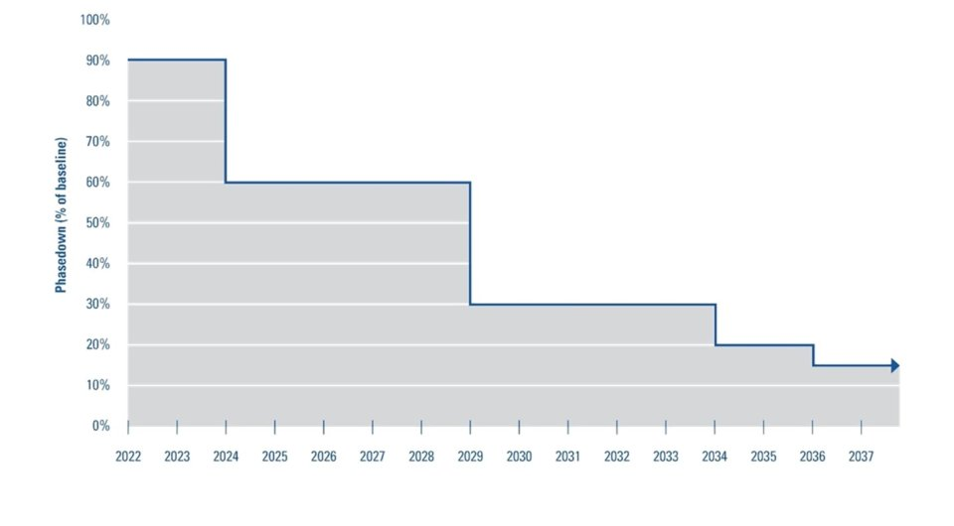
R-32: Common Misconceptions – ‘Is it as simple as GWP?’
Does the higher GWP of R-32 relative to R-454B mean R-32 is worse for the environment or will be phased down sooner?
-R-32’s GWP is higher than R-454B’s GWP but…
-Charge/ton is typically lower for R-32
-R-32 efficiency is superior
-Produced Mass * GWP is what matters
-Less mass of R-32 per ton of cooling is needed
Phasedown Schedule
Production & Import of Bulk HFCs
All sectors
CO2eq = GWP x mass
Refrigerant | Safety Class | GWP100 (AR4) | Refrigerant charge level (R-410A baseline) | 'Adjusted' GWP vs R-410A
R-410A | A1 | 2088 | 1 | 2088
R-32 | A2L | 675 | ~0.65 | ~435
R-454B | A2L | 466 | ~0.9 | ~419
Source: US EPA
©2025 Daikin Applied

Slide 11
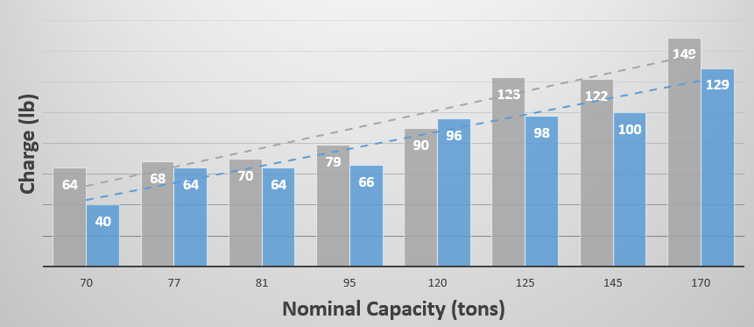
Efficiency and Refrigerant Charge
R-32 air-cooled scroll chiller vs. comparable R-454B scroll chiller
Actual side-by-side comparisons will vary due to non-refrigerant design factors
Tradeoff between efficiency and charge – maximizing efficiency would limit charge savings and vice-versa
R-32 Charge
19% Less
19% lower avg. charge
R-32 Efficiency
5% higher
R-32
R-454B
©2025 Daikin Applied

Slide 12
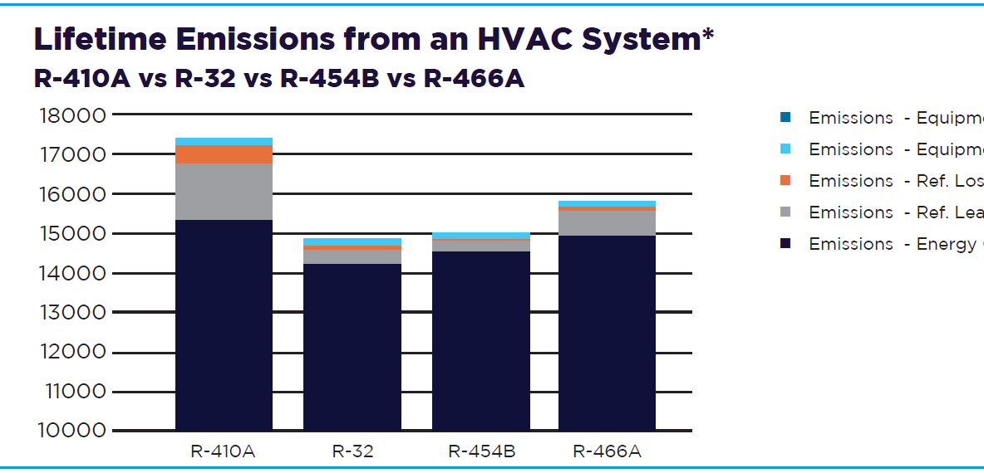
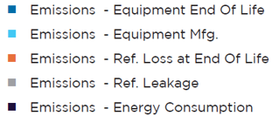
Lifetime Emissions
*Comparison is made using the Life Cycle Climate Performance (LCCP) metric, measured in kg-CO2.eq. LCCP analysis was performed using a high efficiency HP (24+ SEER), using performance gains claimed by respective refrigerant manufacturer, for a residential sized (9000 Btu/h cooling capacity), installed in Houston, TX climate zone, with an assumed annual leakage rate of 4% and end of life refrigerant leakage of 15% with a 15 year lifetime. The heating COP and SEER were adjusted based on refrigerant characteristics and performance. The physical system size, trim charge requirements and capacity were kept consistent to ensure a like-to-like comparison.
©2025 Daikin Applied

Slide 13
Intellectual Property & Patents
R-32
R-454B
No active patents on the chemical itself – used in R-410A
Technology patents have been released to allow easier adoption
Proprietary and patented
2011
Daikin offered free access to 93 patents for emerging countries
2019
Additional non-assertion pledge to patents filed since 2011
2022
Added 120 new patents, bringing the total to 419 to be used free of charge
R-32 TECHNOLOGY PATENT TIMELINE
2015
Expanded free access worldwide
2021
Released 123 further patents
The underlying concern is really cost, not patents, right…?
©2025 Daikin Applied

Slide 14
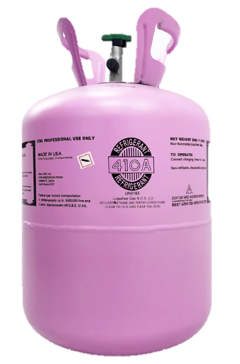
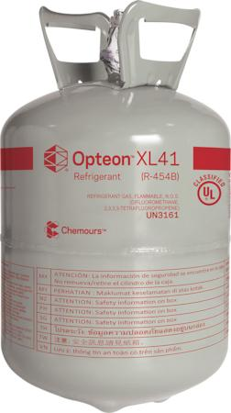
R-32: Common Misconceptions - Cost
Is R-32 more expensive than R-454B?
R-410A
R-32
R-454B
R-410A 25lb Cylinder
R-32 20lb Cylinder
R-454B 20lb Cylinder
$5.67 / lb
$11.12 / lb
$15.70 / lb
* Price source: Daikin Parts (January 2025)
**Online retailer eRefrigerants lists R-32 for $369/20lbs and R-454B for $499 per 20lb cylinder
©2025 Daikin Applied

Slide 15
R-32 Can Help Save Valuable Time, Money, and Effort
COST
Less expensive than many blends to install and maintain during servicing, saving technicians valuable time and effort on site
ACCESSIBILITY
R-32 is used globally and is the base of many blends, for several decades
©2025 Daikin Applied

Slide 16
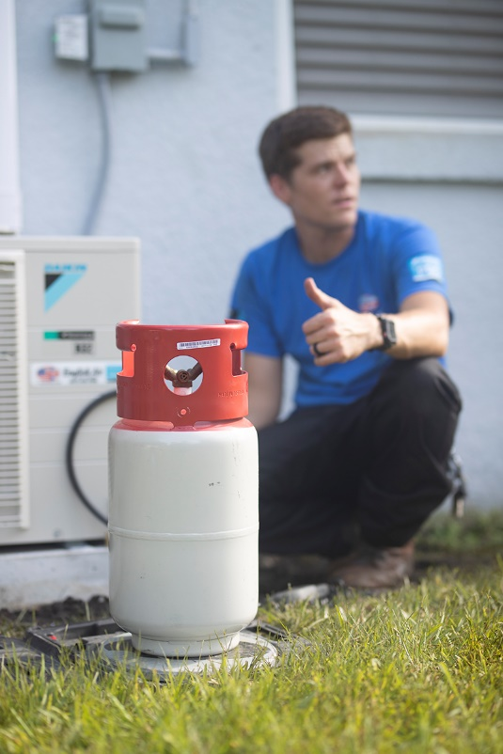
In Summary
R-32: An IDEAL Solution to Replace R-410A
Proven, easy, efficient, available, results in lower lifetime cost and emissions
©2025 Daikin Applied

Slide 17
Where Can I Go for Information?
General Guidance:
https://www.daikinapplied.com/training
https://www.ahrinet.org/saferefrigerant
https://www.escogroup.org/training/lowgwprefrigerant.html
https://www.acca.org/education/a2l-refrigerants
https://www.rses.org/training/lowgwpa2l.aspx
https://www.r32reasons.com/
https://www.ashrae.org/technical-resources/bookstore/ashrae-refrigeration-resources
https://www.achrnews.com/articles/153195-understanding-a2l-refrigerants
https://www.esmagazine.com/articles/99996-a2l-refrigerants-safely-addressing-refrigerant-flammability-concerns
©2025 Daikin Applied

Slide 18
Where Can I Go for Information?
Building Codes:
https://www.iccsafe.org/products-and-services/i-codes/a2l-refrigerants-transition/
https://www.ahrinet.org/a2l-refrigerant-building-code-map?state=OH#map
https://www.ashrae.org/technical-resources/standards-and-guidelines/read-only-versions-of-ashrae-standards
https://www.iapmo.org/media/31999/2024-umc-code-changes-randy-young.pdf
https://www.iccsafe.org/products-and-services/i-codes/a2l-refrigerants-transition/
Presentations and Podcasts
https://www.ashrae.org/news/ashraejournal/ashrae-journal-podcast-episode-37
AHRI Webcast Series
An Introduction to A2L Refrigerants
A2L Refrigerants Webinar Series Part 2 - Updates to Standards and Model Codes
A2L Refrigerants Webinar Series Part 3: State and Local Codes and Available Resources
©2025 Daikin Applied

Slide 19
Thank you for your time and attention
For more information, contact:
https://www.daikinapplied.com/decarbonization/refrigerants
©2025 Daikin Applied

